Slide 1
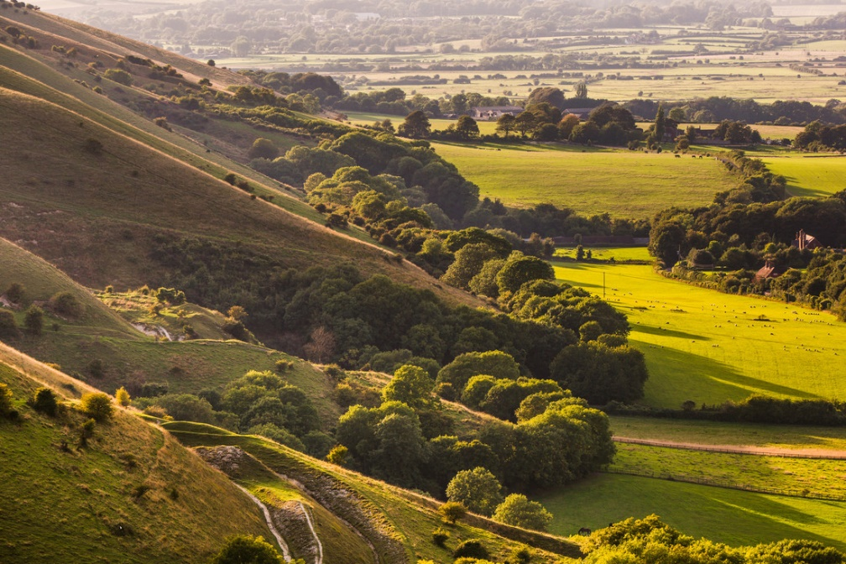
Brighton Chalk Management Partnership:
Brighton ChaMP for Water
Aimee Felus, Project Manager
aimee.felus@southdowns.gov.uk

Slide 2
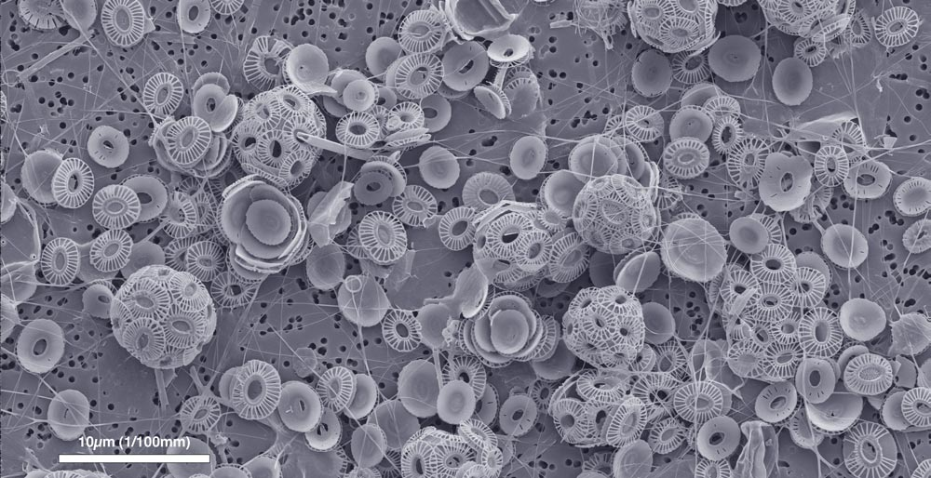
In and around Brighton and Hove public water supply is pumped from groundwater held in the chalk beneath our feet. The abstraction boreholes are operated by Southern Water.
Chalk is formed of compacted coccoliths, the skeletons of tiny marine organisms which lived millions of years ago. Within the chalk are tiny holes like those in a sponge which allow it to hold water in an underground aquifer.
Chalk is able to filter out some pollutants as water passes through it from the surface and into the groundwater. However some, such as nitrates, are not filtered out.

Slide 3
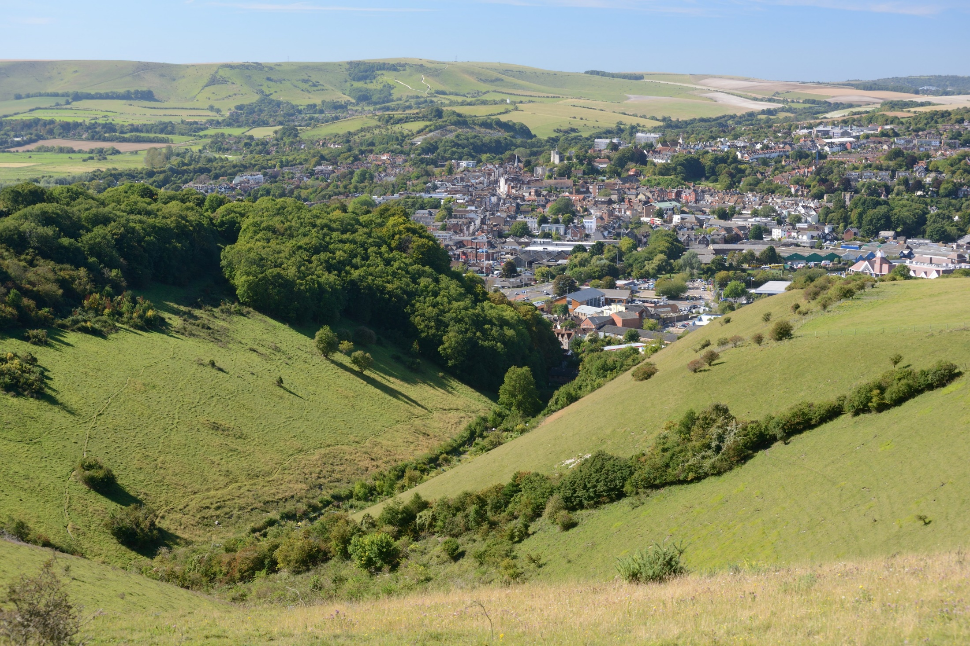
ChaMP is a collaborative project to tackle the rising trend of nitrates in the groundwater. This problem is not exclusive to Brighton, it’s a global issue.
ChaMP aims to protect and improve the quality of groundwater in the Brighton Chalk, to ensure it remains a sustainable resource for public water supply.
To do this, ChaMP:
Provides practical advice and improvements to land management in the urban and rural area
Raises public and land-manager awareness of groundwater protection­
Informs the evidence base & undertaking success monitoring

Slide 4
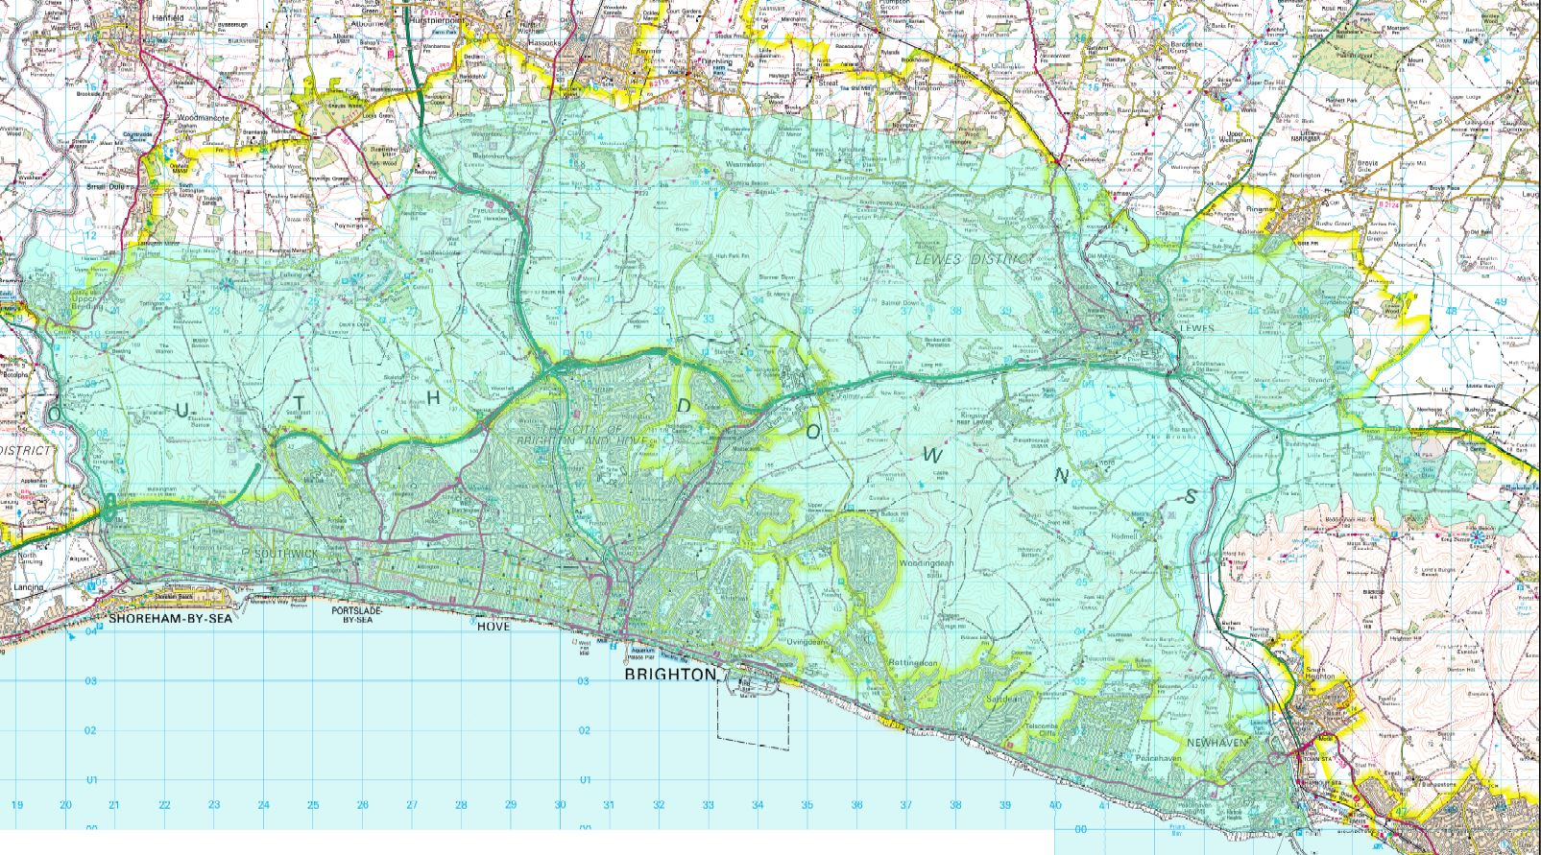
ChaMP covers the Brighton chalk block, the majority of which lies between the rivers Adur and Ouse and up to the edge of the scarp slope on the downs.

Slide 5
ChaMP stands for ‘Chalk Management Partnership’

Slide 6
Thresholds for nitrates in drinking water are:
Environment Agency warning level = 35 mg/l NO3
Drinking Water Standard = 50mg/l NO3
Many of the abstraction boreholes in the Brighton chalk block have at some point reached the Drinking Water Inspectorate level for nitrates. When nitrates reach this level the source must be turned off or blended with another source of water. Of course water is never supplied with nitrates over the safe level.
As well as most boreholes showing a general rising trend for nitrates there are also seasonal peaks; levels spike in autumn and winter when rain mobilises nitrates held in the soil and makes them wash through to the groundwater (known as leaching).

Slide 7
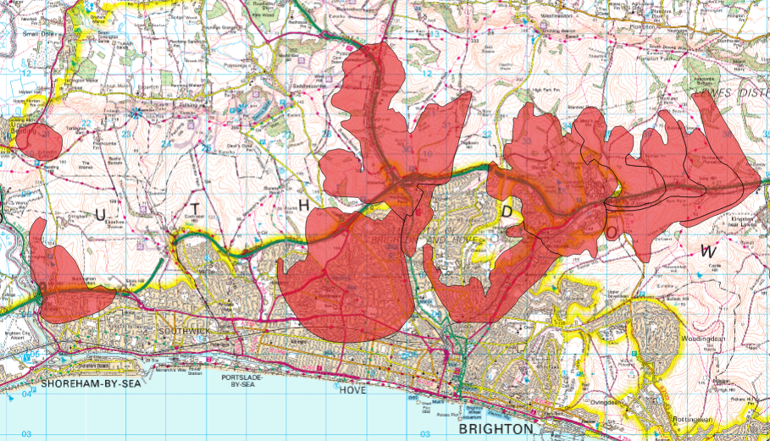
ChaMP is particularly concerned with Safeguard Zones (SGZs). Drinking water SGZs are ‘designated areas in which the use of certain substances must be carefully managed to prevent the pollution of raw water sources that are used to provide drinking water’ (EA Website). They are a joint initiative between the Environment Agency and water companies. Maps of SGZs help us to target our interventions.

Slide 8
ChaMP has a Catchment Sensitive Farming Officer who works with rural landowners to promote groundwater protection.
The use of fertilisers on farms can be a problem. If all the fertiliser applied is not taken up by the plant some can remain in the soil and wash through to groundwater during wet weather. Manure piles can also leach nitrates.
The Defra Fertiliser manual ‘RB209’, commonly used by farmers, illustrates this problem. Below are figures for the efficiency of fertilisers applied to different soil types:
Light sand soils 70% efficiency
Medium, clay, silty, organic and peaty soils 60% efficiency
Shallow soils over chalk and limestone 55% efficiency
In chalky areas such as that covered by ChaMP only 55kg of nitrogen will be taken up by the crop for every 100kg if nitrogen applied as fertiliser. 45% can be lost.

Slide 9
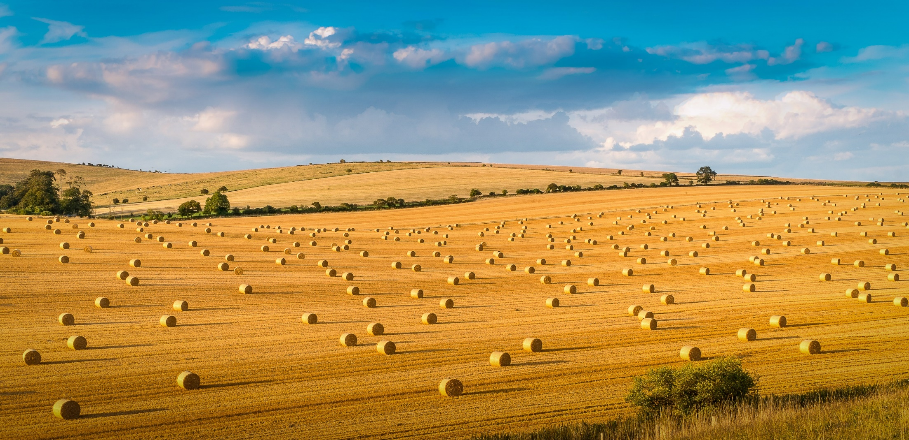
The ChaMP Catchment Sensitive Farming Officer gives advice to farms and can access specialist assistance, grants and incentives to support change in management. For example:
Optimal nutrient management
Precision farming
Cover crop trials
Farm Advice Framework specialist visits:
Bio-bed / Bio-filters
Manure & Slurry Management
Farm infrastructure audits
Nutrient Management
We also want to know from farmers ‘What else do you need?’ to help with groundwater protection. For more information contact shai.gilad@naturalengland.org.uk

Slide 10
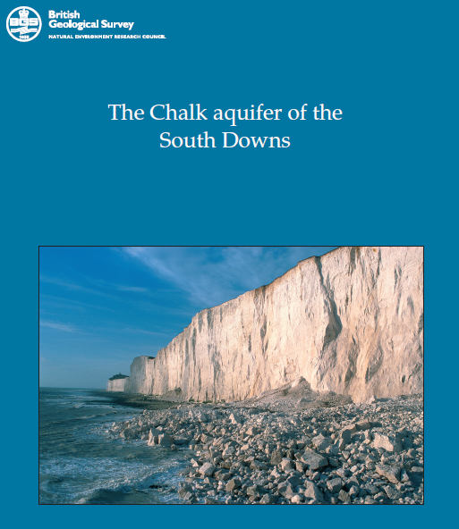
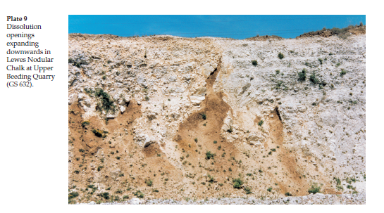
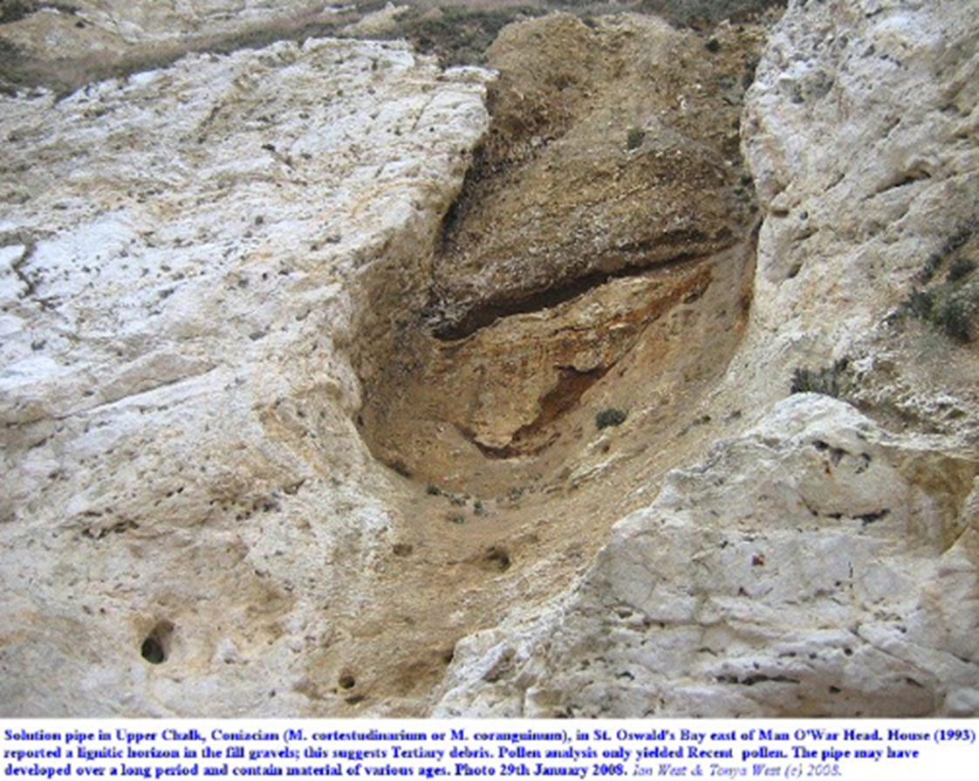
An important consideration for ChaMP is the nature of the chalk, as this will help us determine priority areas which are more vulnerable than others. Chalk is made from calcium carbonate and does have some filtration capability for certain pollutants. However it’s not just one homogeneous block of rock, it also has karst features. These are fractures, swallow holes and openings which allow rapid transmission of water and any pollutants into the aquifer.
It’s possible to calculate the period of time since groundwater fell as rain. This is known as ‘aging’ waters. There is a great range in the age of water abstracted from boreholes in the Brighton chalk block, from less than a year to 100+ years.
Looking at the percentage of water of a given age pumped from a borehole is a good indication of how much karst is in that area. If there is a lot of ‘young’ water, there is a lot of karst in that area.

Slide 11
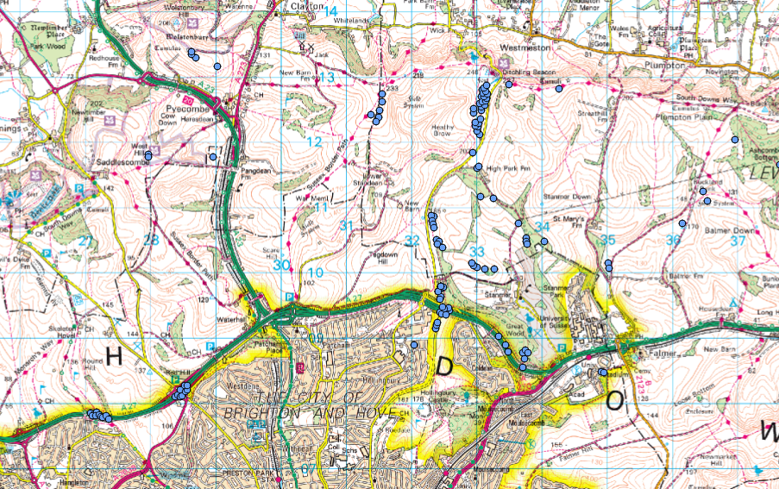
Karst is not well mapped in the Brighton chalk block. ChaMP is hoping to work with research organisations and universities to improve this knowledge and allow us to better understand where the most vulnerable areas are. This would allow us to target interventions even more effectively.

Slide 12
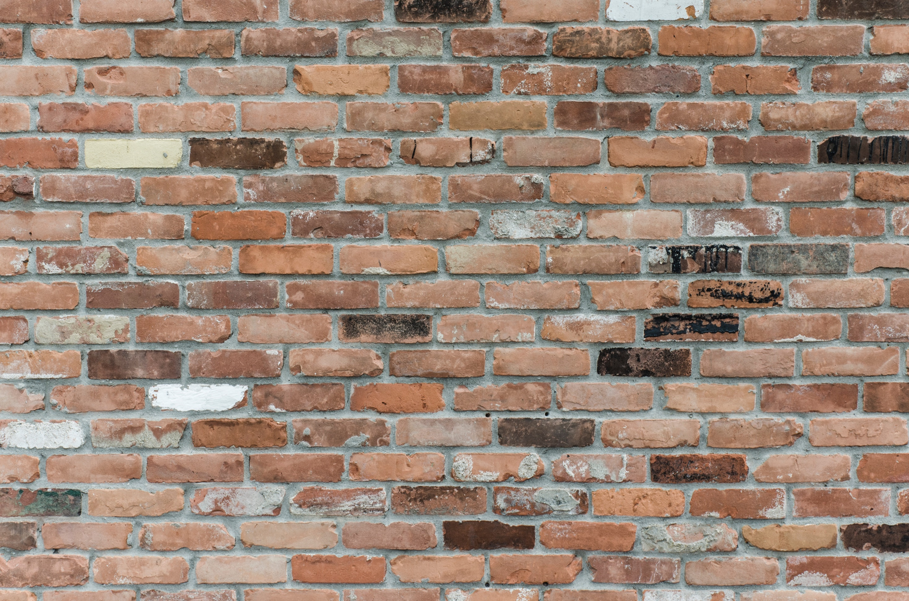
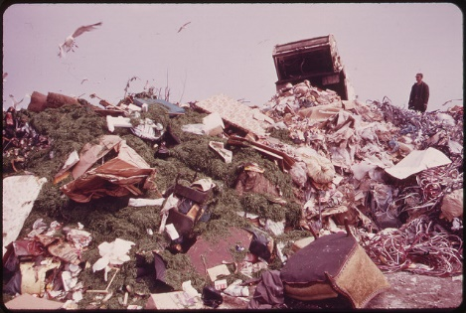
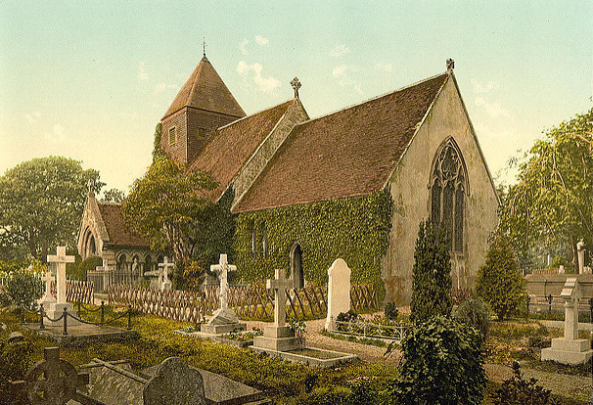
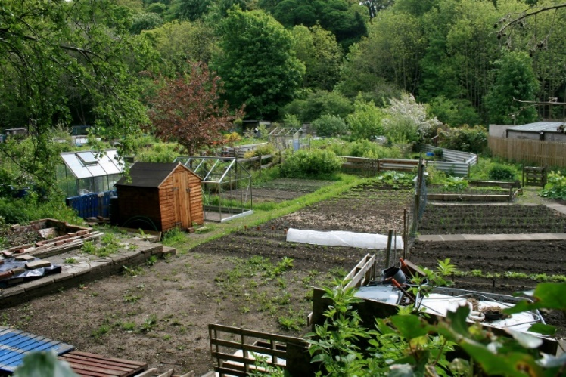
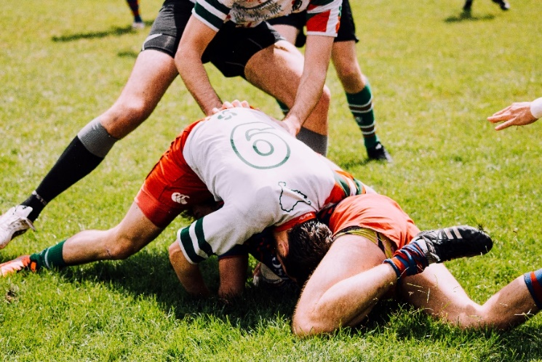
Urban sources of nitrates include historic landfill, leaking sewers and mains, cemeteries, and chemicals used on allotments, sports pitches, golf courses and gardens.

Slide 13
Another significant input is from road run-off. ChaMP is working to tackle this. This is innovative as there are no other groundwater protection projects working specifically in the urban setting.
Vehicle use doesn’t just cause air pollution;. The third highest cause of water pollution in the UK today is from highway run-off. Brake pads and tyres wear down, cars leak fuel and oil and this releases heavy metals, hydrocarbons and nitrates onto the surface of the road. It remains there until the next rainfall, and is then washed into the drainage system and ultimately ends up in our rivers, streams, groundwater and seas. The highest proportion of microplastics in the ocean comes from car tyres.
A good illustration comes when it snows – this quickly turns to black mush as it combines with the pollutants that usually lay unseen on the road.

Slide 14
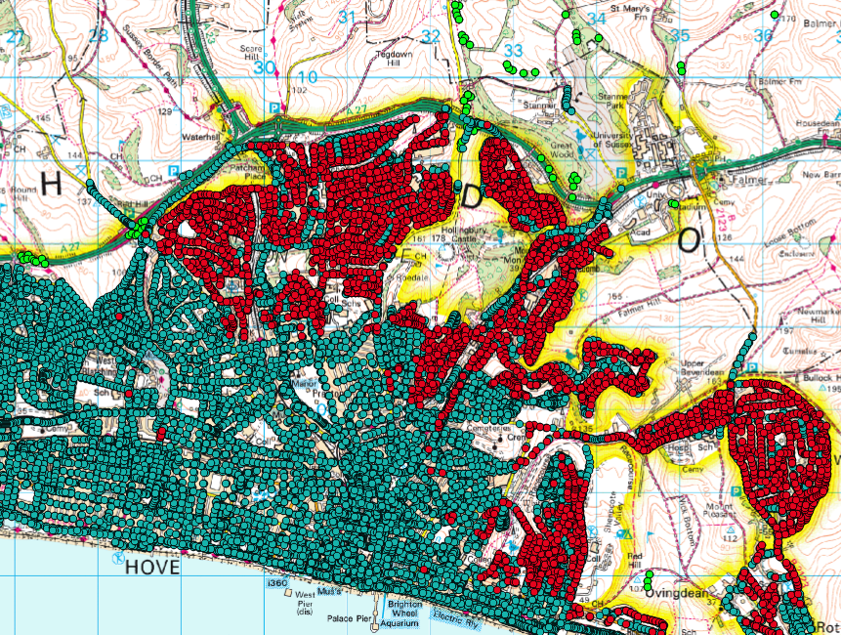
Road gullies
Soakaways
Known dissolution features
In Brighton and Hove, Lewes and surrounding areas road drains are often linked to soakaways. These are brick or concrete lined chambers sunk into the chalk, often constructed decades or centuries ago. An Environment Agency colleague has described them as like a hypodermic injection of pollution. They provide a direct pathway for pollutants to access groundwater.
Soakaways are particularly concerning when they also coincide with areas where there are karst features.
Unfortunately there are so many of these soakaways that it’s impossible to remove them all. We need an alternative…..

Slide 15
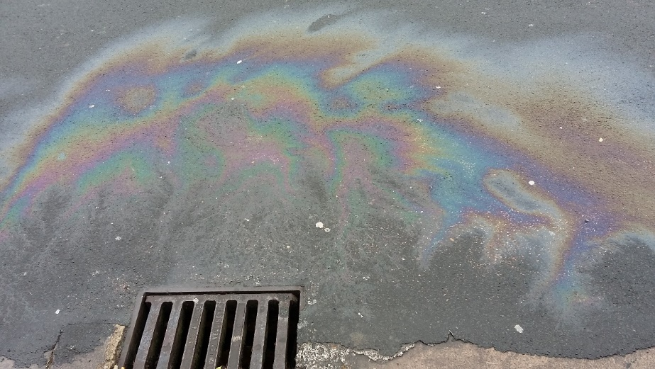
Sustainable Drainage Systems (SuDS) are an alternative to this traditional drainage. They are shallow planted areas which intercept polluted road run-off and remediate the pollutants by actions of bacteria in the roots and soil. There is even a bacteria nicknamed ‘Conan the Bacterium’ which is able to change lead so it becomes harmless in the environment!
ChaMP will create 3 SuDS to showcase this urban intervention and demonstrate SuDS efficiency at removing pollutants. As well as protecting groundwater SuDS have many other benefits such as flood protection, increasing biodiversity, improving air quality and greening streets.
© RBA Associates

Slide 16
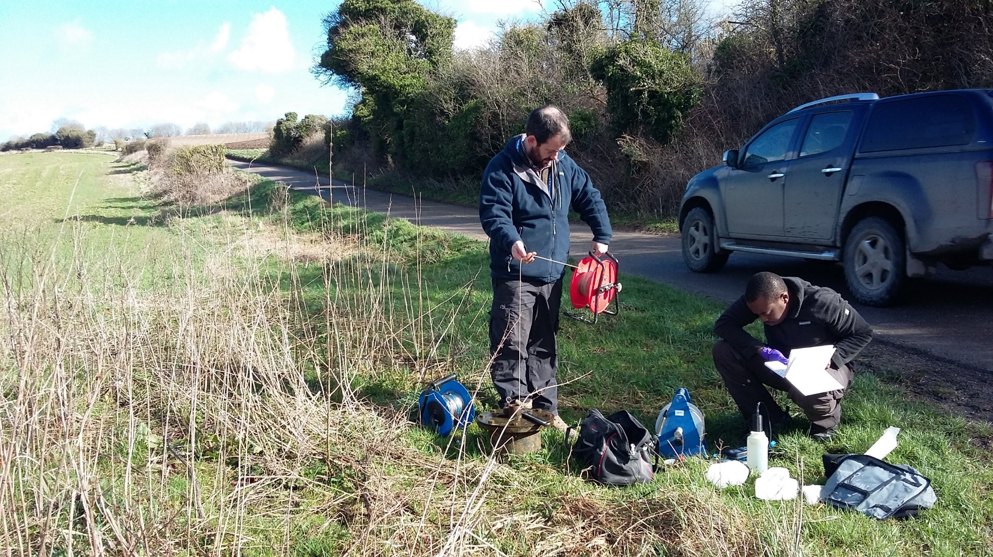
ChaMP is working with a number of organisations to undertake a variety of research to help inform the project. We’ll be gathering data and evidence on the issues and monitoring the success (or otherwise!) of the solutions. We’re collating information on how similar problems are tackled globally so we can learn from this too.
Then we’ll be sharing best practice and lessons learnt with others concerned with groundwater protection in the UK and overseas.
We have a list of research opportunities available to any suitable organisation or student, and are also happy to discuss student placements. For more information please contact the Project Manager: aimee.felus@southdowns.gov.uk

Slide 17
The first phase of ChaMP will continue until March 2020. For more information on any aspects of the project please contact aimee.felus@southdowns.gov.uk
© TEXAS A&M AGRILIFE RESEARCH PHOTO BY KAY LEDBETTER

