Slide 1
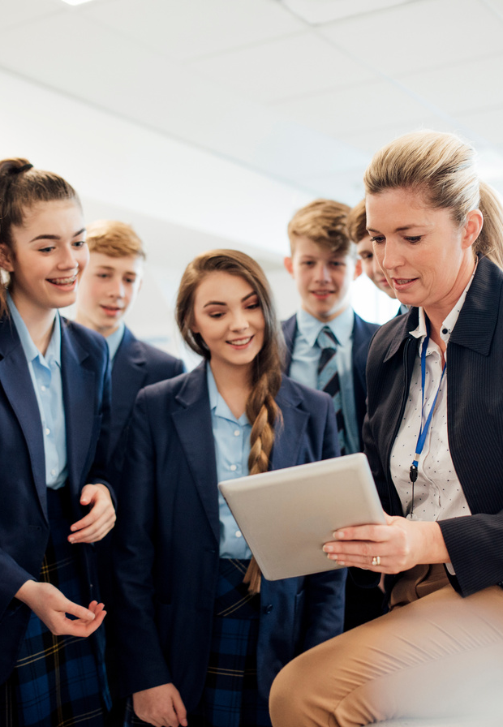






South Downs National Park
Outdoor Learning Providers
Networking
How can your outdoor learning opportunities become ‘experiences of the workplace’
for students?

Slide 2
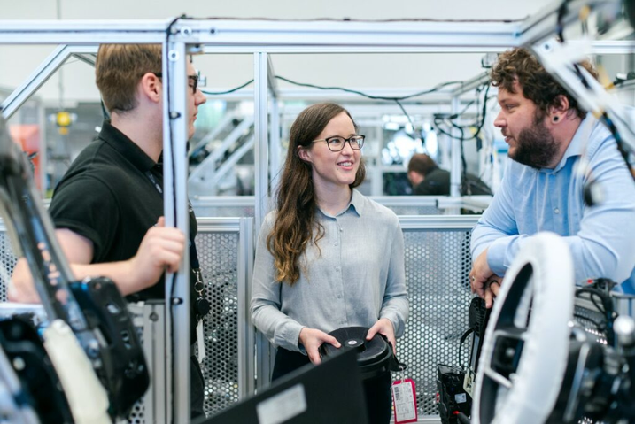



?
We are one of 44 Careers Hubs across England. In our case, we are funded by Careers and Enterprise Company (part of the Department for Education), West Sussex, Brighton and Hove Councils, and the districts and boroughs.
Who are the
?
Careers Hub?
WE SUPPORT 55 MAINSTREAM SCHOOLS AND COLLEGES, 19 SPECIAL SCHOOLS, AND 7 ALTERNATIVE PROVISION CENTRES (FOR STUDENTS WHO CAN NO LONGER BE IN MAINSTREAM EDUCATION).
?
We link education and employment to help schools and colleges deliver high-quality careers education that meets the needs of every student. We work with employers, schools, colleges and independent training providers to raise students’ aspirations and prepare them for the fast-changing world of work.

Slide 3





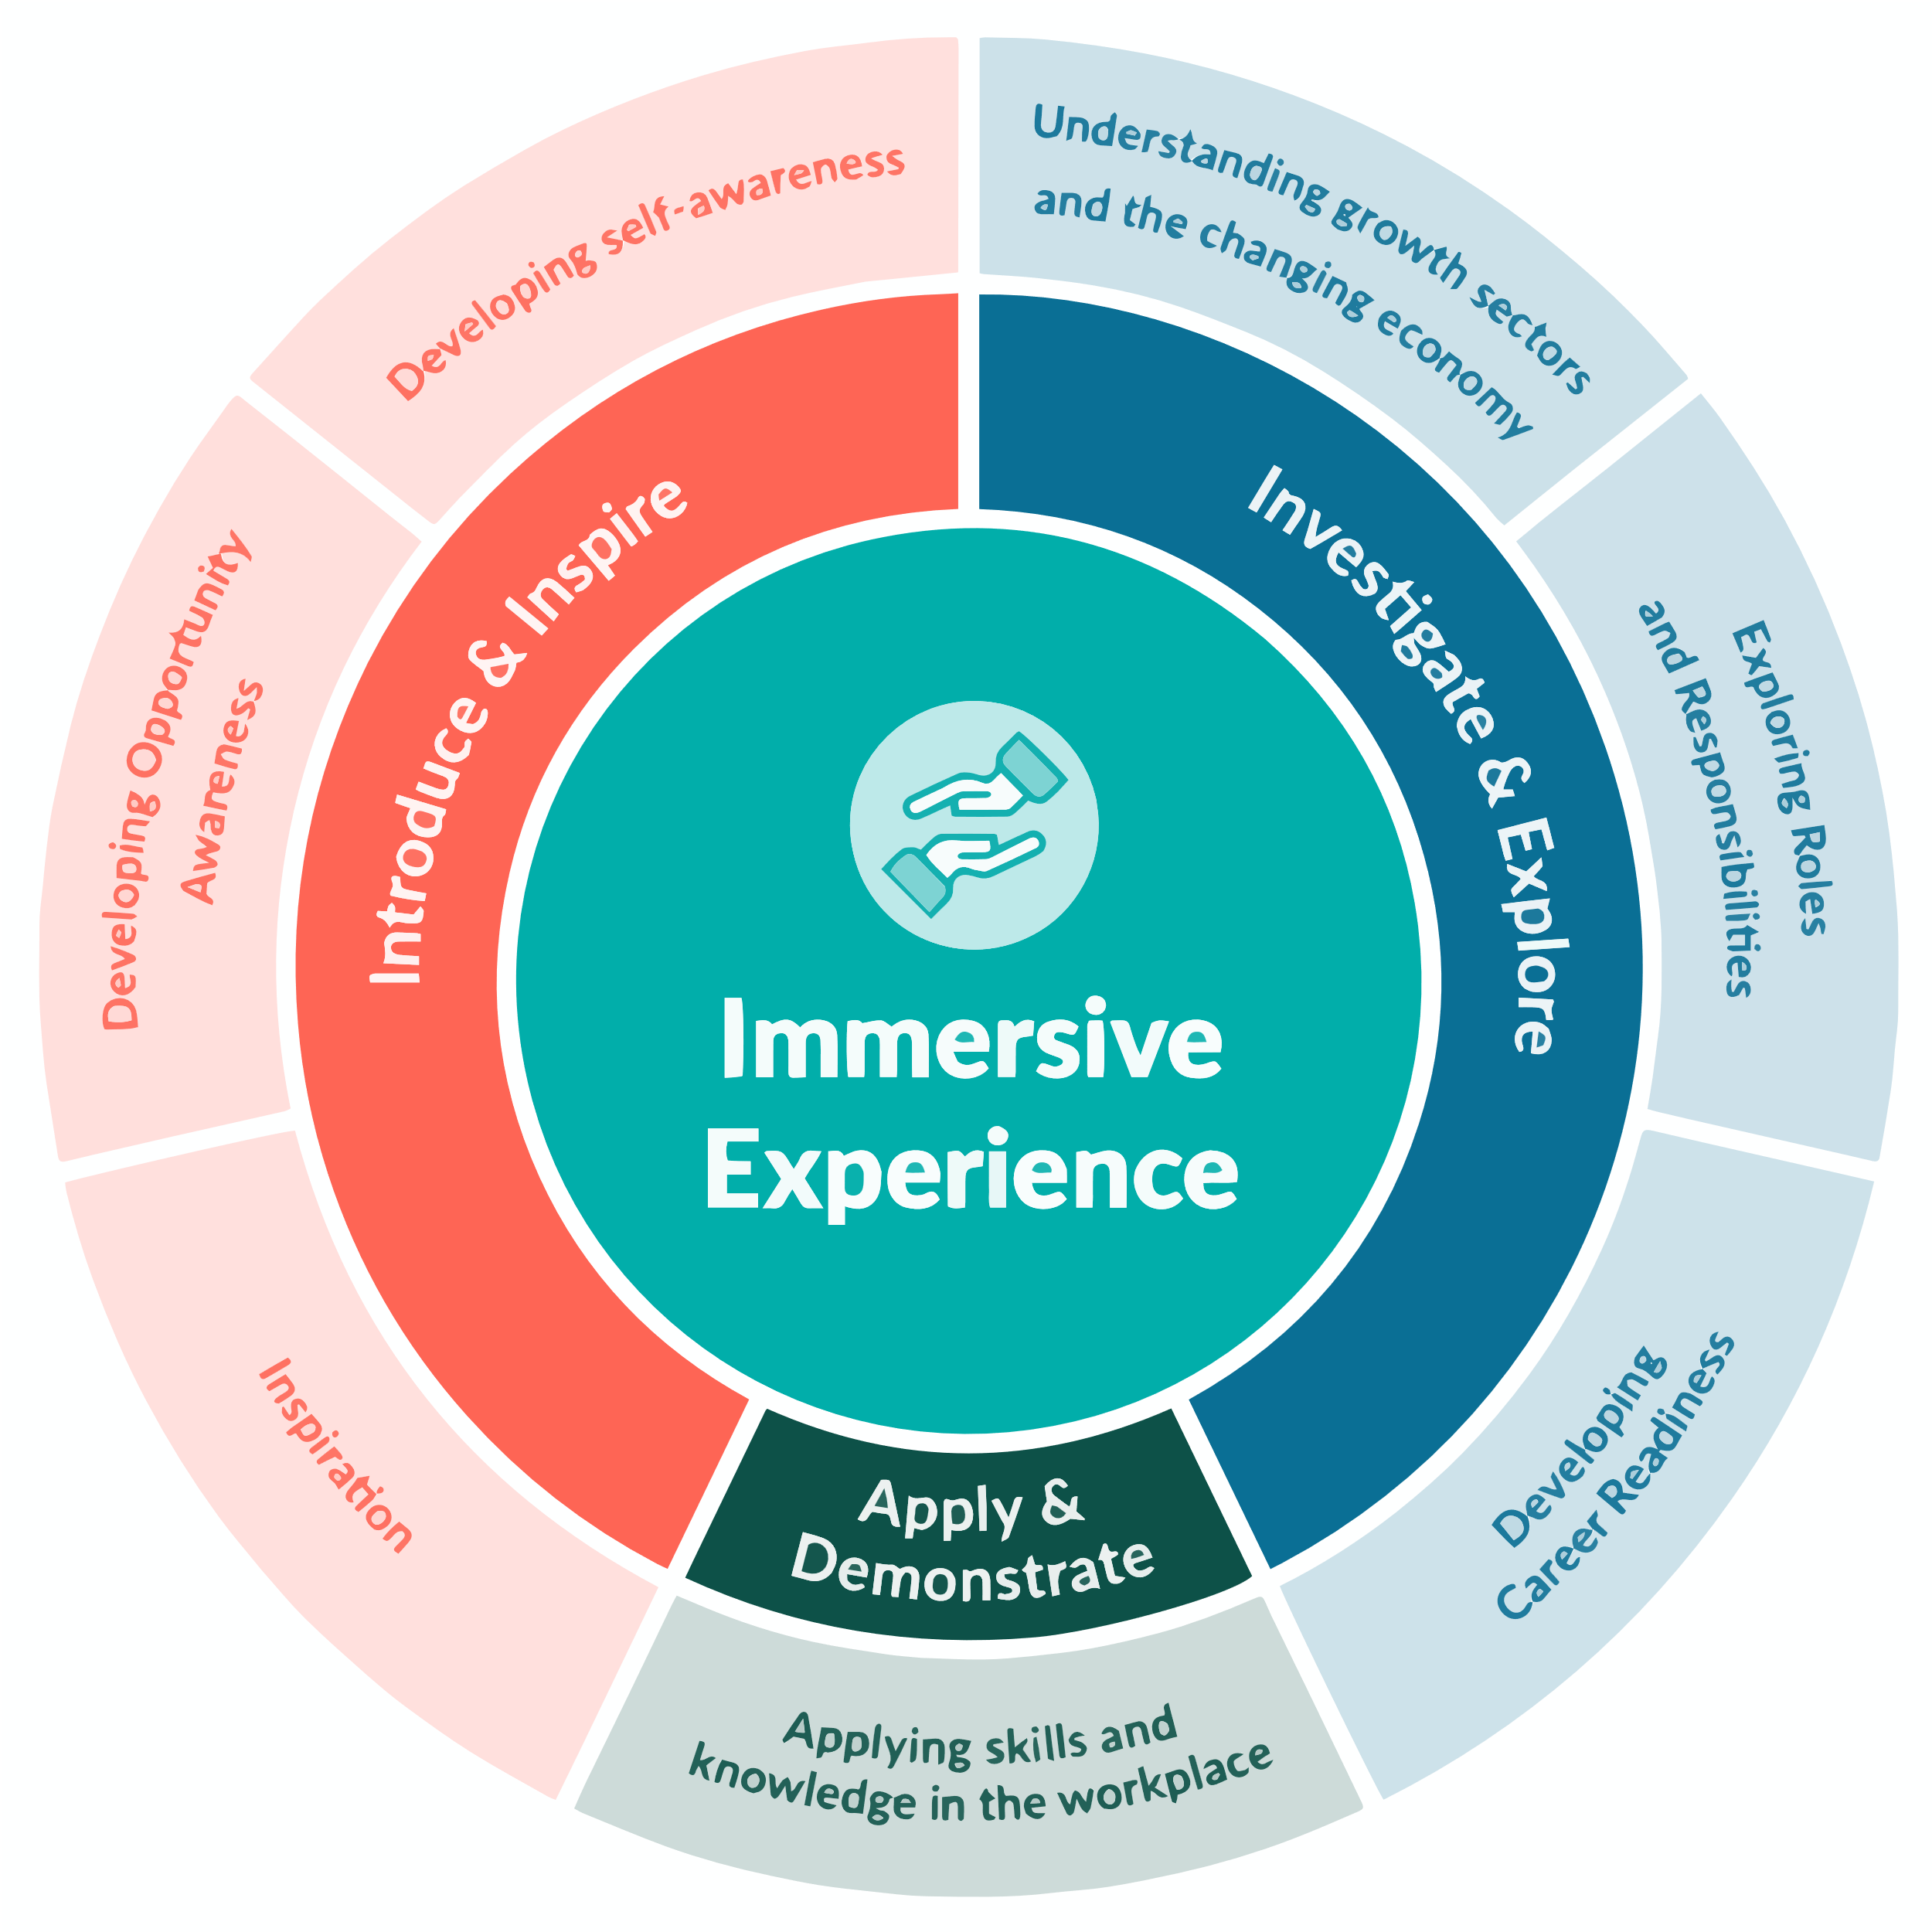
Why now?
Modern Work Experience
Modern work experience gives every young person access to
progressive, high-quality, multiple workplace experiences,
throughout their education journey.
This equitable approach will facilitate a variety of experiences
starting early, connecting education and young people with industry
to unlock the skills and opportunities of the future workforce.
This supports the government’s ambition of:
- A minimum of two weeks’ worth of work experience by Year 11 (age 16), made up of:
  At least one week of work experience activities in Years 7–9,
  At least one week of placements in Years 10–11,
- Access for all learners, regardless of background, ensuring equitable participation,
- Flexibility for schools, learners, and employers to design experiences that meet local and individual needs.

Slide 4






We are conscious that we need to be doing more around corporate social responsibility but don’t know where to start!
The benefits for you...
I would like to engage more with my future employees but don’t have time to devise my own programmes.
I have really struggled to find apprentices who stick at it and add value to the company.
We want educators to be teaching the skills we need most!
We would love to raise our profile in the local community and build on our great reputation.
We are a small employer who wants our local young people to understand the opportunities we offer.

Slide 5







We provide
Let us handle work experience
The tools to make engaging easy - however much time you have
to give.

Slide 6




Over to you!
Let’s start small.
How can you make...
Every trip a ‘Careers Trip’

Slide 7

Thank You
For Listening!
LINKEDIN
WWW.LINKEDIN.COM/COMPANY/CAREERS-HUB-WEST-SUSSEX-BRIGHTON-HOVE/
  WEBSITE
WWW.WSBHCAREERSHUB.CO.UK

