Slide 1


South Downs Learning Network Meetings
8th and 10th December 2025

Slide 2

Who is attended the two meetings?
Participants – In person event
Active Sussex
Brownings Farm
Butser Ancient Farm
Chichester Forest Schools
Cobnor Activities Centre Trust
Drusillas Park
Gilbert Whites House and Gardens
Goodwood Art Foundation
Knepp Wildland Foundation
Naturebytes
SoSussex
Sussex Green Living
Sussex Wildlife Trust
The Sustainability Centre
The Watercress Line Heritage Railway Trust
Tuppenny Barn
Weald and Downland
Weald to Waves
West Sussex, B&H Careers Hub
West Sussex Outdoor Learning Advisor
Wonderseekers and Winchester Science Centre
Participants – Online
Ashdown Forest
Brighton and Hove County Council
Cowdray Heritage
East Sussex County Council
Hampshire and Isle of Wight Wildlife Trust
Hampshire County Council
Sussex Wildlife Trust
West Sussex County Council

Slide 3
What’s hot, what’s not?
Update of themes from in person meeting
Hot:
Delivery taking place with diverse and new audiences: Home ed groups, Alternative Provisions, Forest Schools. Toddler groups, young carers
Work experience including Sussex Heritage Days
Visits have been increasing across providers
Wellbeing groups, especially with secondary schools, have been popular
Government policy with aims to promote outdoor learning has been great to see
Collaboration between providers!

Slide 4
What’s hot, what’s not?
Update of themes from in person meeting
Not:
Funding
Transport costs
Staffing
Accessibility issues. It has been tricky to create a space that is accessibly without damaging heritage or biodiversity
Establishing contacts within schools

Slide 5
What’s hot, what’s not?
Update of themes from in person meeting
Questions for others in the network:
- How do others successfully network and engage with schools and contacts? (Weald to Waves Lewes)
- Has anyone had experience reaching out to Care Homes? (Gilbert White House)
- How does the LOtC Award improve bookings and status? And who has achieved the award already? (various)
- How to mitigate impact of weather for outdoor learning? (Chichester Forest School)
- How to work out the optimum group size for activities? (Goodwood Art Foundation)
- How to promote the importance of repeat engagement? (Sussex Wildlife Trust)
- Which Providers can attend or signpost the Careers & Networking Fair on 19th Feb 2026? (Gwen, Butser Ancient Farm)

Slide 6
What’s hot, what’s not?
Important messages from in person meeting
Funding opportunities
Government PE and Sport Premium Fund
Sport England Movement Fund
(Active Sussex and Naturebytes)

Slide 7
What’s hot, what’s not?
Update of themes from online meeting
Hot:
Buoyant visitor numbers were reported across providers
Great response when the offer is linked to areas of school curriculum especially the ones schools find harder to fulfil
Linking to businesses is a good way to secure funding
Not
Funding remains tricky to find.
Questions:
Raised by Lisa from Ashdown Forest: Does anyone have the Learning outside the classroom quality mark? Would anyone be happy to talk to me about the process and whether it has been useful?

Slide 8
What’s hot, what’s not?
Important messages from online meeting
Participants
Ashdown Forest
Brighton and Hove County Council
Cowdray Heritage
East Sussex County Council
Hampshire and Isle of Wight Wildlife Trust
Hampshire County Council
Sussex Wildlife Trust
West Sussex County Council
Lloyd (Hampshire Council Outdoor Team)
DofE has now moved over to Hampshire outdoor education centres and no longer sits with the participation team
Participation team is currently offering therapeutic outdoor education provision for those struggling to access mainstream education.
Carrie (Sussex Green Living)
Pollination Education Stations have been a great success
Taking on a grant writing one day a week has helped secure funding opportunities
Lisa (Ashdown Forest)
Having a lot of success with a regular group of youth volunteers.

Slide 9

SDNP Updates – Curriculum review
In July 2024, the Government commissioned a review of the curriculum and assessment system including qualification pathways, across primary, secondary and 16-19 phases.
The review aims to prepare young people for life and careers in a changing world
Final review findings were published on 5 November 2025
The final curriculum will be published in spring 2027
Schools will start teaching it from September 2028

Slide 10
SDNP Updates – Curriculum review
Building strong foundations
Stronger foundations – more focus on speaking and listening (oracy), reading, writing and maths from early years through to secondary school.
Clearer structure – teaching subjects in a logical order so children build on what they've already learned.
Inclusive support for all abilities – supporting teachers to adapt their teaching for children with SEND and other needs and stretching the most able learners further.
High standards, more choice
Improvements to specific subjects – revitalising arts subjects, reinforcing the importance of two hours of PE each week throughout school
GCSE improvements – helping all schools offer triple science, giving students more choice in subjects, encouraging arts, and reducing time spent sitting exams.
New vocational qualifications – introducing V Levels, a new post-16 qualification after GCSEs for students following a vocational route.

Slide 11

SDNP Updates – Curriculum review
Learning for a changing world
Boosting crucial skills – increased focus on financial education, media and digital literacy, and improving climate and sustainability education.
Better computer education – a broader computing GCSE and possible new level 3 qualification (A level standard) in data science and AI.
Access to enriching activities – ensuring all pupils can access arts, sports, nature, civic engagement and volunteering.
Citizenship lessons – will be compulsory in Yrs 1-6.

Slide 12




SDNP Updates –Education Nature Park
https://www.educationnaturepark.org.uk/
Free resources, support and guidance to embed climate and nature into learning in a way that suits your setting and learners.
The National Education Nature Park supports the development of Climate Action Plans in education settings across England as part of the Department for Education's Sustainability and Climate Change Strategy.
‘Sister' projects include: Climate Ambassadors, Sustainability Support for Education and Climate Action Advisors.

Slide 13

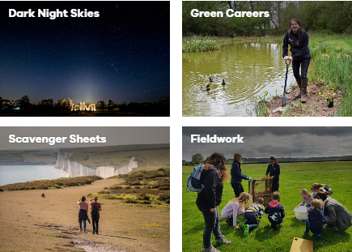
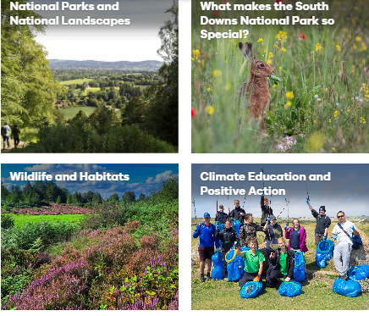
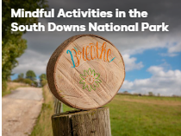
SDNP Updates – Learning Hub
Newly launched Learning Hub on SDNP website.
Do you have anything to share with schools, colleges or universities?
Take a look at the categories and please send us over links or documents you would like embedded into the website. Please let us know which category they best fit within.
https://www.southdowns.gov.uk/learning-and-youth-volunteering/schools-groups/south-downs-education-team/learning-zone/

Slide 14
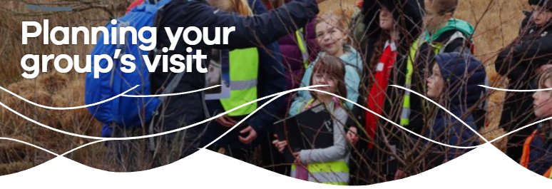
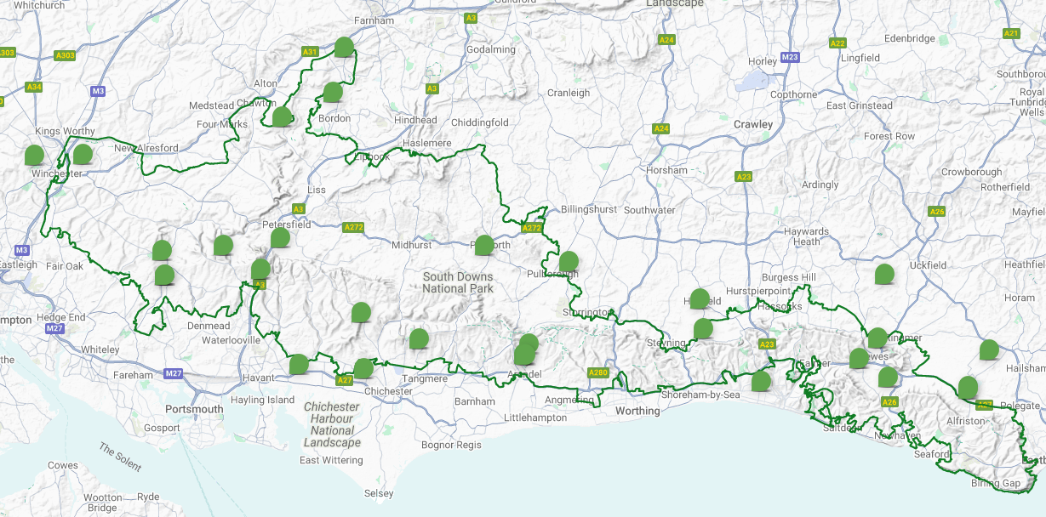
SDNP Updates – Learning Offer
Education establishments and Youth groups often reach out to us looking for trips and advice about visits within the SDNP.
If you feel it would be beneficial to remind us of your offer, site or learning resources, please do reach out and set up a meeting.
We want to ensure we are signposting effectively!
Don’t forget to add yourself to the Learning Map if you haven’t already!
Learning Providers Learning Map - South Downs National Park Authority

Slide 15
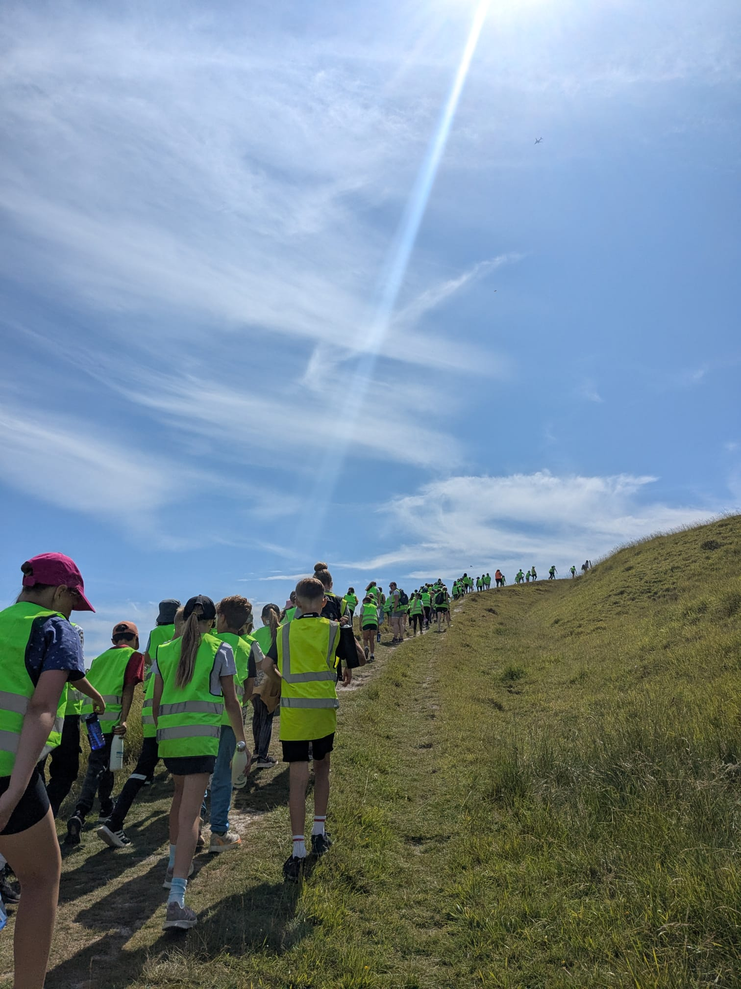
SDNP Updates – Travel
Total grant allocated: £69,322.44
Number of school visits: 119 (average £583 per school)
Number of pupils benefitting: 6,816 (average £10 per pupil)
Ages of pupils:
28% Early Years Foundation Stage or Key Stage 1
63% Key Stage 2
6% Key Stage 3 (11-14 years)
3% Key Stage 4 or 5 (14-18 years)
“This funding is crucial to schools currently. There is no way school budgets can cover the costs, and our families are unable to contribute the large amounts that would be required without such funding. These kind of visits, which are invaluable for building cultural capital and providing opportunities for our most disadvantaged, will quite simply stop if funding isn't available.” Grant beneficiary, 2024-25

Slide 16
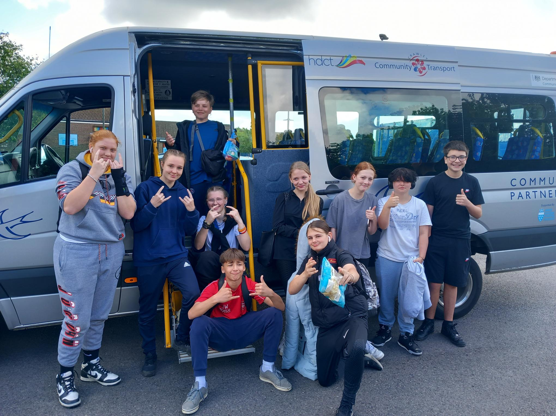
SDNP Updates – Travel
National Express Transport Solutions now The Coach Company
The Lucketts Group and Worthing Coaches, are proud to be partnered with South Downs National Park to offer local schools affordable and reliable coach hire from as little as £345. Visit: https://www.lucketts.co.uk/middle-day or https://www.worthing-coaches.co.uk/middle-day
Community Transport Sussex
Some funding is available for rural areas of Arun and Chichester to get groups of people out where they might otherwise struggle. Travel would be via 16-seat minibuses so would only support small groups.
Visit: https://www.ctsussex.org.uk/services/group-hire/

Slide 17
Workshop
Make every trip a careers trip!
Hosted by West Sussex, Brighton and Hove Careers Hub

Slide 18
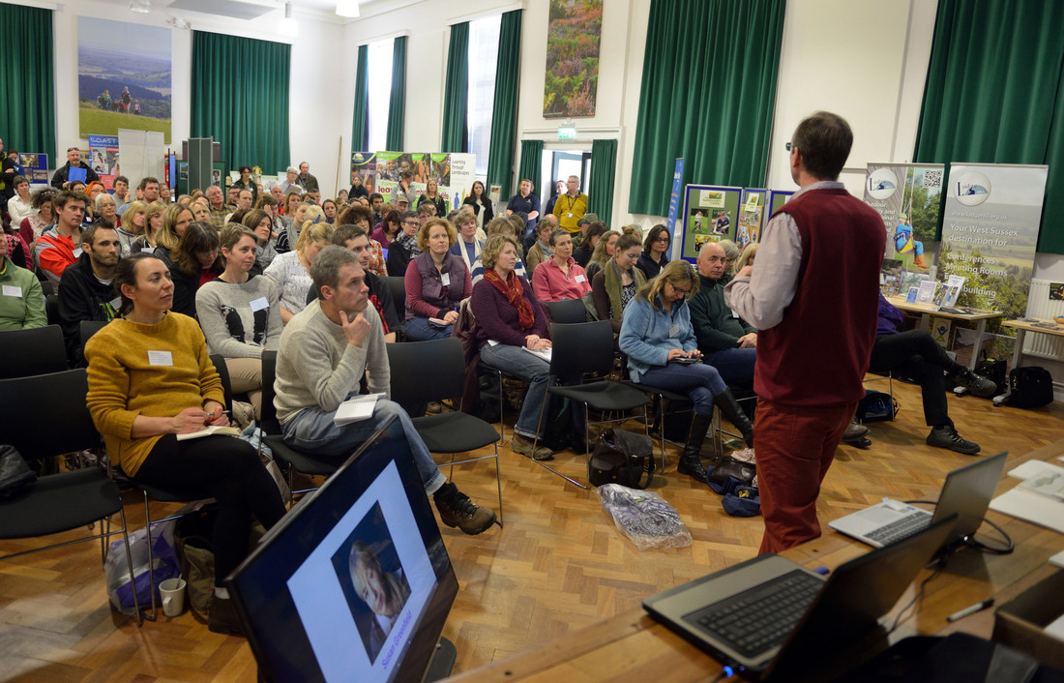
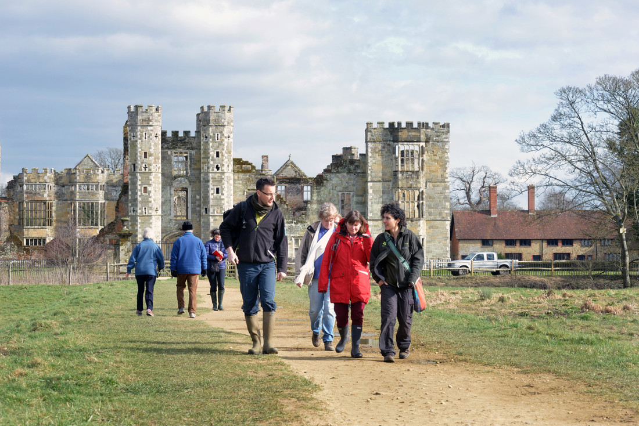
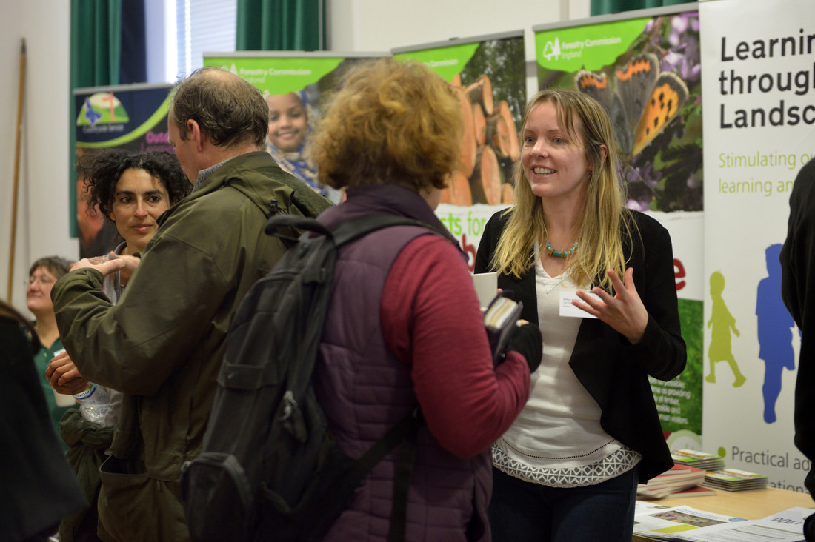
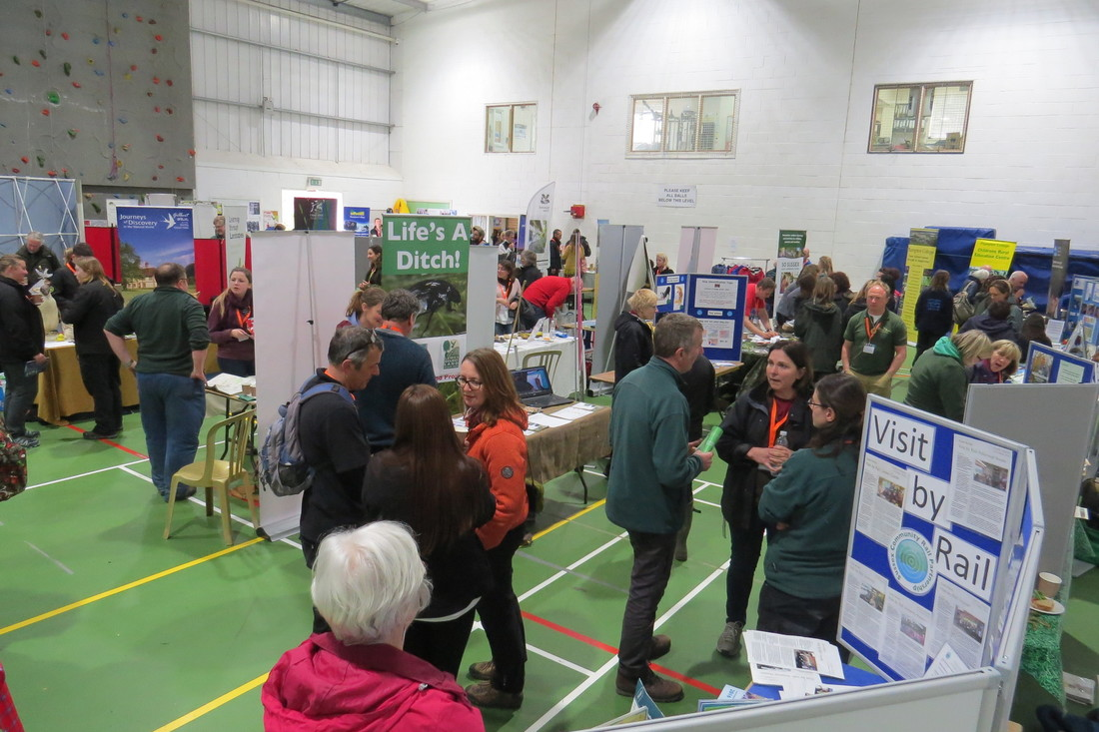
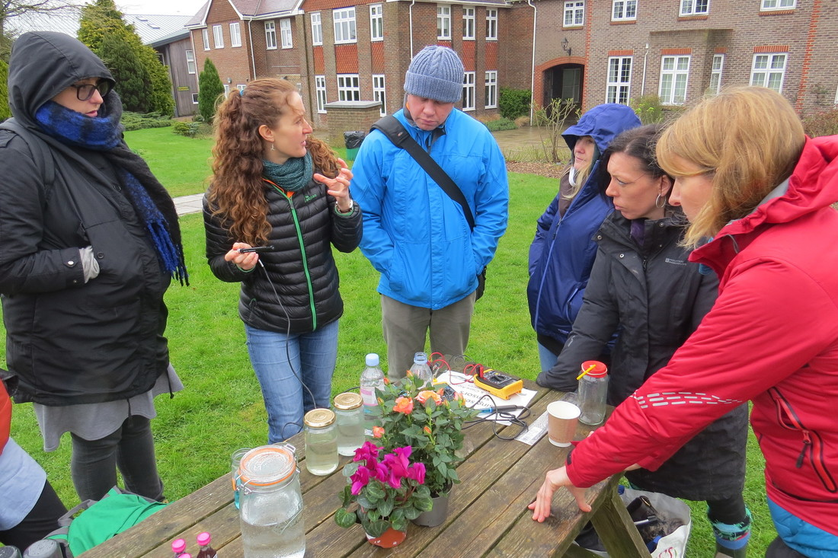
Reviving the SDNP Teachers conference and future collaborations

