Slide 1


Think like an Ancestor
Session 1 [50 mins]
Notes:
Welcome!
This lesson is called Think like an Ancestor
Option to clarify definition of ancestor: According to classic dictionary definition an ancestor is a person related to you who lived a long time ago. In this lesson we will use it more widely to include anyone who lived in the same part of the UK as we do now. So not just our family ancestors but also our local ancestors.

Slide 2

Notes:
Introduce key concepts of long and short term thinking [20 mins]
Has anyone ever heard of The Marshmallow Test? It’s a famous experiment often carried out with children.
a) Show students a video of ‘The Marshmallow Test’ to highlight an example of moving towards longer term thinking in early development.
b) Group Discussion: Ask students for any examples in their lives of where they have to develop self control to resist short term gains for a better long term outcome.
It’s not only children who sometimes find it difficult to resist the temptation of instant gratification.
Can anyone suggest a time when they are tempted towards instant gratification?
Can anyone suggest any examples of times in their when they have to develop self control to resist short term gains for a better long term outcome.
c) Solo work: Write down three ways in which they could improve their lives by implementing long term thinking.

Slide 3
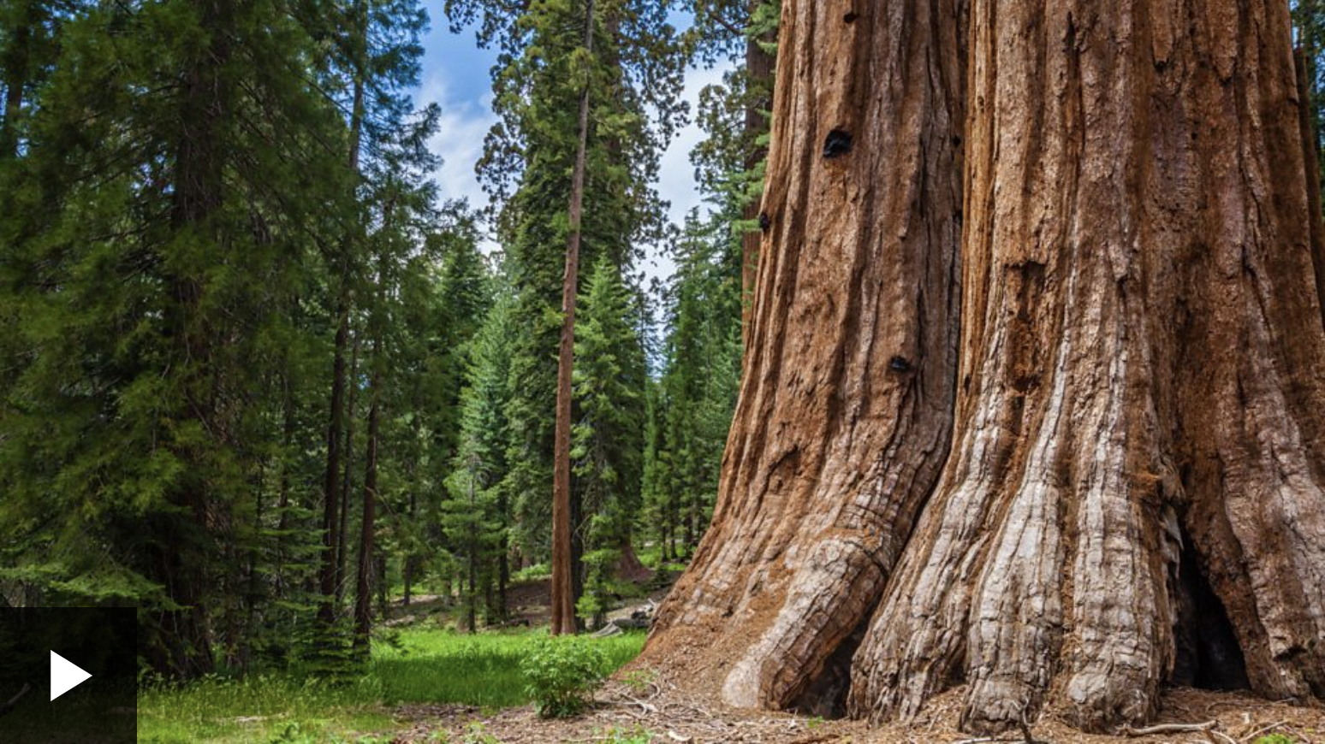
Notes:
2. Connect key concepts of short-termism and long time thinking with climate and environment [15 mins]
a) Watch The Long Time Project video [5 mins]
b) Teacher leads group discussion asking students
i) What examples of short termism can you think of in your town/city/country, and what are the problems with this?
ii) Are there any examples of long term thinking you can think of and what are the benefits?

Slide 4
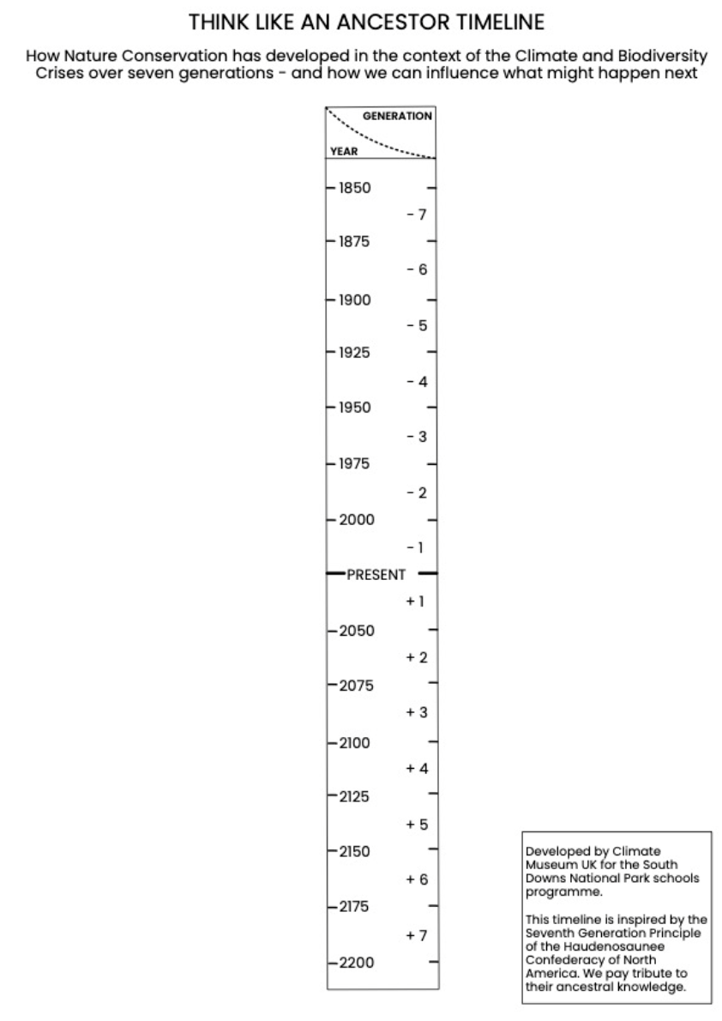
Notes:
Show students the seven generations timeline:
Explain that this represents 7 generations back and forward from today.
Highlight that this 7 Generations Principle originates from with the Haudenosaunee, a group of First Nations people in North America, who believe that decisions being made about our energy, water, and natural resources should be sustainable for seven generations in the future.
Clarify that students understand this key idea.
In this lesson we will be looking at the story of one particular natural resource - carbon - over the past seven generations.

Slide 5
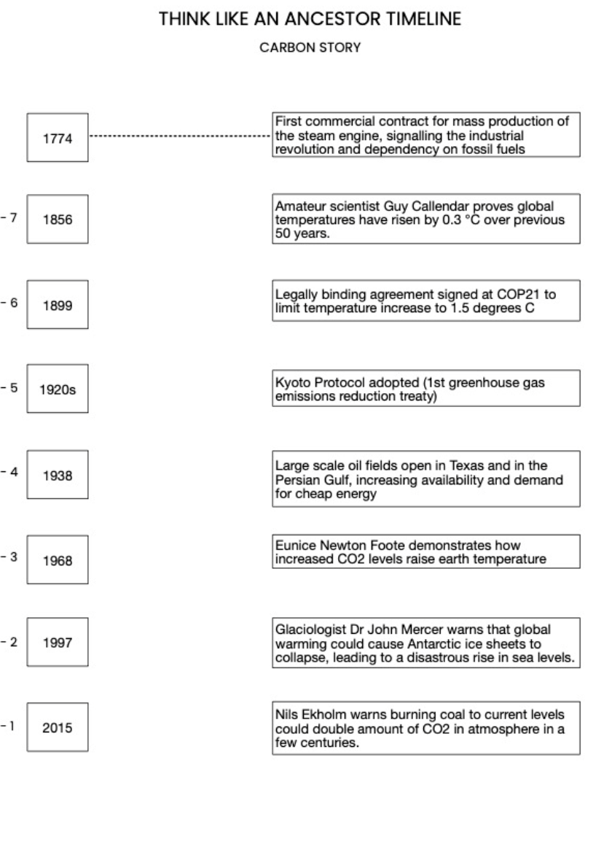
Notes:
Give students printed copies of Appendix B (option to work in pairs).
Introduce matching task:
On the left hand side are seven years, one from each of the seven generations before 2024.
On the right hand side are key events in the story of carbon.
Use estimation to match up the years with the events.
The next slide contains the answers

Slide 6
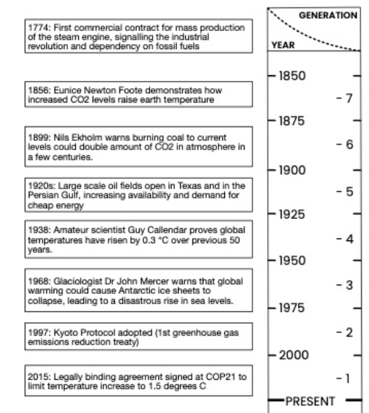
Notes:
Reveal the answers:
Explore with students which ones were easier and which were harder.
This may reveal aspects of students’ knowledge about carbon
What was the most unexpected / surprising discovery?

Slide 7
End of session 1

Slide 8
Think like an Ancestor
Session 2 [50 mins]
Notes:
Welcome!
This lesson is called Think like an Ancestor
Option to clarify definition of ancestor: According to classic dictionary definition an ancestor is a person related to you who lived a long time ago. In this lesson we will use it more widely to include anyone who lived in the same part of the UK as we do now. So not just our family ancestors but also our local ancestors.

Slide 9
Review session 1
Notes:
1. Review key concepts & learning from session 1 [15mins]
a) What happened in the marshmallow test?
b) What examples were given about short term and long term thinking?
c) Which was most surprising about the carbon timeline? What did you learn?

Slide 10
Notes:
2. The Nature Conservation Story over seven generations [15 mins]
We will now return to the seven generations timeline:
Recap that this represents 7 generations back and forward from today.
Recap that this 7 Generations Principle originates from with the Haudenosaunee, a group of First Nations people in North America, who believe that decisions being made about our energy, water, and natural resources should be sustainable for seven generations in the future.
Clarify that students understand this key idea.
In this lesson we will be looking at a different story - nature conservation - over the past seven generations.

Slide 11
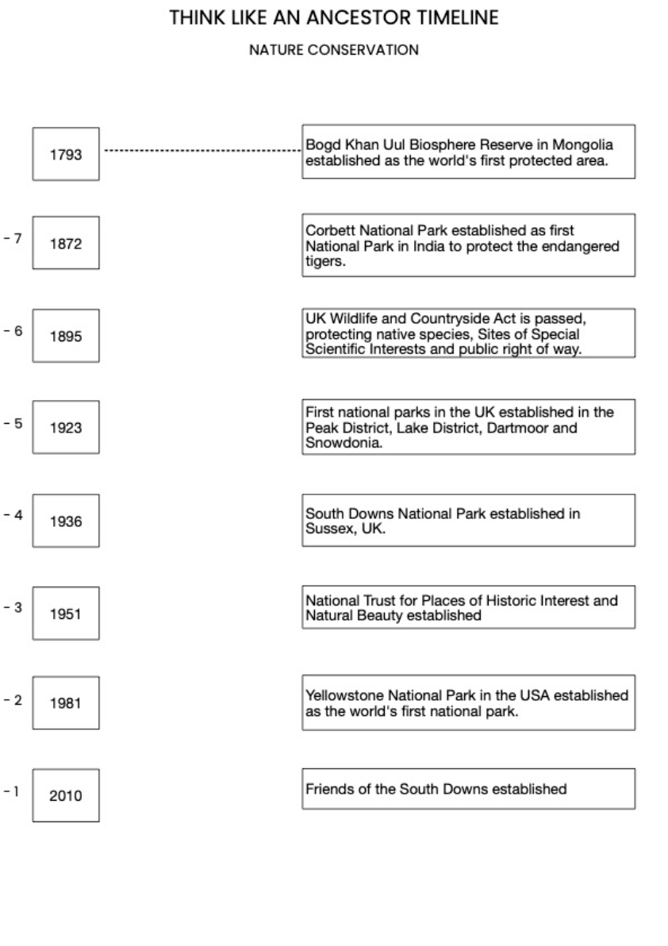
Notes:
Give students printed copies of Appendix C (option to work in pairs).
Introduce matching task:
On the left hand side are seven years, one from each of the seven generations before 2024.
On the right hand side are key events in the story of nature conservation.
Use estimation to match up the years with the events.
The next slide contains the answers

Slide 12
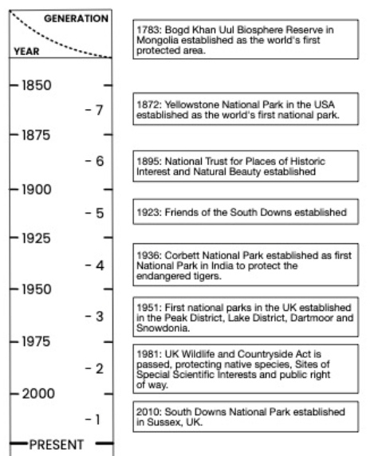
Notes:
Reveal the answers:
Explore with students which ones were easier and which were harder.
This may reveal aspects of students’ knowledge about nature conservation.
What was the most unexpected / surprising discovery?

Slide 13
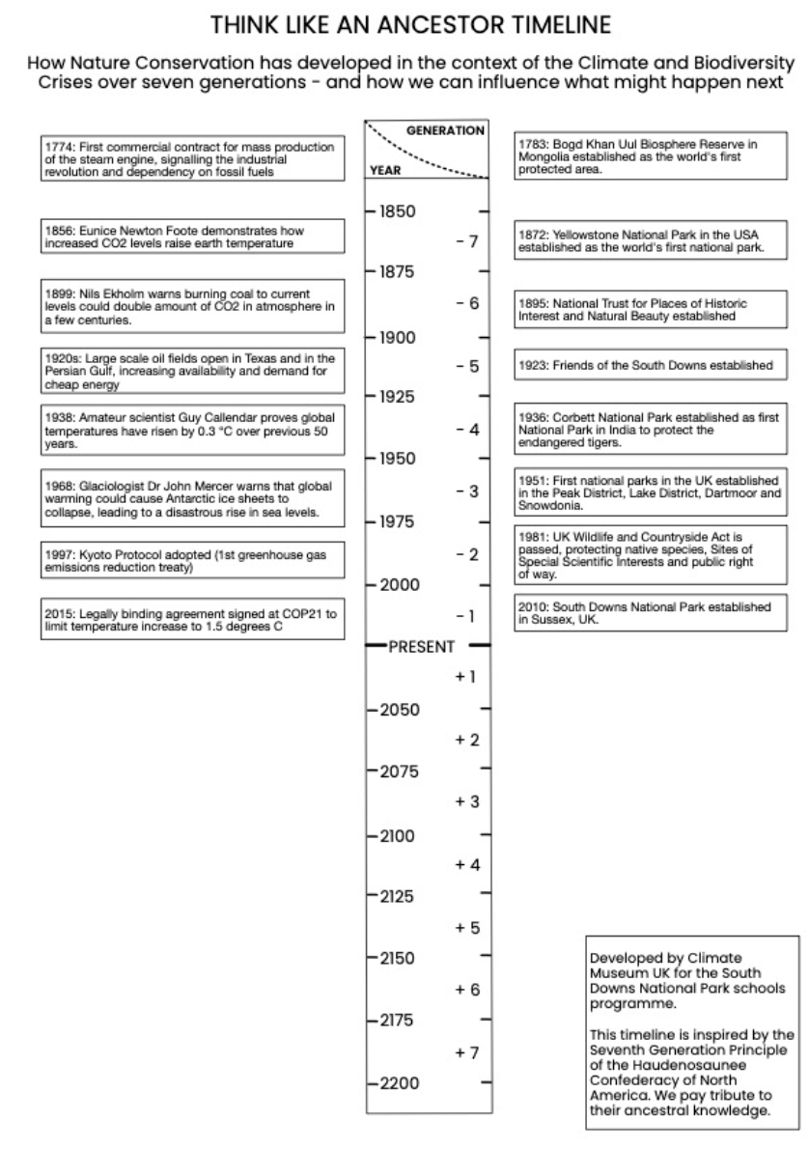
Notes:
3. The Carbon and Nature Conservation stories together [10 mins]
a) Students shown the carbon and nature conservation stories side by side.
b) With this overview, ask students to get into small groups and discuss which events had the best and worst impact on future generations?
c) Share thoughts in group discussion.

Slide 14
Long Time Locally
Notes:
4. Long time thinking locally [10 mins]
a) Teacher leads a whole group discussion about any examples of long term thinking they already do or have noticed in their neighbourhood/village/town/city.

Slide 15
End of session 2

Slide 16
Think like an Ancestor
Session 3 [50 mins]
Notes:
Welcome!
This lesson is called Think like an Ancestor
Option to clarify definition of ancestor: According to classic dictionary definition an ancestor is a person related to you who lived a long time ago. In this lesson we will use it more widely to include anyone who lived in the same part of the UK as we do now. So not just our family ancestors but also our local ancestors.

Slide 17
Review session 2
Notes:
1. Review key concepts & learning from sessions 1 & 2 [10 mins]
a) From the carbon and nature conservation stories, which events did the group feel had the best and worst impact on future generations?
b) Were there any examples of long time thinking locally?

Slide 18

Notes:
2. The Earthshot Prize [15 mins]
Watch first 1 minute of this video of the Earthshot Prize awards ceremony 2023.

Slide 19

Notes:
Watch this 3 minute video to introduce the origins of the Earthshot Prize in 2020.

Slide 20
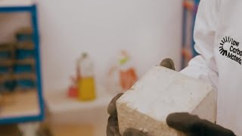
Notes:
Watch this 2 minute video to see a UK finalist in the Earthshot prize in 2022, who have developed an innovative response to the use of carbon.
Teacher leads a group discussion to respond to these questions:
How does this technology reduce our use of carbon?
How might this technology improve the lives of the future seven generations?

Slide 21
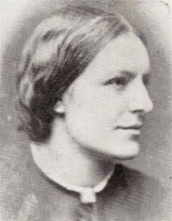
Role Play: Meet a local Ancestor
Notes:
3. Role Play activity: [20 mins]
a) Meet Ancestor 1 Octavia Hill: in small groups of 3-4, students will role-play a conversation between Octavia Hill and a present day person. (See Appendix E for instructions and Appendix F for character sheets).

Slide 22
Reflective Writing
Notes:
4. Individual reflective writing [5 mins]
a) Students asked to write for 2 minutes about how you feel after doing this
activity.
b) Students talk in their small groups to share reflections.

Slide 23
End of session 3

Slide 24
Think like an Ancestor
Session 4 [50 mins]
Notes:
Welcome!
This lesson is called Think like an Ancestor
Option to clarify definition of ancestor: According to classic dictionary definition an ancestor is a person related to you who lived a long time ago. In this lesson we will use it more widely to include anyone who lived in the same part of the UK as we do now. So not just our family ancestors but also our local ancestors.

Slide 25
Review session 3
Notes:
1. Review key concepts & learning from sessions 1, 2 & 3 [10 mins]
a) How does the Earthshot prize promote long time thinking and support the seven generations principle?
b) What did Octavia Hill do to promote long time thinking and support the seven generations principle?

Slide 26
Role Play: Meet a local Ancestor
Notes:
2. Role Play activities: [25 mins]
Meet Ancestor 2 Robert Thurston Hopkins: students will role-play a conversation between Robert Thurston Hopkins and a present day person. (See below Appendix G for instructions & Appendix H for character sheet).

Slide 27
Role Play: Meet a Future Being
Notes:
b) Meet the Future Beings: in the same groups, students will role-play a conversation between a present day person and a future being from the year 2195. (Appendix J)

Slide 28
Reflective Writing
Notes:
3. Individual reflective writing [5 mins]
a) Students asked to write for 2 minutes about how you feel after doing this
activity.
b) Students talk in their small groups to share reflections.

Slide 29
Review Session 4
Notes:
4. Session Overview: Whole group discussion [10 mins]
Teacher leads a whole group discussion by asking each small group to share one reflection.
Discussion can be further developed using additional prompts/questions as below:
One day, you will be the ancestors, so what can you imagine for the next seven generations?
What strategies do you think have been successful so far? What should be improved on?
Can you think of other laws, treaties, campaigns or societies we should be working on?
Who needs to be around the table? If you were in charge, what would you do?

