Slide 1

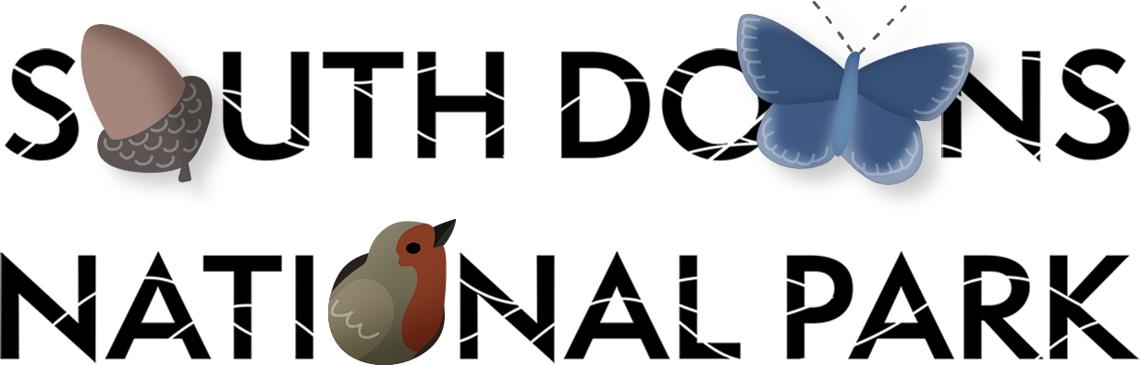
The Skeleton Dance
KS1 [30 mins]
Notes:
Welcome!
This lesson is called the Skeleton Dance - has anyone ever done the skeleton dance before?

Slide 2
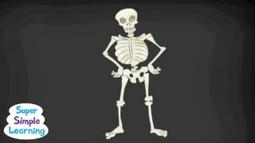
Notes:
1. Connection in the Body: Group Movement activity: [5 mins]
“Everyone up on your feet.”
“Your challenge is copy the skeleton as best you can!”
(Feel free to do a second attempt if it feels like the children would enjoy that)
“Now let’s all see if we can jump all at the same time. Ready 3,2,1: JUMP!”
“When we jump we can feel the whole body is connected, from the feet to the head”
“Let’s do another ready 3,2,1: JUMP!”
After activity, sit down and teacher clarifies that ‘Connection’ is a relationship where one thing is linked with something else.

Slide 3
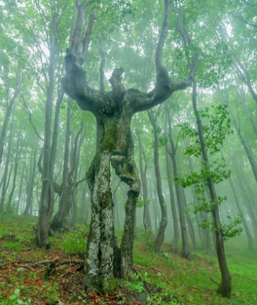

Notes:
2. Connection in Nature: Group Discussion activity: [5 mins]
Teacher clarifies that planet Earth is connected just like our human bodies.
Thinking about the living body of a tree, can anyone think of a way in which the different parts of a tree (roots, trunk, branches, leaves) are connected with the natural elements (sun, rain, wind, soil).
“For example, can anyone think of how the wind is linked with leaves?” etc
(e.g. The tree’s leaves turn sunlight into food, the wind blows leaves to the ground, the rain breaks down leaves and turns them into soil, the soil gives food for plants and flowers, ).

Slide 4
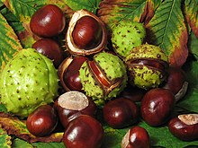
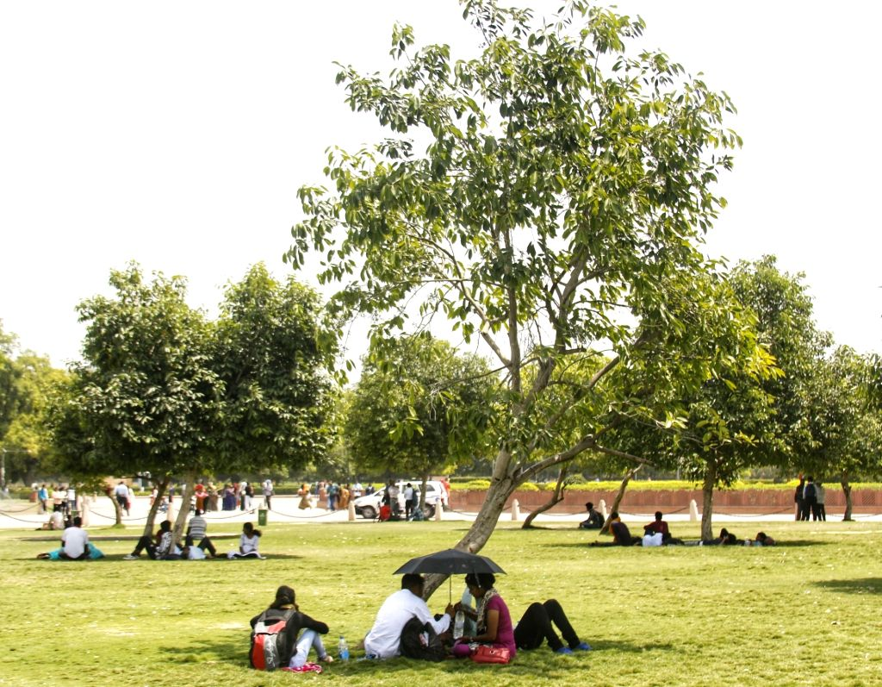
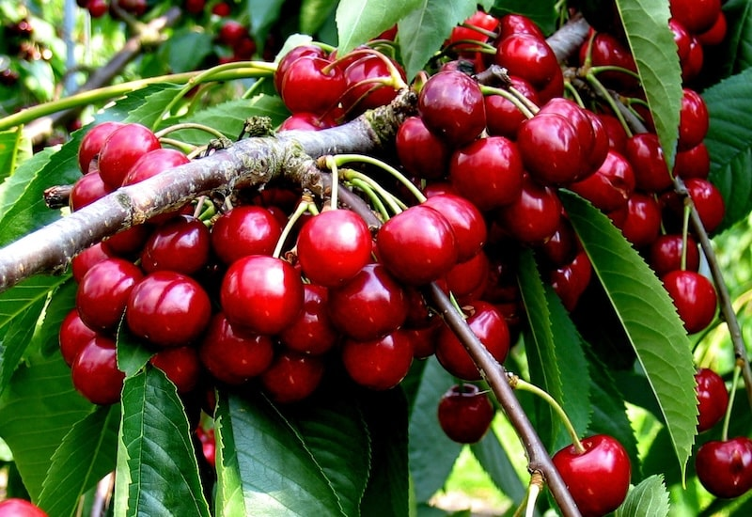
Notes:
c) How do humans connect with different kinds of trees? (e.g. pick fruit/conkers, sit in shade, enjoy autumn colours)

Slide 5
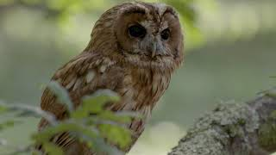
Notes:
3. Connection in the South Downs National Park: Nature Observation activity [8 mins]
Play this video about Woodlands in the South Downs National Park
Watch 00:00 - 1:00
“Can you spot any plants or animals that you might know in the video?”
(e.g Geese, Fallow Deer, Oak Tree, Owl)
“Has anyone seen any of these animals in real life?”

Slide 6
Notes:
Now watch 1:00 - 3:46.
Can you spot two different plants, animals or elements that are connected in the video?
“Has anyone been to THIS wood or another wood which is similar?”
Connections evidence in the video:
Bluebell provides nectar for Duke of Burgundy,
Light helps flowers grow,
Trees provide support for climbing honeysuckle,
Climbing honeysuckle provide nectar for bees,
Bees pollinate other flowers,
Decaying wood provides food and shelter for insects,
The fallow deer keep the shrubland open

Slide 7

Notes:
4. Paired Drawing activity: [10 mins]
Teacher models how to draw a diagram or a scene to show some of the connections between the natural elements and living beings that they have seen in the video
Children do their own diagrams/scenes and might use arrows to show links or draw what they remember seeing.

Slide 8
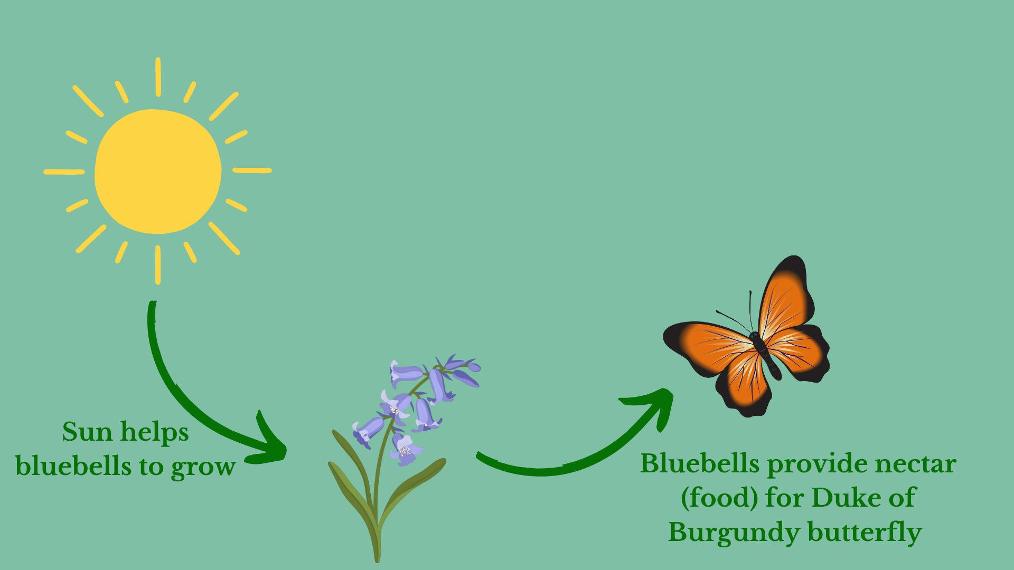
Notes:
4. Paired Drawing activity: [10 mins]
Teacher may wish to use this image as a demonstration.
NB: This activity is a good opportunity for adaptive learning / differentiation, with some children making drawings of two living beings in the video, and others making scenes / diagrams.

Slide 9
Let’s listen to nature while we work
https://soundcloud.com/phil-mill1/sets/colchester-sound-recordings?utm_source=clipboard&utm_medium=text&utm_campaign=social_sharing
Notes:
(This links you to a playlist of sounds in nature (including humans in a park!) which the students can listen to while they draw their posters)

Slide 10
Let’s share our work
Notes:
5. Lesson ending: Share drawings [2 mins]
a) Pairs hold up their drawings for others to see.
b) Subject to time, the teacher may ask some children to describe the connections they’ve seen.

