Slide 1

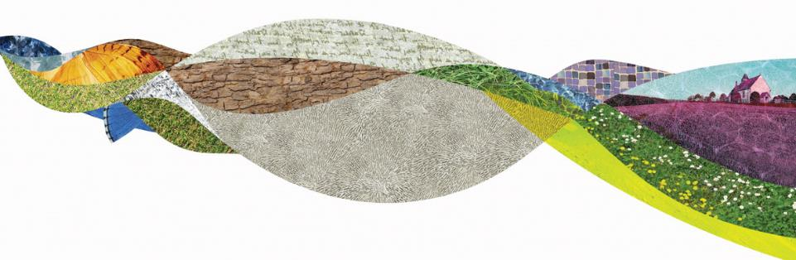
Pathways to Green Careers
South Downs National Park
Emma Bruce

Slide 2
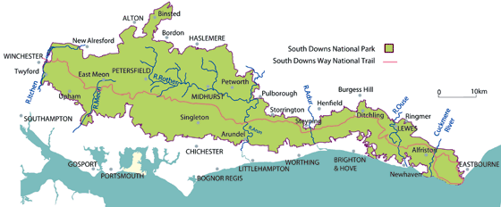

South Downs National Park
A National Park is a designated landscape that is protected in law for its special qualities so that people can enjoy it for years to come.
Notes:
There are 15 National Parks in the UK, each doing vital work to support the environment and our green futures.
The South Downs National Park spans from Winchester to Eastbourne and is 100 miles long.
It has 3 main aims: Climate Action, ReNaturing and welcoming all to the park.

Slide 3
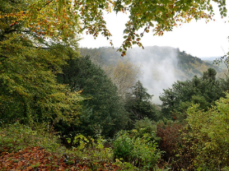
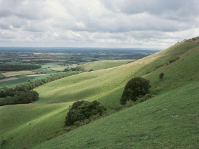
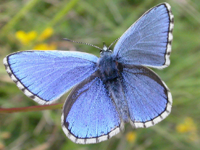

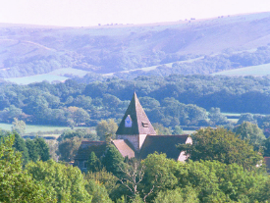
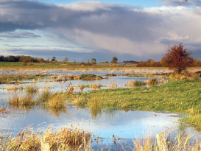
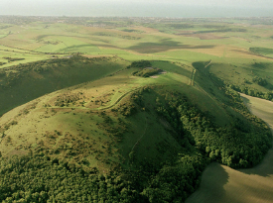
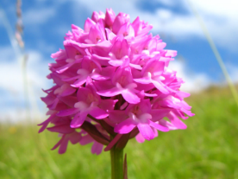
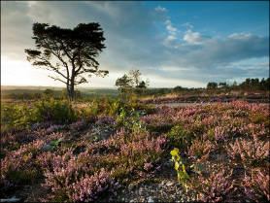
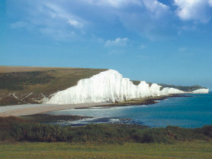
Notes:
SDNP home to some of the rarest habitats and species, has evidence from every period of human history and is the most populate national park in the UK.
What have you spotted when you are out and about?

Slide 4



What careers are in the National Park?
Notes:
If you had to guess, what careers do you think are available in a National Park?

Slide 5

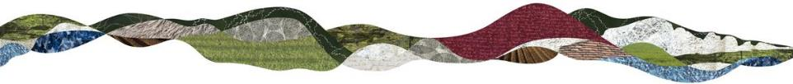
Pathways to Green Careers
What are they?
How to get involved?
Why are they needed?

Slide 6
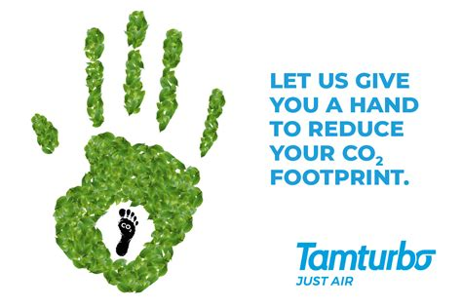

Green Careers – What are they?
Jobs which directly or indirectly contribute to reaching climate and environmental goals

Slide 7
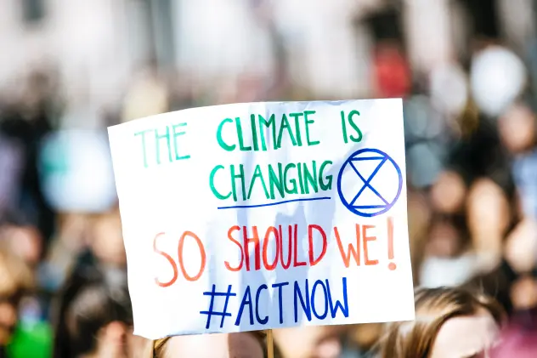

Why are Green Careers needed?
We know:
Temperatures are rising
Biodiversity has been impacted
Limited resources to share
We need to do more
Green Careers can help to be part of the solution
Notes:
Hottest July on record in 2021
40% of all amphibians are under threat.
½ barrier reef is lost.
155 million people (2.3x the number of people in UK) struggle for food due to climate change in 2020
There has been 20,000 years of change in the last 170 year
OR play this video from 1.42 to 4.14 How to Save Our Planet - YouTube

Slide 8

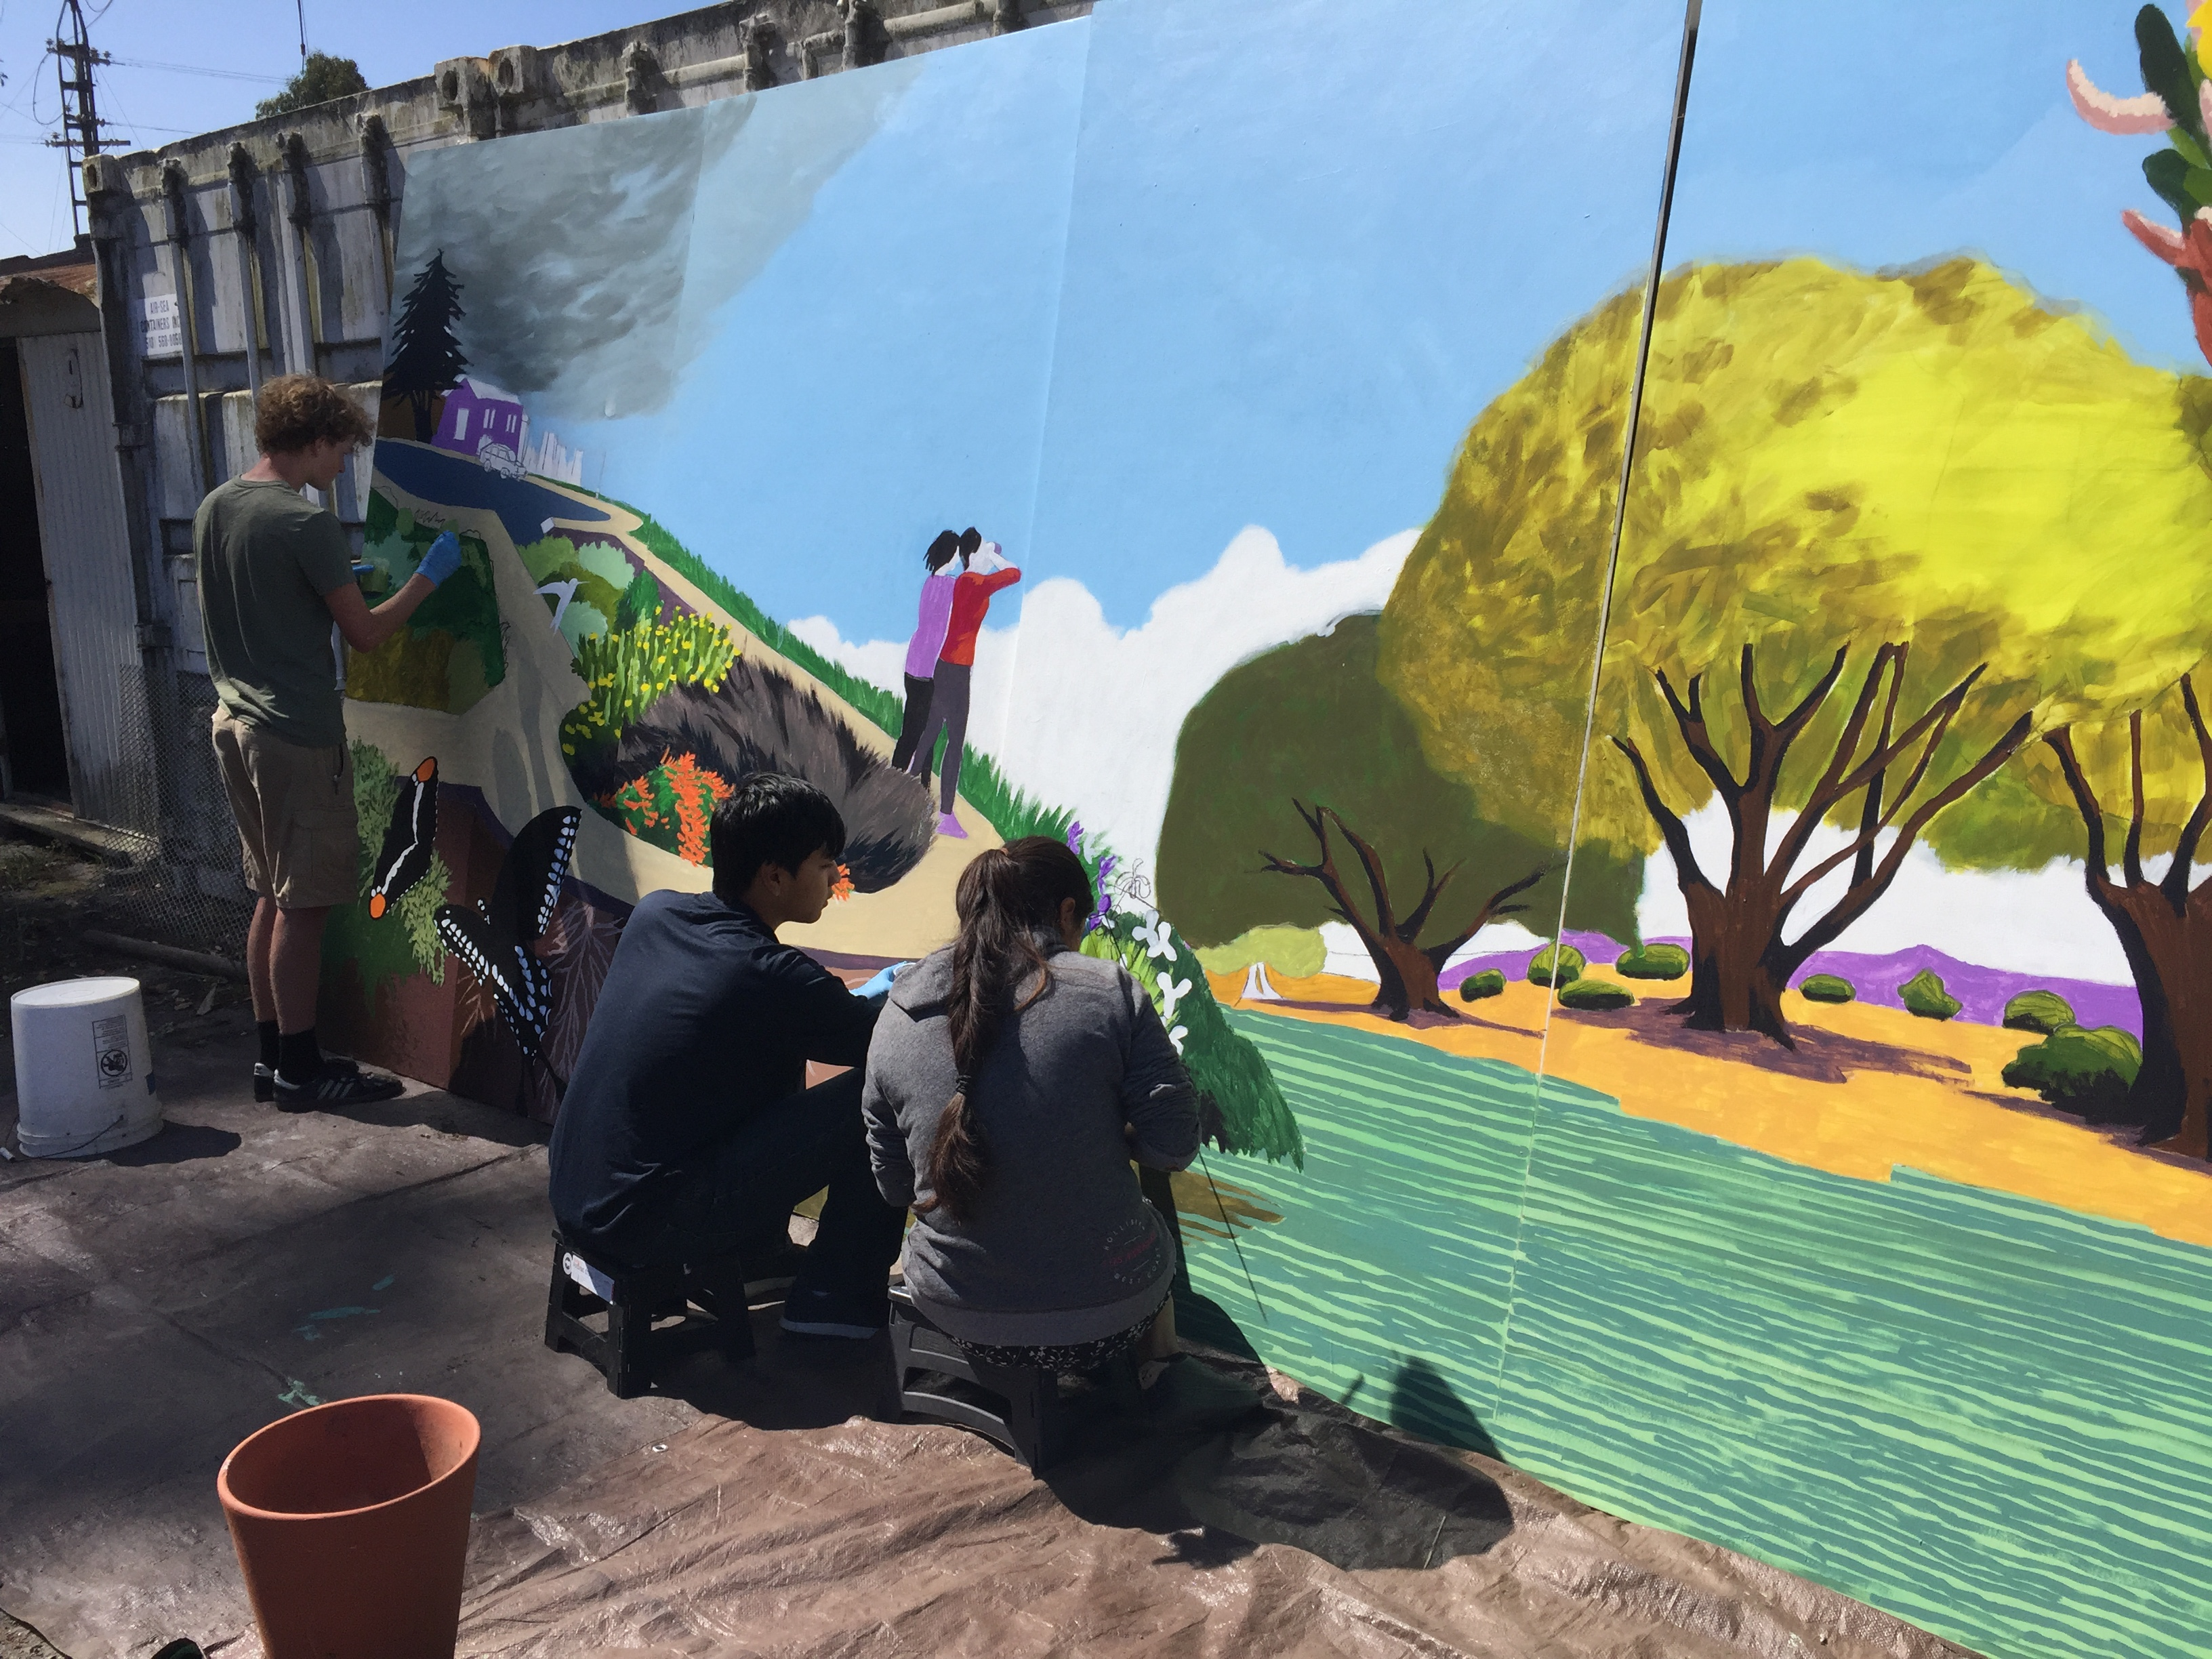
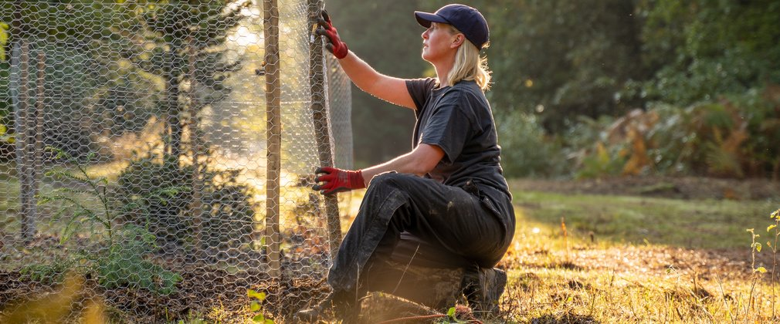
What do Green Careers look like?
Already 40,000 jobs in the Green economy and we are aiming for 2 million by 2030
27% of jobs are reported to already include Green elements
We need STEM skills but also People skills and Transformative capacities
Notes:
Lots of jobs already have green skills within them and the workforce coming through (YOU) need to able to show these too.
Lots of people think it just relates to STEM skills but we need people willing to communicate ideas to bring people along on the journey and we need people willing to disrupt and organise collective action.
Sustainability is going to be an important part of all our jobs – whether it is reducing waste or making positive changes.

Slide 9
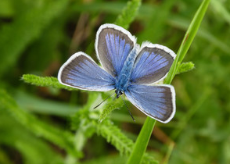
Every subject links to Green Careers
Subject: | Maths and Science
Skills | Understanding and interpreting data, Ecology principles, Technical understanding
Career examples | Biodiversity Officer, Climate Change Officer, Research and Evidence Officer
Biodiversity Officer
This role works with local organisations to support them to restore and protect Chalk Grassland.
On one project, an incredible 34 species of butterfly were recorded in an ecological survey, making it one of the best sites in Britain for biodiversity.

Slide 10
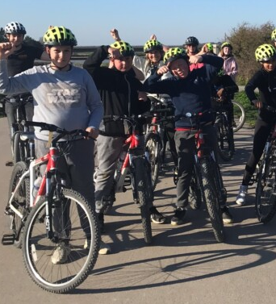
Every subject links to Green Careers
Subject: | Sports
Skills | Encouraging Active Travel Reduction of waste in sporting events
Career examples | Health and Wellbeing Officer Cycling Officer
Health and Well-being Officer
In this role, the H&WB officer can take their own love of the outdoors and share it with others. They aim to remove barriers for those that find accessing green spaces tricky.

Slide 11
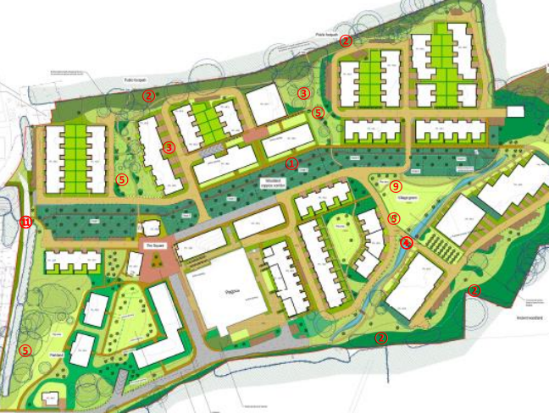
Every subject links to Green Careers
Subject: | Geography
Skills | Modelling and understanding processes, Interpreting data Decision making
Career examples | Planning Officers, Landscape specialists
Planning Officers
This role supports the sustainable development of landscapes within the National Park. Here they balanced 210 new homes being built whilst protecting ancient woodlands, restoring streams and using local building materials.

Slide 12
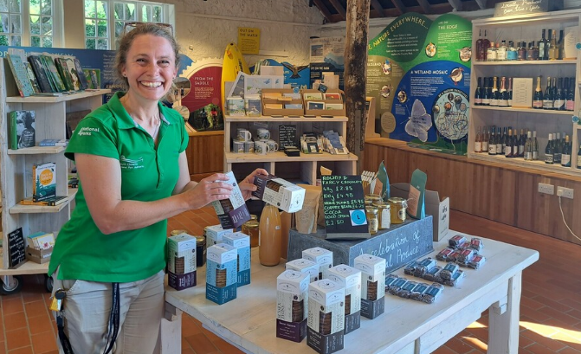
Every subject links to Green Careers
Subject: | Business studies
Skills | How to be sustainable in business practise, Psychology of consumers
Career examples | Country Park Visitor Experience Manager, Sustainable Tourism Officer
Visitor Experience Manager
This role needs to balance making enough money to keep the park open whilst ensuring the human impact isn’t affecting the special qualities of the landscape.
One small step they have taken is sourcing local produce for the visitor shop.

Slide 13
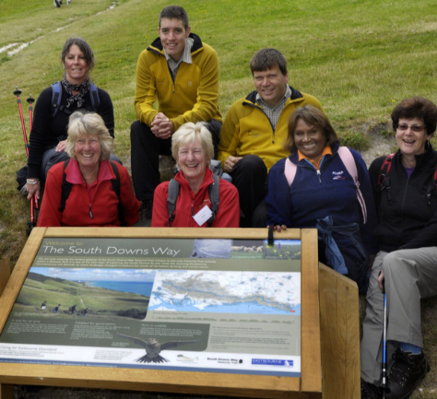
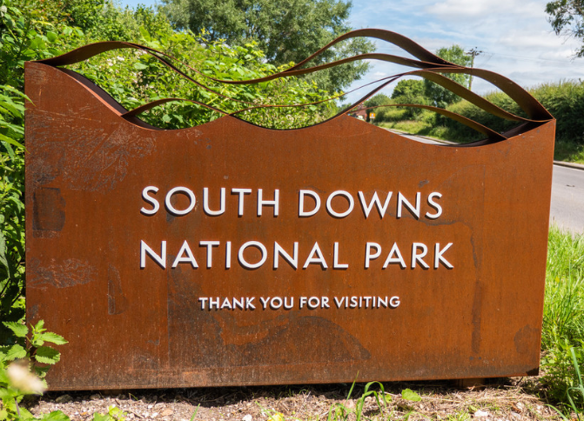
Every subject links to Green Careers
Subject: | Art/ English
Skills | Marketing of sustainability issues, Bringing attention to critical issues Inspiring people to make positive change.
Career examples | Communication Officer, Press Office, Interpretation Officer, Social Media Officer, Education Officer, Heritage Lead
Interpretation Officer
They design anything associate with a National Park. From the branding on this slide, to the signs you see welcoming you to the National Park, to the audio guides you can listen to around the park.

Slide 14
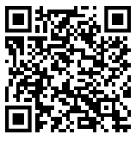
How to get started in Green Careers:
Take action for our planet!
Gain experiences for applications and jobs in the future.

