Slide 1
Discover the Dark Side of the Downs
Amanda Elmes and Jonathan Dean
CLICK TO ADVANCE THIS SLIDE
All other slides will:
advance automatically, or
prompt you to click

Slide 2
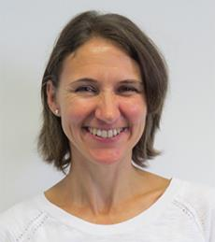


Amanda Elmes
Learning, Outreach and Volunteer Lead
Jonathan Dean
Education Officer
Notes:
AMANDA: Hello, I’m Amanda Elmes, I work at the South Downs National Park Authority and part of my job is to give talks and presentations to people to help them understand more about the South Downs National Park and the International Dark Sky Reserve.
JONATHAN: I’m Jonathan Dean, I work with Amanda and as part of my job, I help Amanda with presentations and I also visit lots of schools across Hampshire and Sussex to tell them all about the National Park.

Slide 3
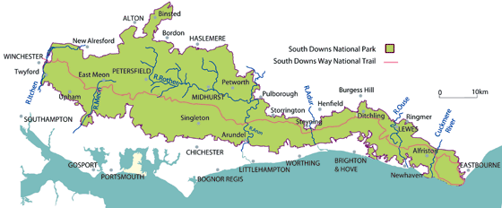
Map of the South Downs National Park
Notes:
JONATHAN: This is the South Downs National Park, everything on the map that’s green is the Park. It is a huge area, over 1,600 kmsq. If you walked along the South Downs Way, the red line running through the middle of the Park, it would take around one week, as it is 100 miles long.
Can you find a place name you recognise? Is it inside or outside the National Park? Where do you live? Are you inside or outside the National Park? You might have to make an educated guess if the name of your home town isn’t on the map.
Once you think you know the answer, click on to the next slide.

Slide 4
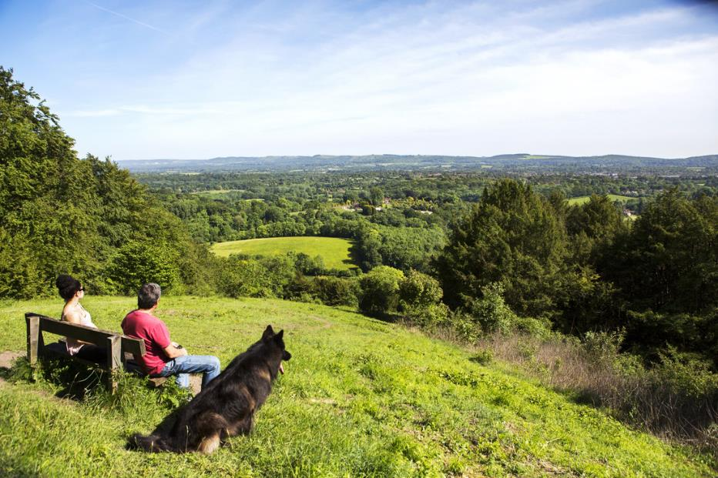
Shoulder of Mutton Hill, near Petersfield
Notes:
JONATHAN: This is one of my favourite places, Shoulder of Mutton Hill, inside the Park, near Petersfield. I like to sit on the ground and feel the grass run through my fingers. Can you name one thing you like about the view and one thing you’d like to do if you were there?
Once you’ve had a think, click to the next slide.

Slide 5
Map of the South Downs National Park
Notes:
JONATHAN: Shoulder of Mutton Hill is near Petersfield, can you find Petersfield on the map? Remember, it’s inside the National Park.
Once you’ve found it, click on to the next slide.

Slide 6
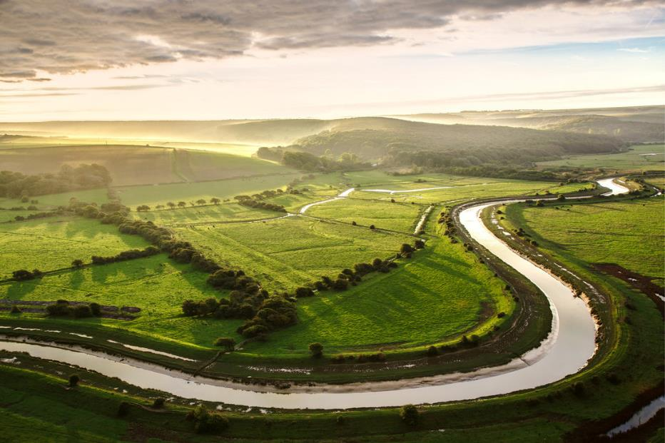
Cuckmere Haven
Notes:
AMANDA: This is one of my favourite places, Cuckmere Haven, very close to the mouth of the Cuckmere River, where it flows into the sea. I like to sit on the hillside overlooking the meanders in the river and the breeze blowing in from the coast, I find it really relaxing. Can you name one thing you like about the view and one thing you’d like to do if you were there?
After you’ve had a think, click on to the next slide.

Slide 7
Map of the South Downs National Park
Notes:
AMANDA: Cuckmere Haven was near the mouth of the Cuckmere River, where it flows into the sea, can you find it on the map? Rivers are usually blue, wiggly lines on a map.
If you’ve found it, click on to the next slide.

Slide 8
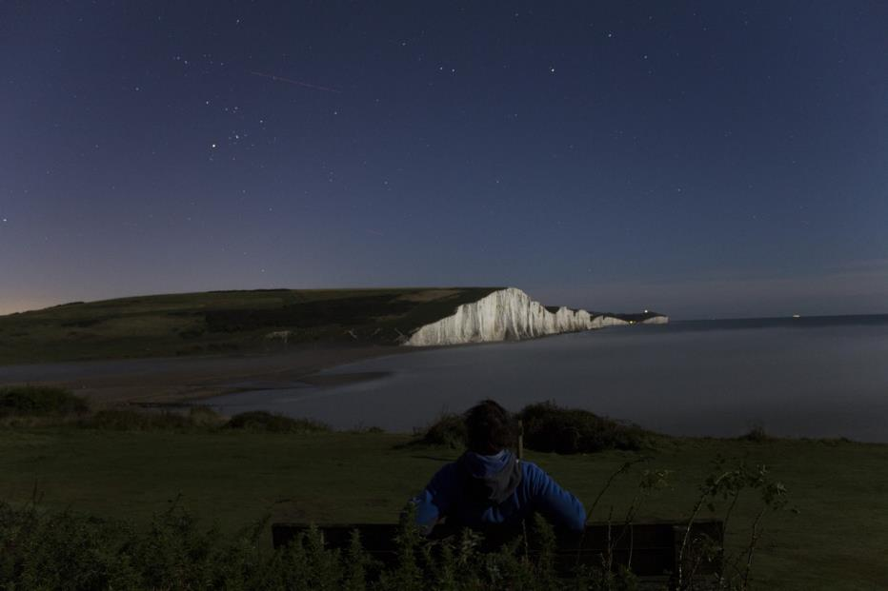
Seven Sisters cliffs at Cuckmere Haven
Notes:
AMANDA: This is at Cuckmere Haven, right on the edge of the land, looking across the mouth of the river at the Seven Sisters Cliffs. Click onto the next slide for a different view at Cuckmere Haven.

Slide 9
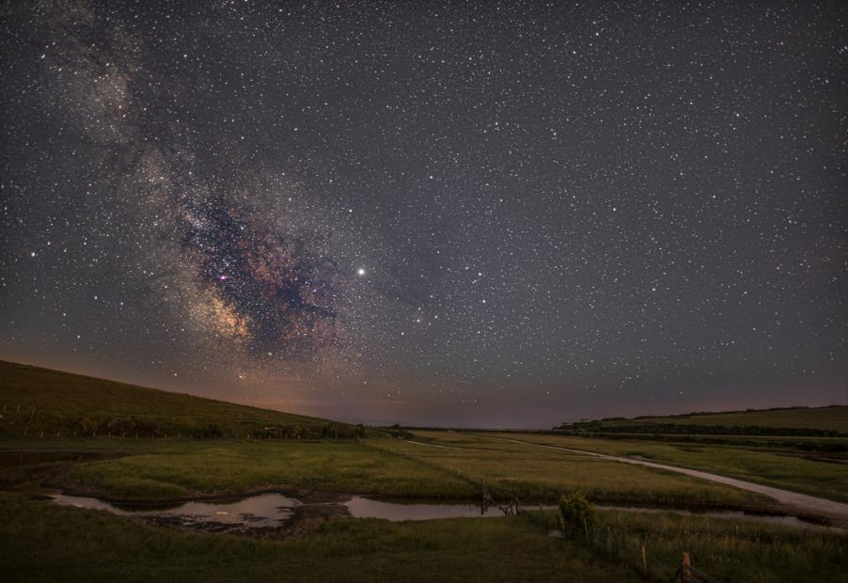
Seven Sisters Country Park at Cuckmere Haven
Notes:
JONATHAN: This is in the valley of Cuckmere Haven, looking out to sea. Because the sky is really dark at night in Cuckmere Haven, you can see the Milky Way galaxy. It is the wide band of bright light going across the sky. In this picture it starts in the top left corner and goes down at an angle. If you went to Cuckmere Haven at different times of year and at different times of night, you would see the Milky Way at a different angle. This is because the Earth is spinning around on its axis and it is rotating around the sun.

Slide 10
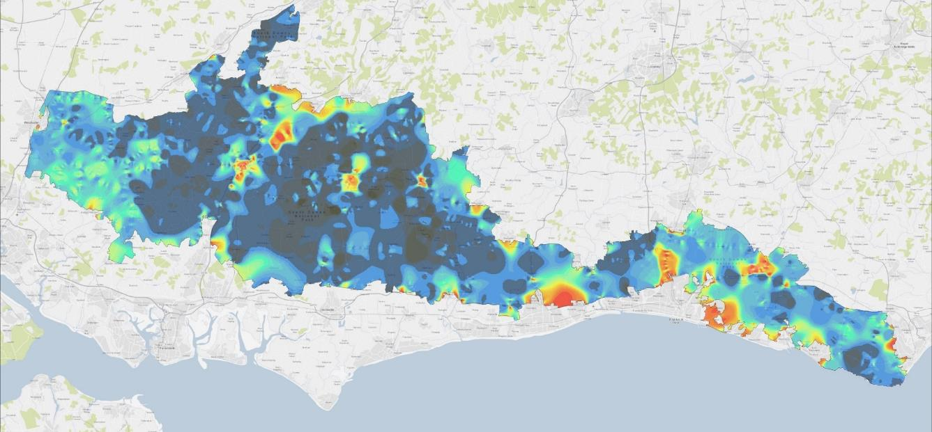
Map of the South Downs National Park
Notes:
JONATHAN: Oh, this is a different map of the South Downs National Park. Instead of being green, with the place names and the rivers labelled, there are a range of different colours on the map. I wonder what the colours mean, perhaps you could explain Amanda?

Slide 11
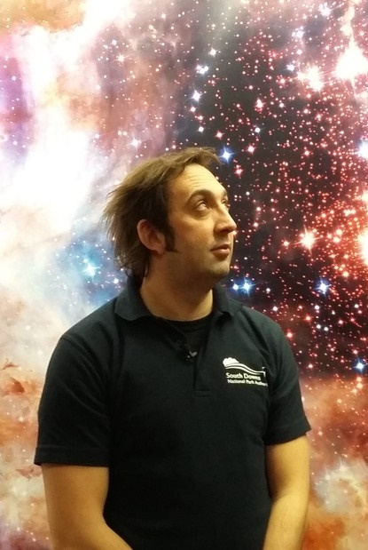
Map of the South Downs National Park
Dan Oakley
“Dark Skies Dan”
Notes:
AMANDA: I certainly can. But before I can explain the colours, I have to introduce Dan Oakley. He is a ranger in the National Park and he loves spending time in the National Park at night. He took the photos we’ve just seen at Cuckmere Haven and Seven Sisters and he loves it when he can see lots of objects in the night sky.

Slide 12
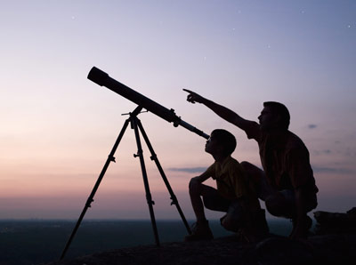
Stargazing
Can you think of five things you might see if you looked up into the sky at night?
Notes:
AMANDA: Dan used the word objects, because there are more things than just stars in the sky at night. Can you think of five things you might see in the night sky? Make a list before advancing to the next slide.

Slide 13
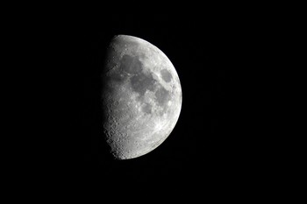
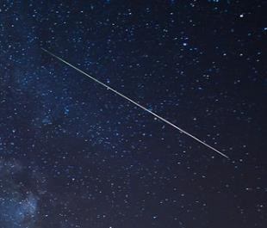
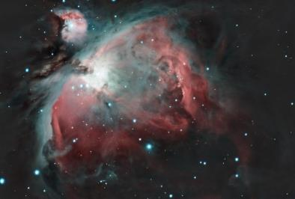
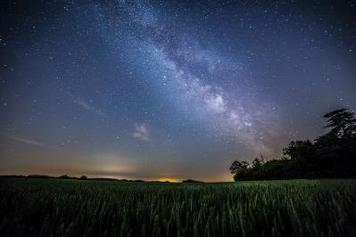
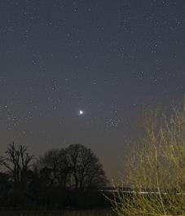
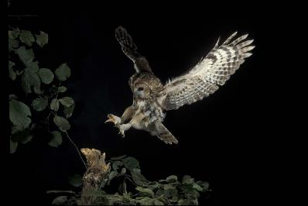
Stargazing
Notes:
AMANDA: Here are some we thought of, but there are lots more.
The moon, a large lump of rock which orbits planet earth.
Shooting stars, they are smaller lumps of rock called meteors and they burn up as they enter the earth’s atmosphere, leaving a trail of light behind them for just a split second.
Orion’s Nebula, you would need a telescope to see it like this. It is a cloud of dust and gas over 1,300 light years away from earth. With your naked eye it appears as a bright dot, like a star.
The Milky Way, notice how the angle is slightly different to the way we saw it at Cuckmere Haven, this photo must have been taken at a different time of year.
Planets, this is Venus, the bright point of light just above the tree. It is visible during Spring when looking to the west.
A tawny owl, or any kind of owl really! These are much closer than the other objects and we’ll talk more about wildlife later.
But now, lets advance the slide and get back to that map, and try to work out why it has all those funny colours!

Slide 14
Map of the South Downs National Park
Dan Oakley
“Dark Skies Dan”
Notes:
AMANDA: We know Dan liked spotting all these objects and he loved taking photos of them. But, depending on where he went in the Park and when he took his photos, Dan found that sometimes he could see lots of objects and sometimes he couldn’t see any.

Slide 15
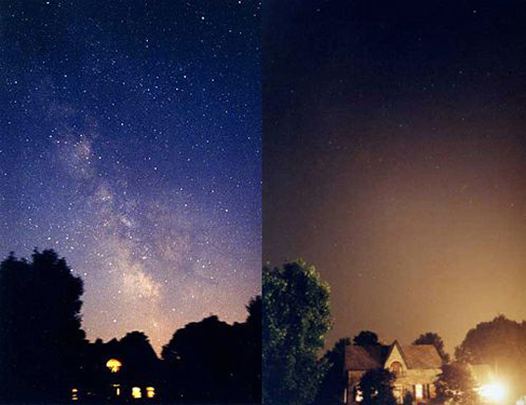
Spot the difference
Notes:
AMANDA: Dan took these two photos at the same place on different nights. He really liked his first photo, the one on the left, so he went back a few weeks later to take another photo, but the second one turned out quite differently. Can you spot at least three differences between these two images?
Once you’ve got at least three, advance to the next slide.

Slide 16
Spot the difference
Notes:
AMANDA: What did you spot? Here’s what we thought.
You can see the Milky Way in the left-hand picture and there are lots of stars visible in the sky in the left hand picture, but not in the right.
In the right-hand picture there is a strange yellow glow in the sky, we think it might be coming from this spotlight near the ground.
The spotlight has also lit up the trees and the building, which we could only see a silhouette of in the left-hand picture

Slide 17
Map of the South Downs National Park
Notes:
AMANDA: Dan thought that this might be happening on a much bigger scale so he went up onto the Downs at night, roughly where the green arrow is, and he took a picture looking south. What do you think the picture might show? Go to the next slide to find out.

Slide 18
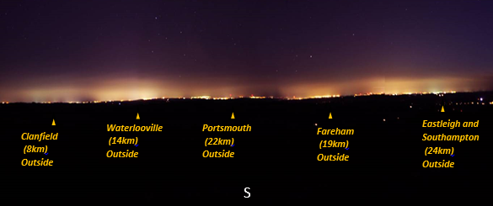
A view of all the “red” areas
Notes:
AMANDA: Dan’s suspicions were correct, there was the same yellow glow coming from all the towns and cities, the bigger the town or city, the bigger the glow.

Slide 19
Map of the South Downs National Park
Dan Oakley
“Dark Skies Dan”
Notes:
AMANDA: Dan knew there were other people like him who liked stargazing, and he wanted to help them find the best spots to stargaze and take photos, so he took a light meter around the Park with him to measure how much light there was at night.
Now I’ve told you all that, maybe you can help Jonathan. What do you think the colours on the map are showing? Once you’ve had a think, move to the next slide to find out the answer.

Slide 20
Map of the South Downs National Park
Dark blue – very dark at night, lots of stars are visible
Red – bright at night, very few stars are visible
Notes:
AMANDA: Well done if you got it right. The best places to see lots of stars are the parts of the map where it is dark blue, the red bits will have lots of yellow glow in the sky and not many stars.

Slide 21
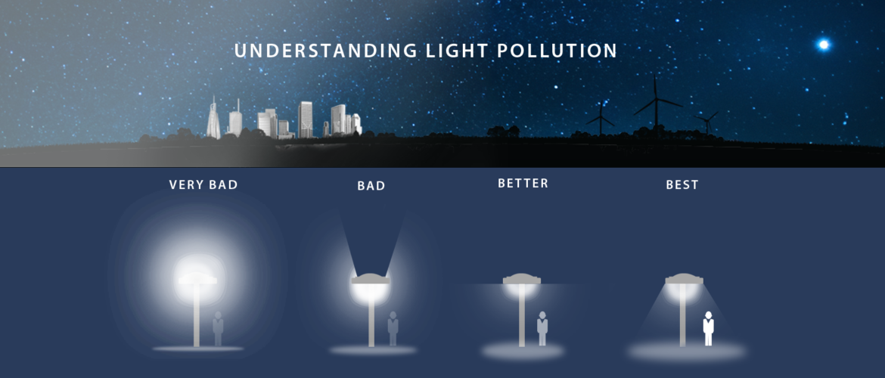
Understanding light pollution
Notes:
AMANDA: This phenomenon is called light pollution. It is caused by lights that don’t point in the right direction. We need some lights at night for our roads and streets, but some lights are better than others. The best lights to reduce light pollution have a cap or cover on them. This makes sure that the light only points at the ground and not into the sky. If you can see the side of a tall building, or the leaves at the top of a big tree, there must be some bad lighting around.

Slide 22

International Dark Sky Reserve
Dark Skies are fabulous for:
Stargazing
Helping nocturnal wildlife
In May 2016 the South Downs became an International Dark Sky Reserve. The aim is:
More dark blue on the map
Less red
Notes:
AMANDA: Dan wanted there to be more places for people to enjoy stargazing. So he wrote to the International Dark Sky Association and told them all about his plans for the South Downs. He had to prove to them he was going to work very hard to reduce the light pollution and improve the skies for people and wildlife. In May 2016, the International Dark Sky Association granted the status of International Dark Sky Reserve. This has been a huge help to Dan and he was really pleased, as it helps him explain to people what he is trying to do.

Slide 23
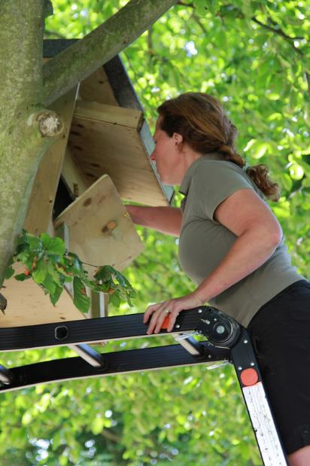
Map of the South Downs National Park
Nocturnal
Angela Ward
Ranger
Notes:
JONATHAN: Another person who was really pleased about this was Angela. She is really passionate about caring for wildlife. Do you care about animals? Can you think of a time when you have done something to care for wildlife?
Angela is particularly fond of owls, which are nocturnal. Do you know what a nocturnal animal is?
This might be a new word to you. Nocturnal means an animal that is active at night, and it will usually sleep during the day. In this picture, Angela is installing a barn owl box, to help provide a good nesting site for barn owls, which are nocturnal birds.

Slide 24
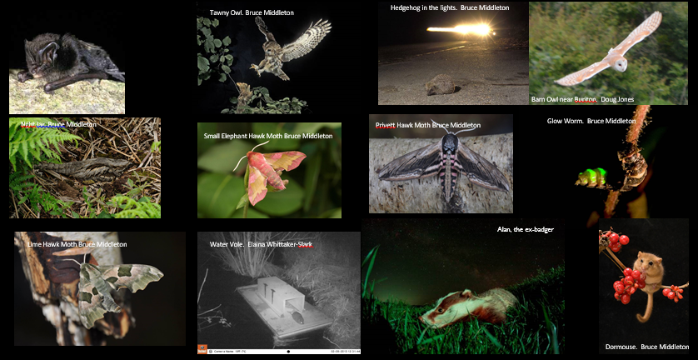
Dark skies mean lots of nocturnal wildlife
Notes:
JONATHAN: There are lots of nocturnal animals that live in the UK and in the South Downs National Park. How many of these nocturnal animals have you seen before? Have you seen them in videos, in zoos, or in the wild?
Once you’ve had a think, click to the next slide.

Slide 25
Which animal makes this noise?
Notes:
JONATHAN: It is often very difficult to see nocturnal animals, because it is dark when they come out! But, we do hear them quite a lot. Which of these animals do you think makes this noise? If you want to listen again, click play on the speaker icon. Once you’ve listened and had a think, advance to the next slide to find out.

Slide 26
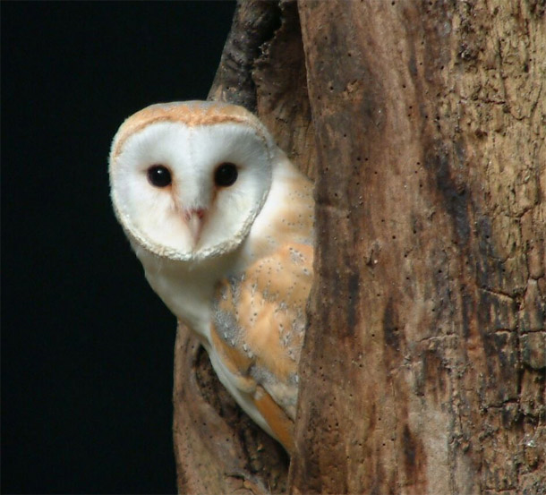
Barn owl
They eat rodents, rabbits, moles, bats, frogs and small birds.
They use exceptional hearing to stalk their prey
They have really soft feathers for silent flight so the prey doesn’t hear them swooping in
LIGHT POLLUTION EFFECT
Prey sees them coming and hides
They don’t get any food
Notes:
JONATHAN: Well done if you knew it, or guessed correctly, it is a barn owl. That call is a screech (sometimes they are known as screech owls) and the owls use that call to communicate with each other. I have been lucky enough to see a barn owl up close at a show, and I have also seen one flying alongside a lane at dusk. It was magical to see it’s white outline floating through the darkness.
Take a few moments to read through the facts on the slide before advancing.

Slide 27
Which animal makes this noise?
Notes:
JONATHAN: OK, let’s try another one. Which of these animals do you think makes this noise? Once you’ve listened and had a think, advance to the next slide to find out.

Slide 28
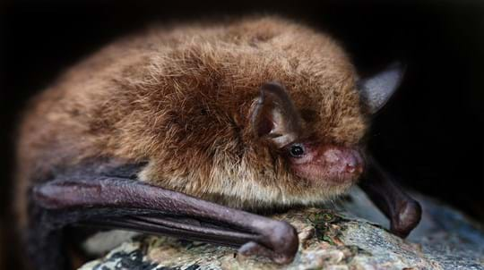
Common pipistrelle bat
They are one of 17 bats found in the UK
They eat midges, moths and other flying insects
They only fly at dusk or during the night and they use echolocation to catch their prey
LIGHT POLLUTION EFFECT
They don’t realise it is nighttime
They don’t come out to eat
Notes:
JONATHAN: Well done if you knew it, or guessed correctly. In reality, we wouldn’t actually be able to hear that noise, that recording was made with a special device which can detect the high-pitched noise of bats, which are outside of our hearing range. I had a really fun night out with the Sussex Bat Group last year at the Steyning Downland Scheme, they taught me how to use the detectors, which you have to adjust to hear the different frequencies made by the different species of bats.
Take a few moments to read through the facts on the slide before advancing.

Slide 29
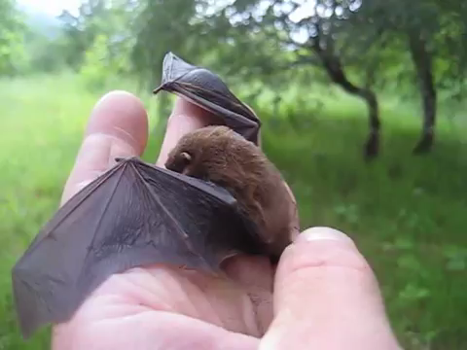
Common pipistrelle bat
Notes:
JONATHAN: This pipistrelle is being handled by a ranger with a bat handling licence. It is against the law to handle bats without a licence because they are a protected species. To get an idea of how it would feel to handle a pipistrelle bat, hold a 1p or 2p coin. This is the weight of the bat, they are light and agile so they can move around quickly in the air to catch their prey.

Slide 30
Which animal makes this noise?
Notes:
JONATHAN: OK, last one. Which of these animals do you think makes this noise? Once you’ve listened and had a think, advance to the next slide to find out.

Slide 31
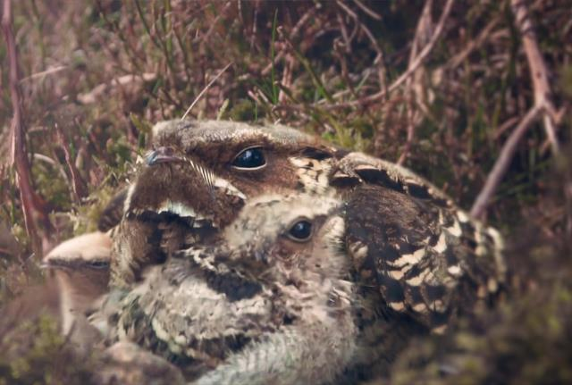
Nightjar
They migrate to the UK in summer, all the way from Africa
They build nests on the ground and are well camouflaged
They fly at dusk, hunting moths
LIGHT POLLUTION EFFECT
Their eyes are specially adapted to low light
White/Blue lights (often LEDs) discourage them from breeding
Notes:
JONATHAN: That was a very rare bird, called a nightjar. These birds are just other-worldy. When I’ve been out on heathland at night, hearing these churring calls echoing from the pine trees across open heath is quite spooky. The males also make a clapping noise by hitting their wingtips together above their heads, and they do this to protect their territory from other males.
Take a few moments to read through the facts on the slide before advancing.

Slide 32
What have we learned?
Give at least one reason why Dark Skies are important.
Explain why the sky isn’t always dark at night.
Do you think there is anything you can do to help dark skies?
  Advance to the last slide for more ideas
Notes:
JONATHAN: Well done, you’ve started your journey to becoming a Dark Skies Explorer. Take a few moments to think about the answers to these questions before advancing to the next slide to find out what you can do next to help look after wildlife and our Dark Skies.

Slide 33

How can you help wildlife and dark skies?
Check your outdoor lighting. Is it really needed? If not, turn it off. If it is, make sure it’s fully shielded so light is directed down to the ground
Buy lamps under 500 lumens to reduce light pollution and buy bulbs with less blue light in them
Plant paler, night-scented flowers to attract night-time insects
Install a bat box on a tree in your garden or school grounds
Spread the word! Tell your family, friends and neighbours about why dark sky friendly lighting is important. The more people that know, the better protected our dark skies will be.
Notes:
AMANDA: Thank you very much for learning about dark night skies with us, we hope this is the start of your journey to becoming a dark skies explorer. Keep an eye on our website and subscribe to our newsletter for information about our events, including our Dark Skies Festival, which usually runs in February each year.
Follow the link in our final slide for more information.

Slide 34
www.southdowns.gov.uk/dark-night-skies
to find out more

