Slide 1
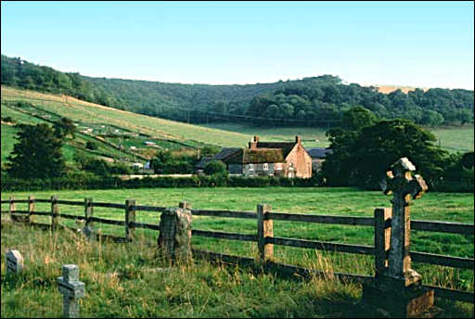

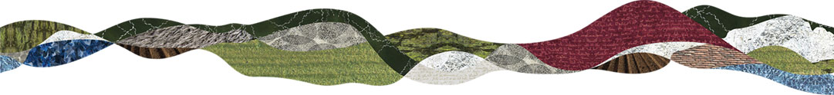
Sue Chalkley
Chief Executive
South Downs Landowners’ Conference

Slide 2
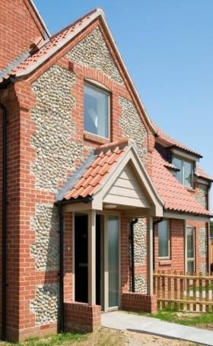
Contents
The national rural housing context
The rural community led development model
Looking forward?
Some examples of community led rural housing

Slide 3
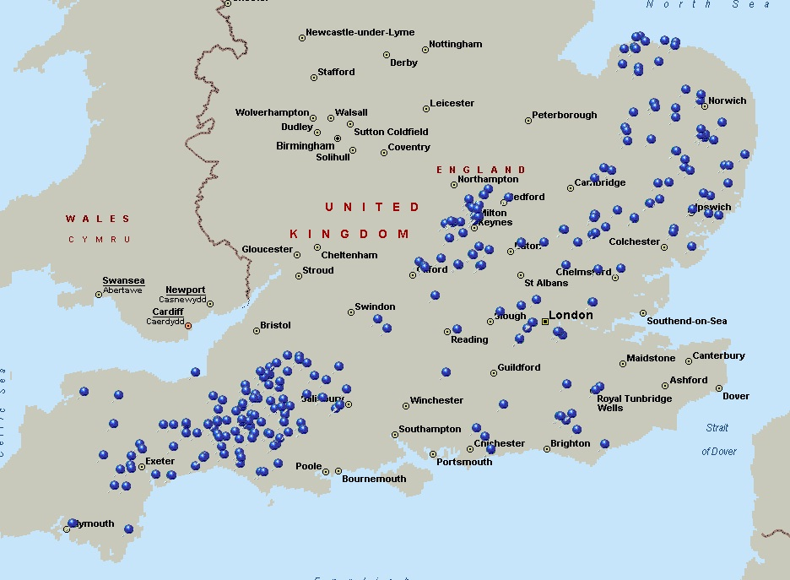
About Hastoe
Established in 1962
Rural housing specialist
Working in more than 250 villages
Approx 7,500 homes
Hampshire Village Homes

Slide 4

A partnership of 5 housing providers:
  Hastoe Housing Association
  English Rural Housing Association
  New Forest Villages
  PHA Homes
  Winchester Housing Trust
Partnership with Hampshire Alliance for Rural Affordable Homes (HARAH)
Building new affordable homes
for local people in rural Hampshire

Slide 5
1. The national rural housing context

Slide 6
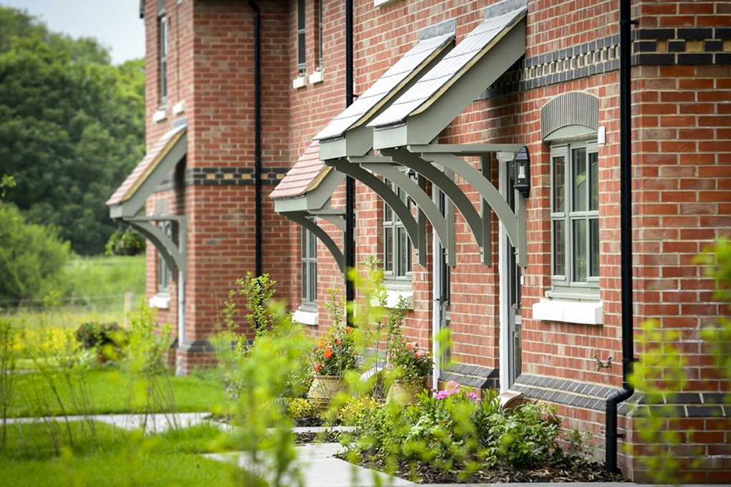
Affordable housing
Housing affordability gap is greater
  Average prices are 26% higher than urban
  Local earnings are consistently lower by avg £7,600pa
More workers need to live locally:
  Poor public transport
  Portfolio of part time and seasonal work
Affordable housing is in lower supply:
  8% is affordable compared to 20% in urban
  Was 24% in 1980s
Great Kimble, Bucks
Notes:
this includes schools, care organisations, the farming industry, the racing industry and many more rural businesses large and small. This was a particular point raised by the previous government Future of Farming Review chaired by David Fursdon.

Slide 7
Housing affordability ratios
Inward migration
Second home ownership
Holiday lets squeezing out rental market

Slide 8
A shortage of homes in the National Park

Slide 9
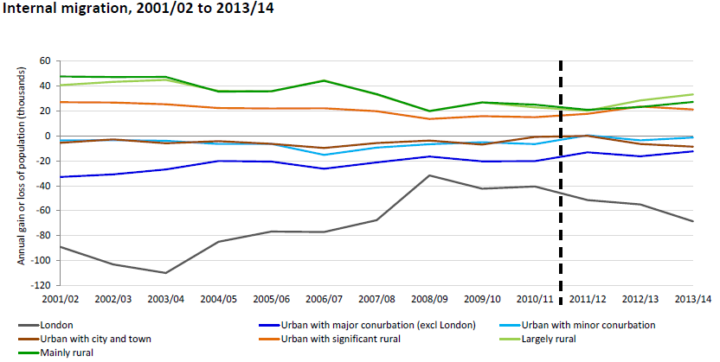
Inward migration of approx 50,000 pa (net)

Slide 10
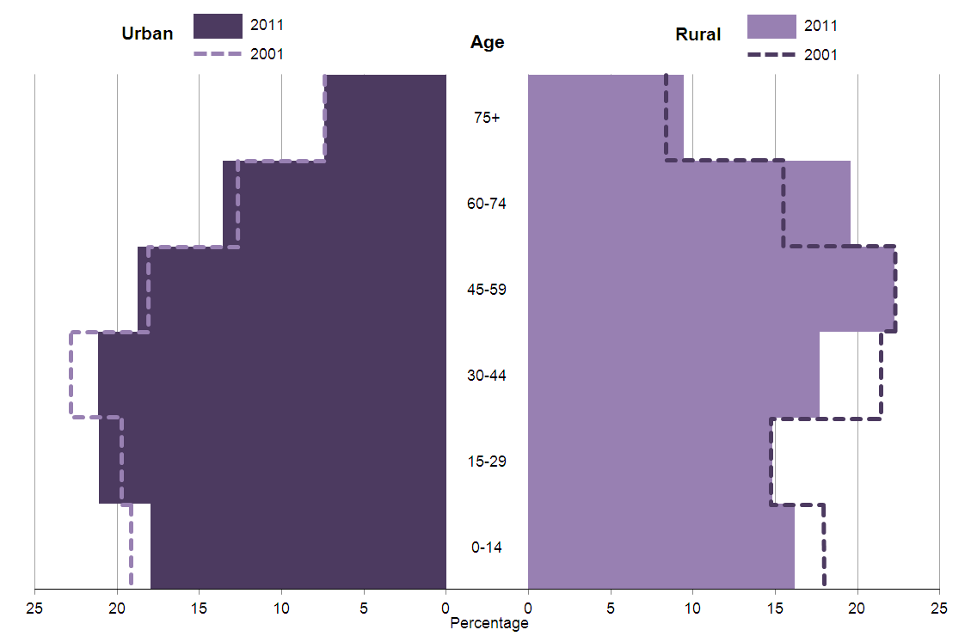
Young families moving away.
Population growing older.
Ten years, 2001-2011, median age rose from:
  42 to 45 yrs (rural)
  36 to 37 yrs (urban)
Notes:
Older people 50%+aged 45 and above, compared with around 40 per cent in urban areas

Slide 11
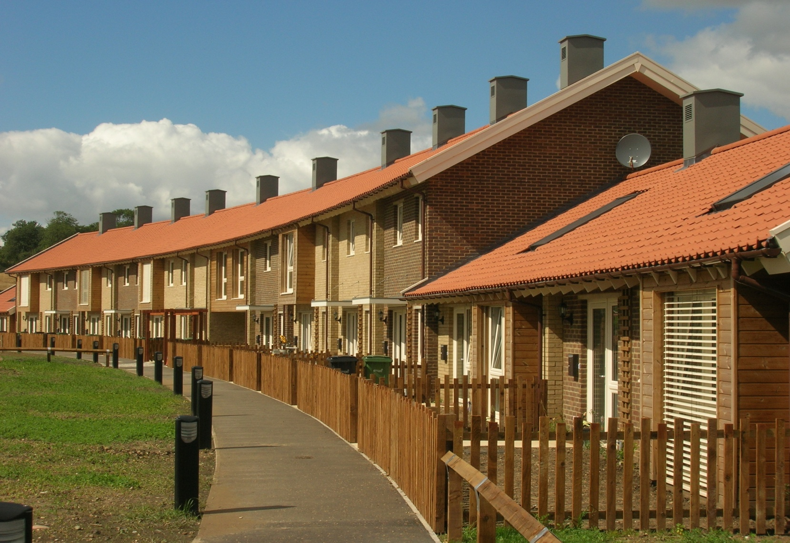
Rural is RURAL (not a small version of urban)
Often:
fewer landowners
landowners are prepared to be generous for their community
development is led or supported by community
Ditchingham, Norfolk
Passivhaus
Notes:
this includes schools, care organisations, the farming industry, the racing industry and many more rural businesses large and small. This was a particular point raised by the previous government Future of Farming Review chaired by David Fursdon.

Slide 12
Greg Clark’s speech at the LGA conference 2015
“The basic condition of a community is that successive generations of that community should be able to live there. Otherwise they are, in effect, exiled. Exiled from their families, exiled from their roots and their shared history, exiled from each other.
... in many parts of our country it has become normal for young people to leave, though not out of choice. This might be to find work, but more-and-more it is to find a home they can afford.
If we want to maintain the chain of community – and a place for the next generation – then we must make sure we have the homes to welcome them to.”

Slide 13
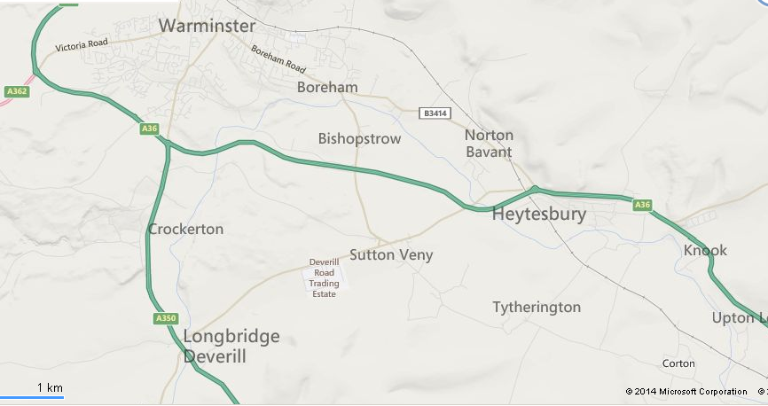
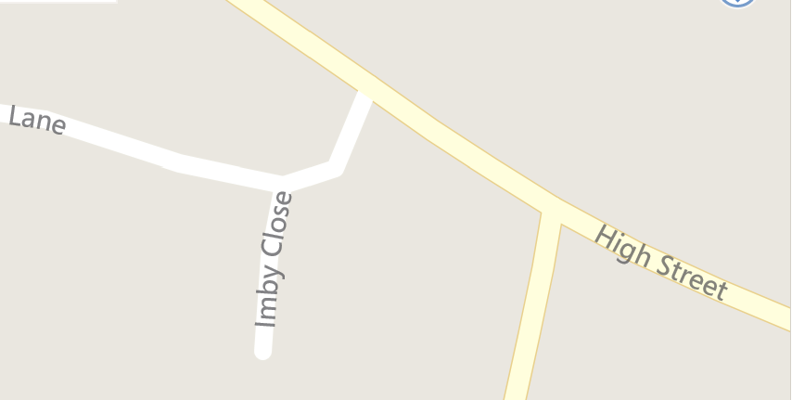
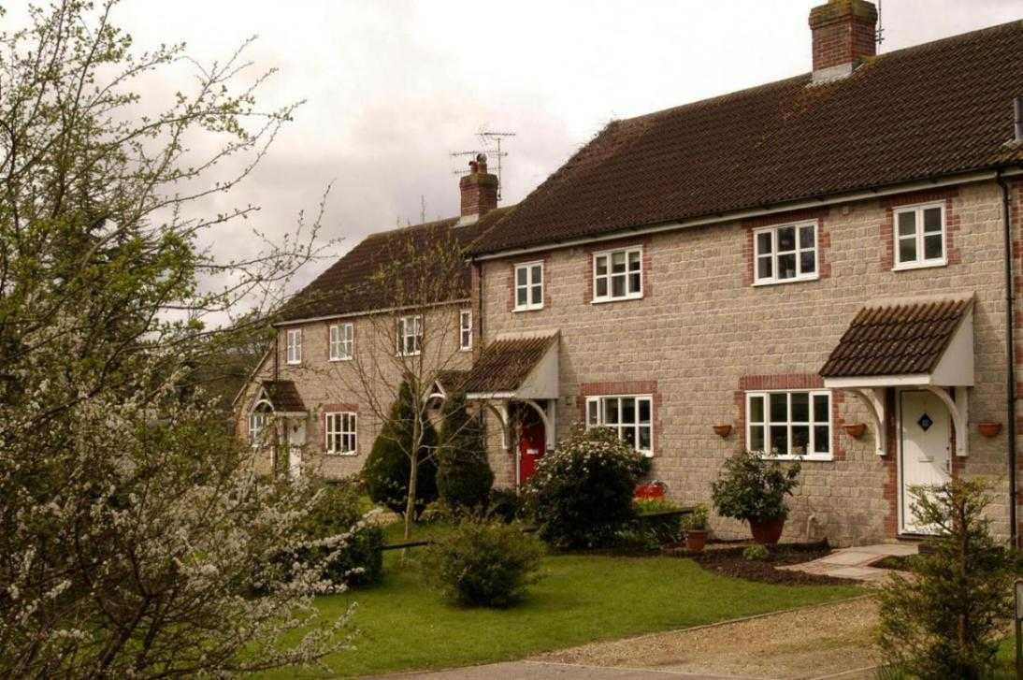
Emergence of the Imby!
Imby Close, Sutton Veny, Wiltshire
Top of its category in CPRE's Best Kept Village Award 2014

Slide 14
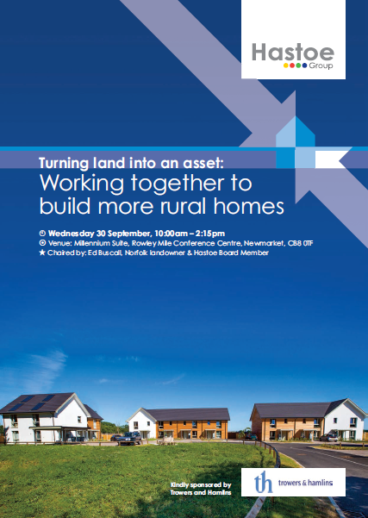
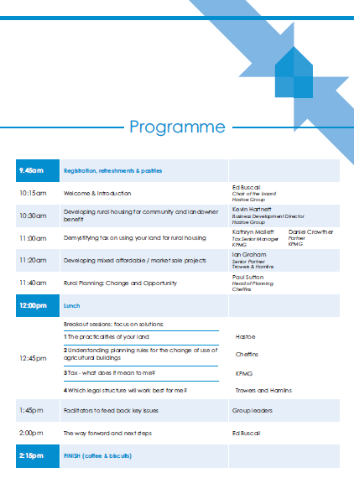
Newmarket September 2015

Slide 15
An awakening!
Much interest in development but, not now, because cautious about:
Working with major developers:
  Legacy
  Control
  Quality
Local reputation and relationship with community (long memories)
Planning process and housing construction
Future without EU CAP subsidies?

Slide 16
House building completions since 1949
Could rural landowners be part of the solution to our national housing crisis?
Source: CLG data
(now discontinued)

Slide 17
2. The rural community led development model

Slide 18
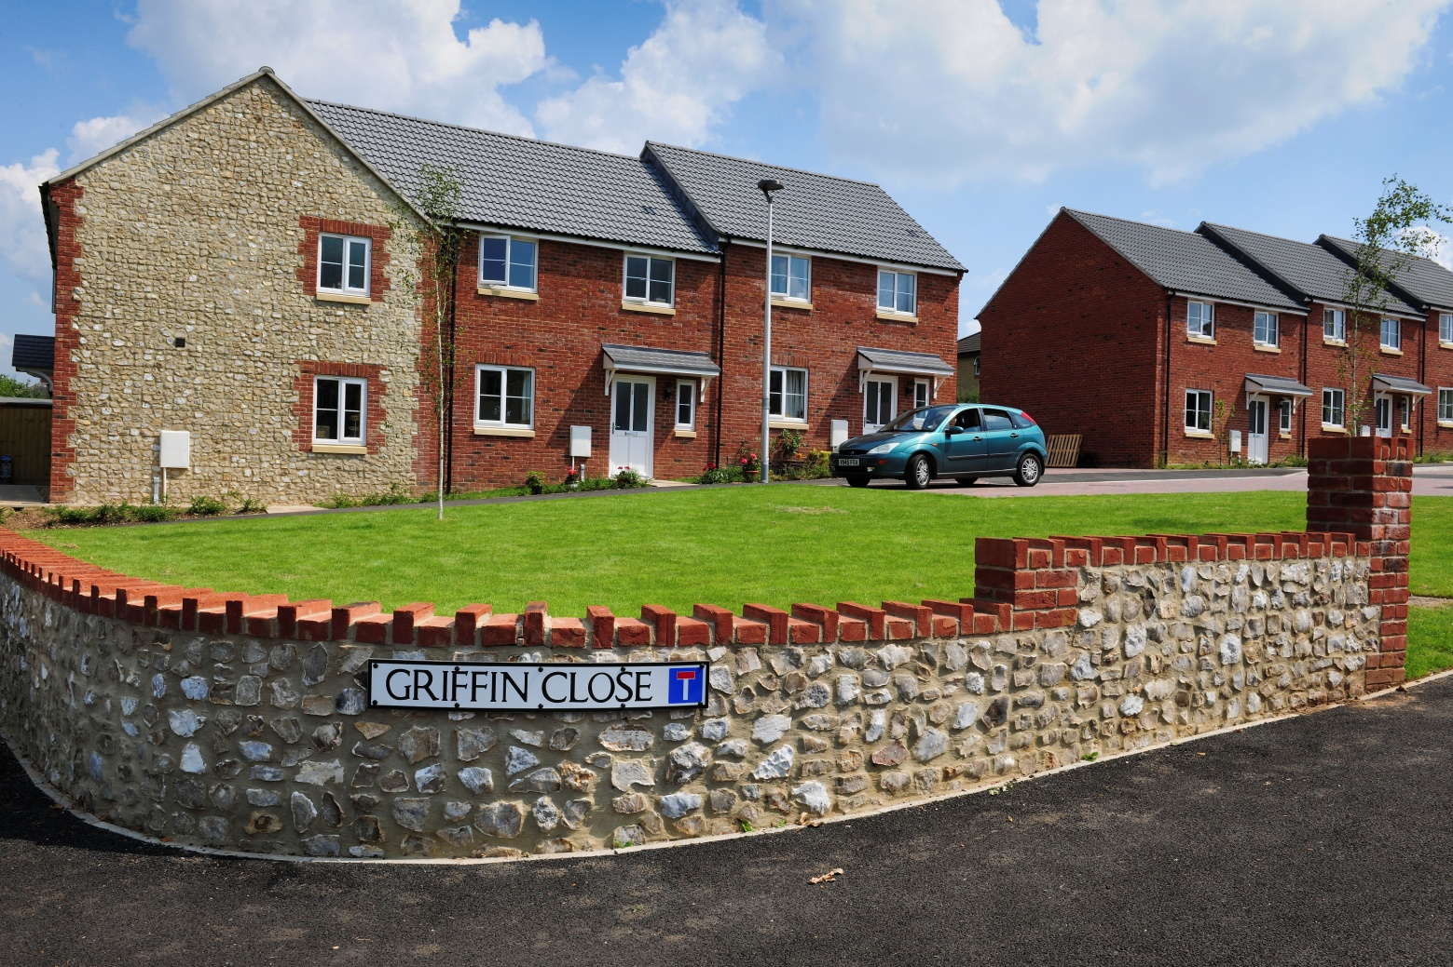
The rural community led development model
1. Community identifies need and asks for assistance
2. Needs assessment and site options appraisals
3. Iterative design process in partnership with community
4. Planning and construction
5. Scheme opening. Neighbouring communities ask for help too
Hemyock, Devon

Slide 19
Rural housing associations’ pledge
Work closely with the local community and Parish Council to find the right site
Always give qualifying local people in housing need first priority for every home
Ensure that affordable homes always remain affordable
Build sensitively designed, high quality homes to high environmental standards
Provide good quality and locally sensitive management services to our residents
Always respond positively to the local community

Slide 20
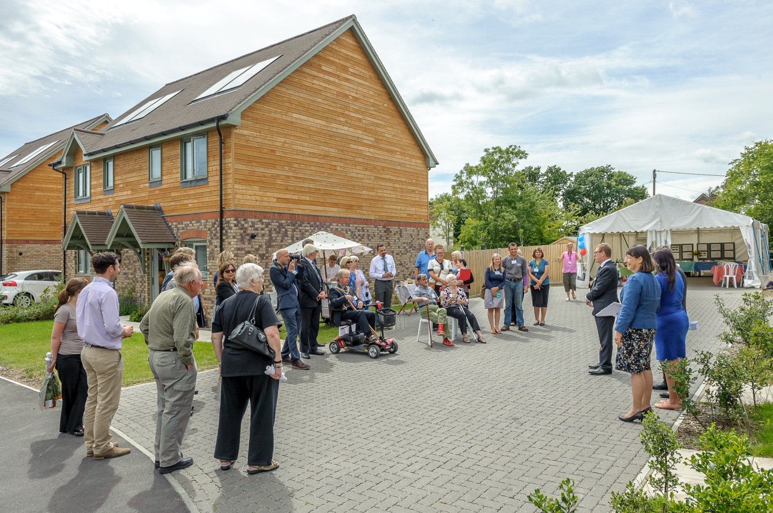
Scheme opening, Hailsham, East Sussex

Slide 21
Community Land Trusts
Established to further the social, economic and environmental interests of a local community by acquiring and managing land and other assets in order to:
  provide a benefit to the local community and/or
  ensure that the assets are not sold or developed except in a manner which the trust's members think benefits the local community.
Surpluses must be used to benefit the local community
Individuals who live or work in the community must have opportunity to be members

Slide 22
Hemyock CLT (Devon) in partnership with Hastoe

Slide 23
3. Looking forward?

Slide 24
A more encouraging environment?
Grant for rented homes
Community Housing Fund:
  Rural and coastal communities
  High proportion of second home ownership
  Administered by local authorities
Housing White Paper

Slide 25
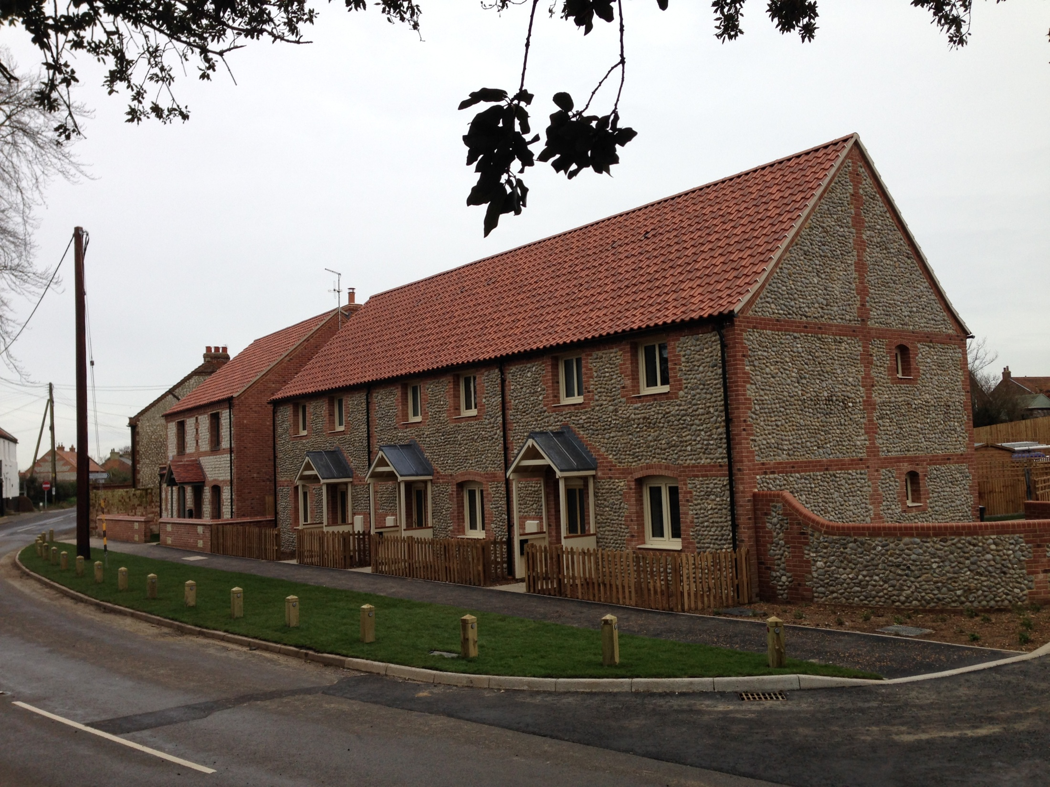
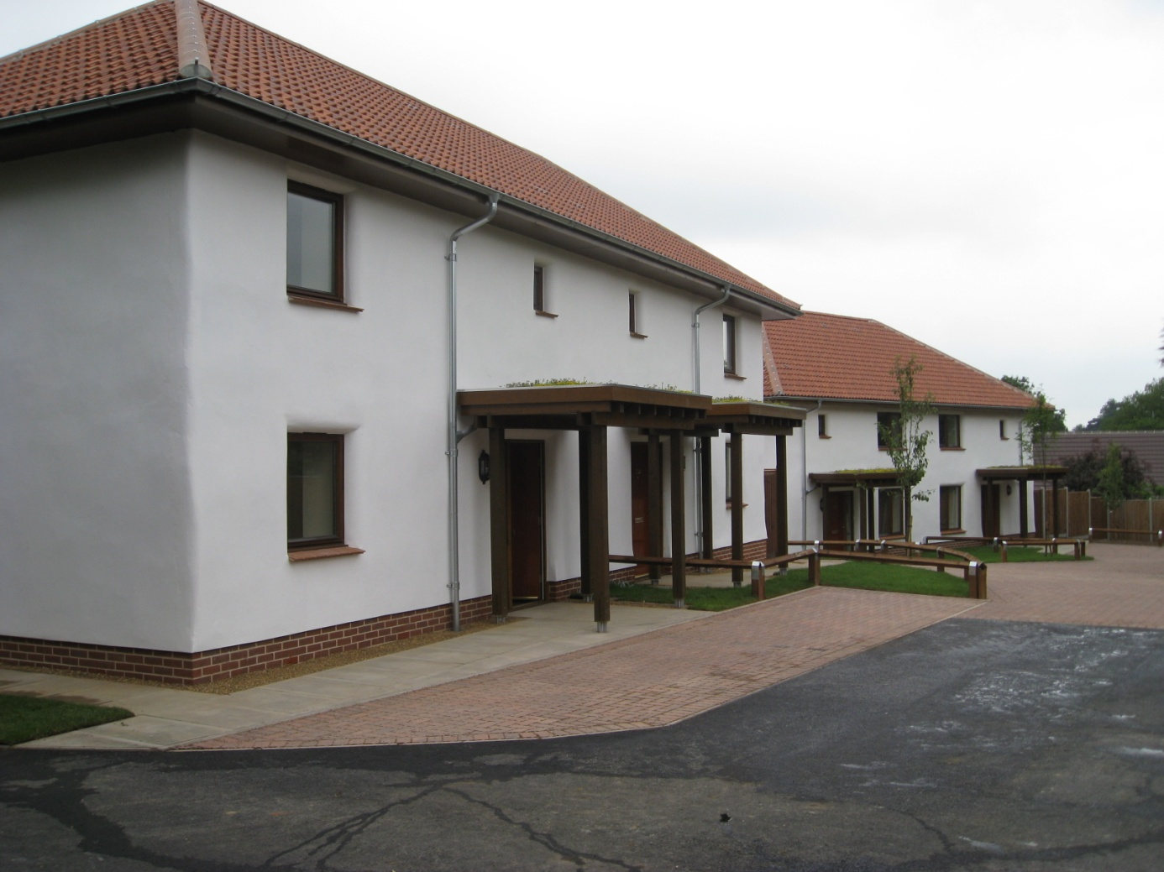
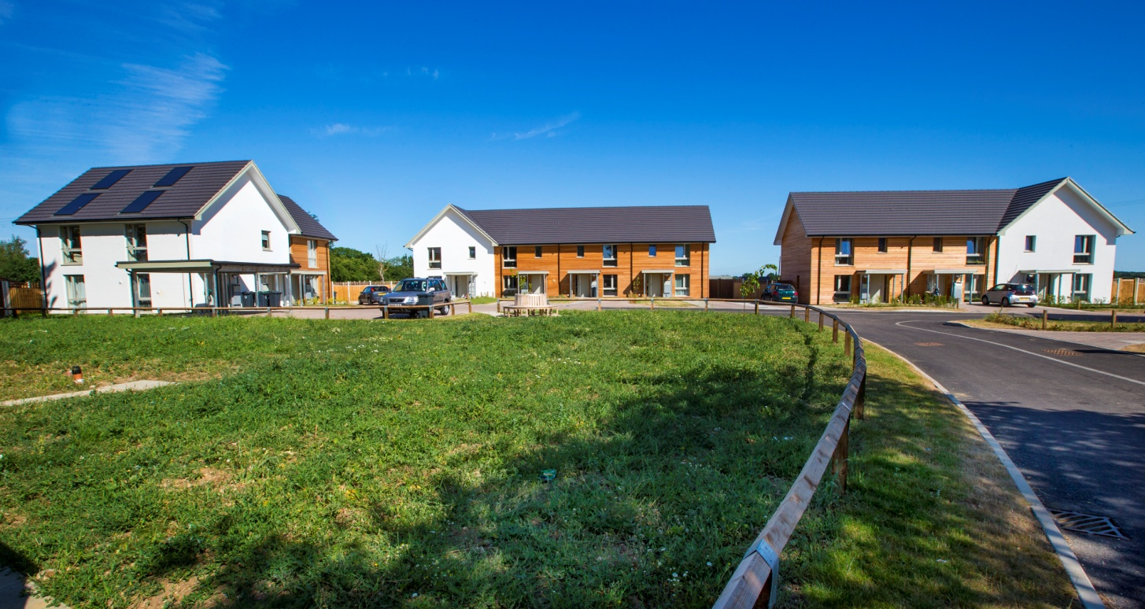
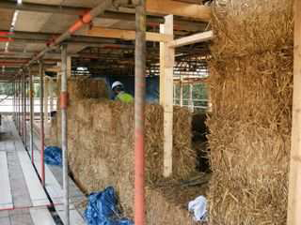
Re-define affordability?
Passivhaus
Straw bale homes
Carbon emissions approx 10% UK average
Fuel bill 3 bed house £125 pa
60% reduction CO2 emissions
Insulation 3x more than building regs
Fire resistance 2x required
Burnham Overy Staithe, Norfolk
Hatfield Heath, Essex
High Ongar, Essex

Slide 26
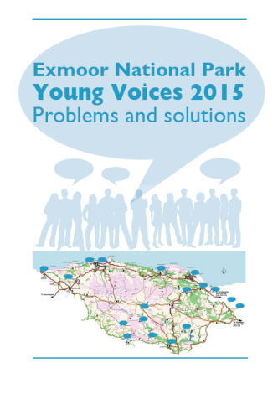
Listen to the young voices
Exmoor National Park: Young Voices 2015.
Young people competing with second home/holiday let market
Low rent accommodation to fill gap between leaving home and eligibility for affordable home (even caravans/timber homes)
Priority to young people working in agriculture
Specific design:
  Generous porch for wet clothes and boots
  Space for dogs and for kennel
  Storage for working clothes
  Parking for truck as well as car
  Involve agricultural people from the start
Planning flexibility to support local initiatives

Slide 27
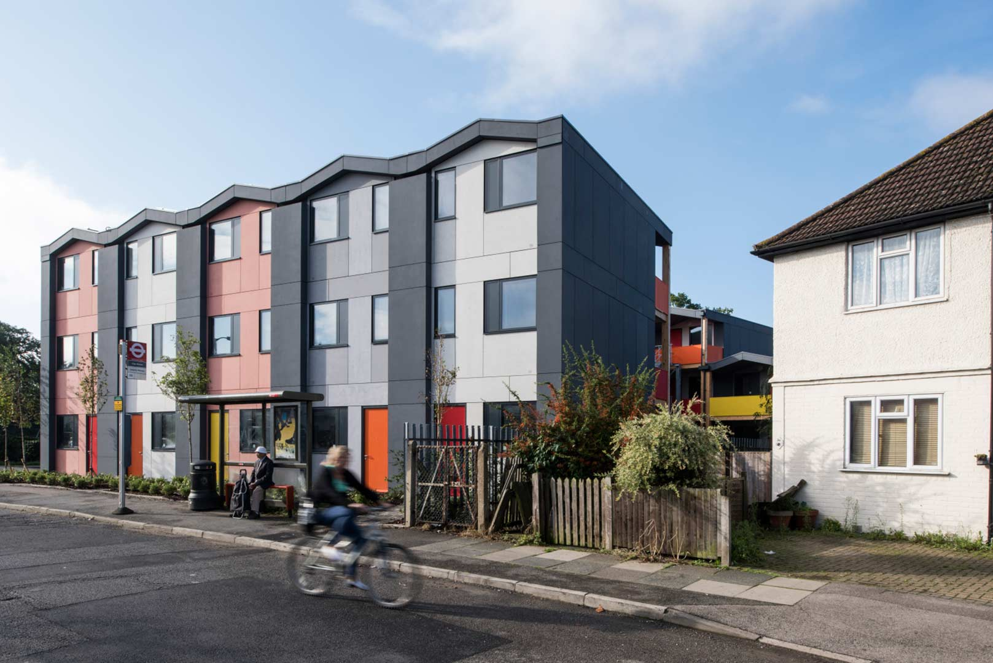
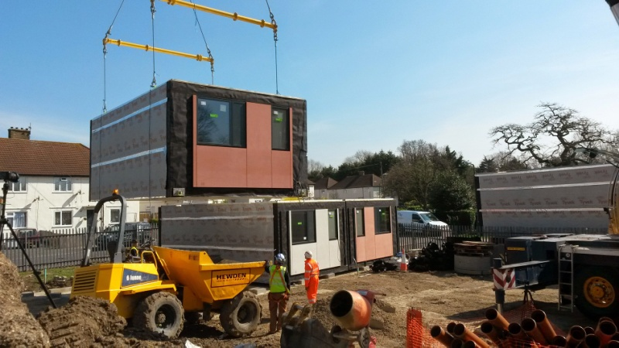
Y:Cube: an example of housing for young people
£45,000 per unit
Offsite manufacture
26m² one-bed studios
CSH Level 4

Slide 28
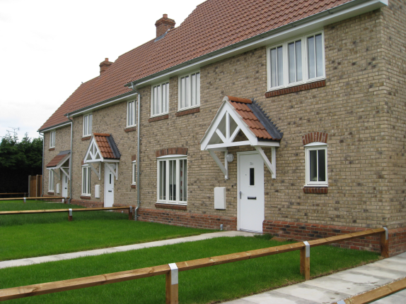
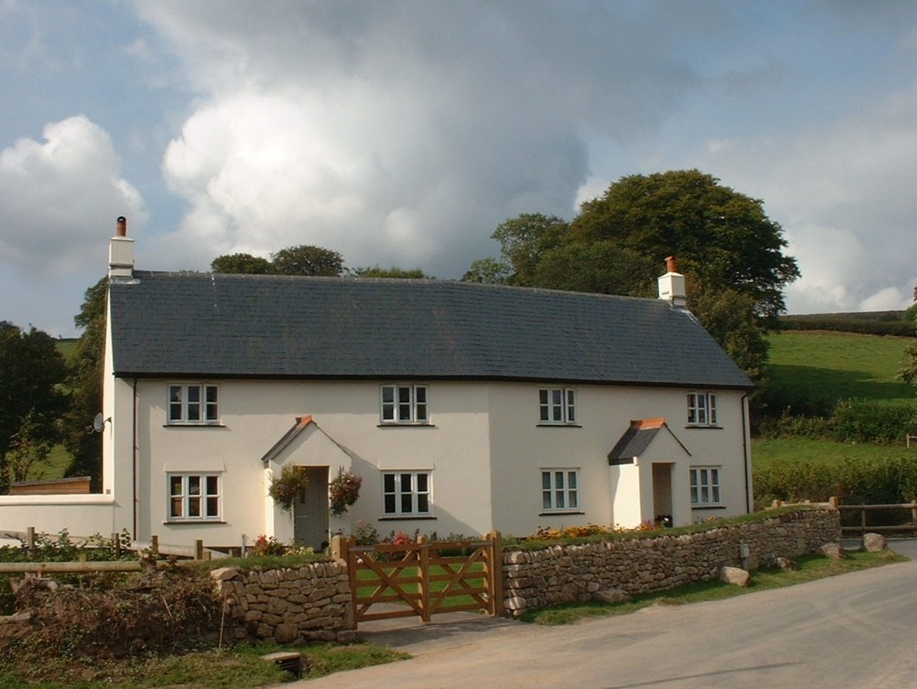
Four point plan?
Value ‘community’ and small scale
Listen to the quiet voices (young people, older home owners, elderly farmers/farm workers?)
Look for change and growth
Quality, quality, quality
Barton Mills, Suffolk
Widecombe, Devon

Slide 29
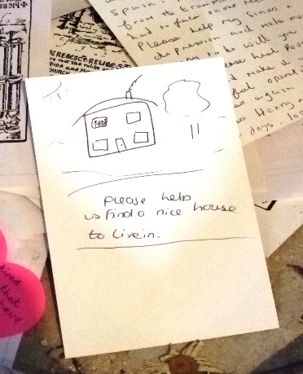
Prayer found by Hastoe staff member at St Candida’s shrine in the church at Whitchurch Canoricorum, Dorset.

Slide 30
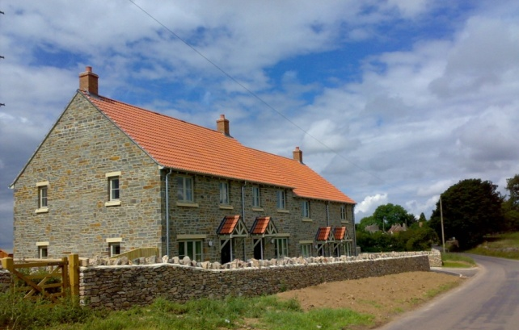
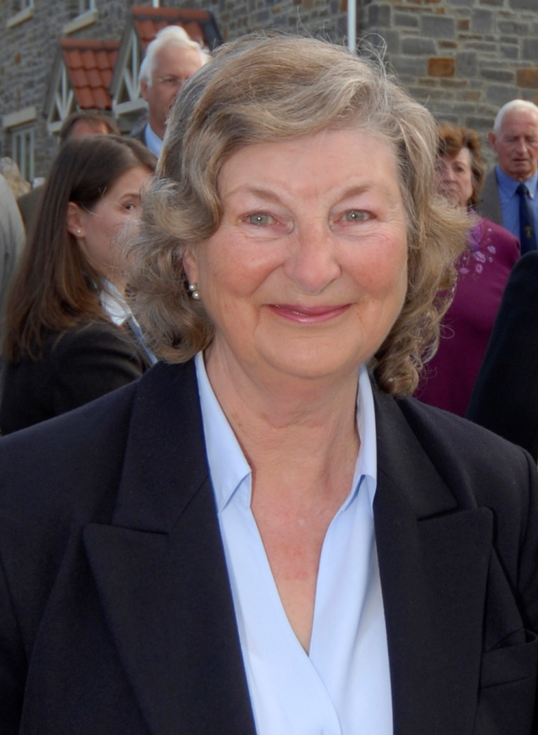
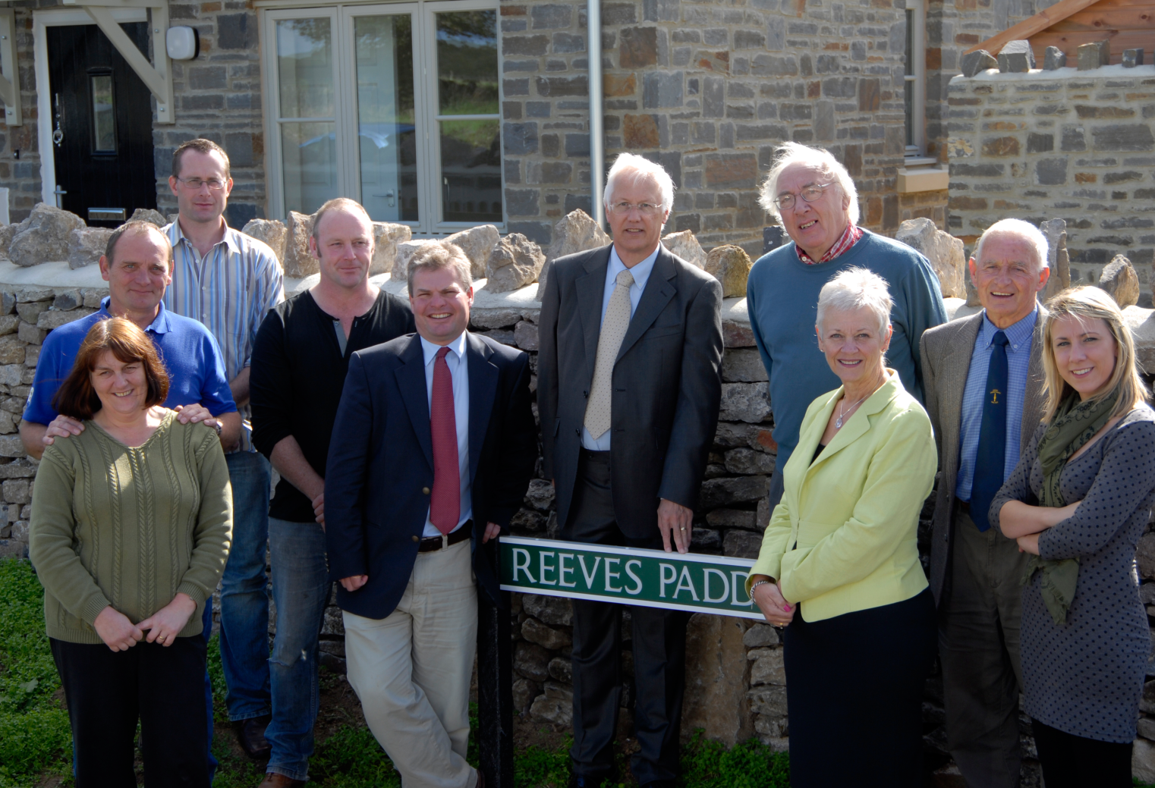
Nobby’s legacy to Priddy, Somerset

Slide 31
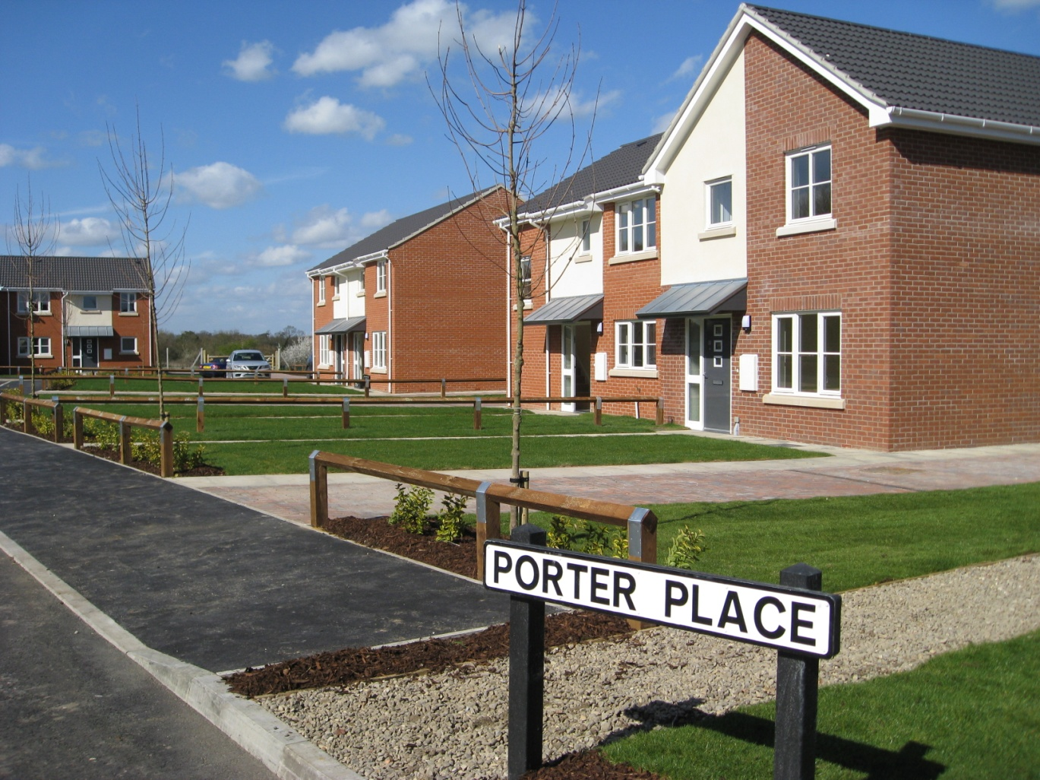
Russell Porter’s legacy to Tollesbury, Essex
My sons and I would like to ... thank you for the wonderful way in which my late husband has been honoured.
We are so pleased with the way the Council, the developer and the local community came together to create this very nice development and celebrate my husband's memory. (July 2014).

Slide 32
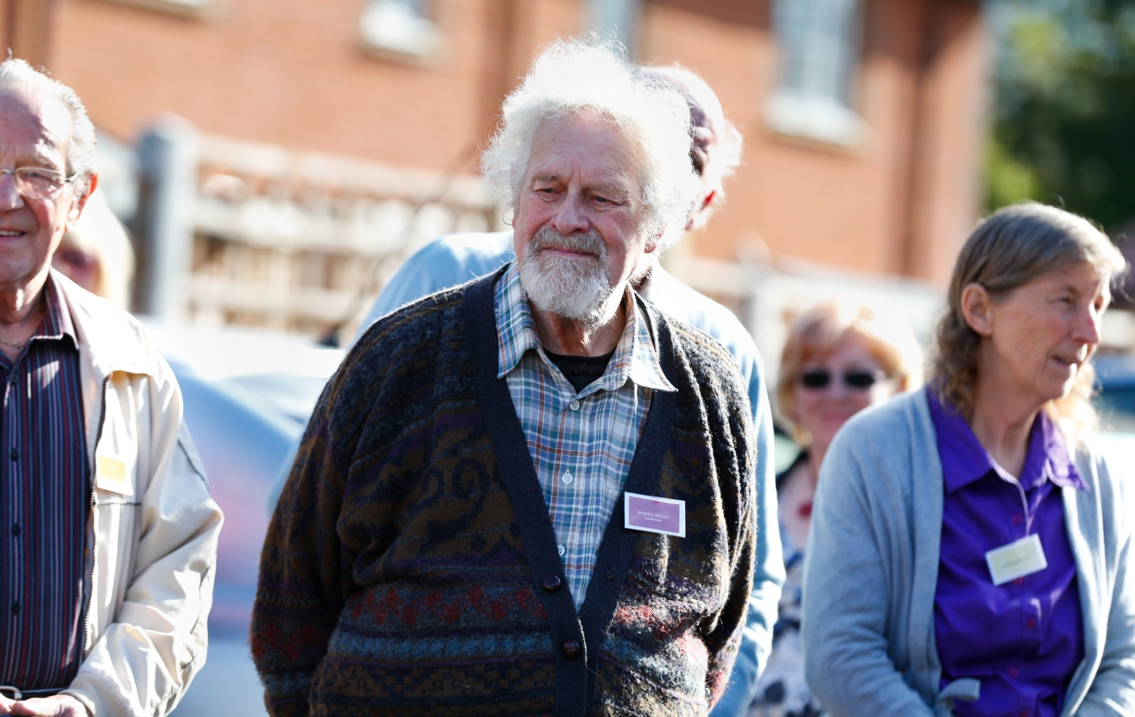
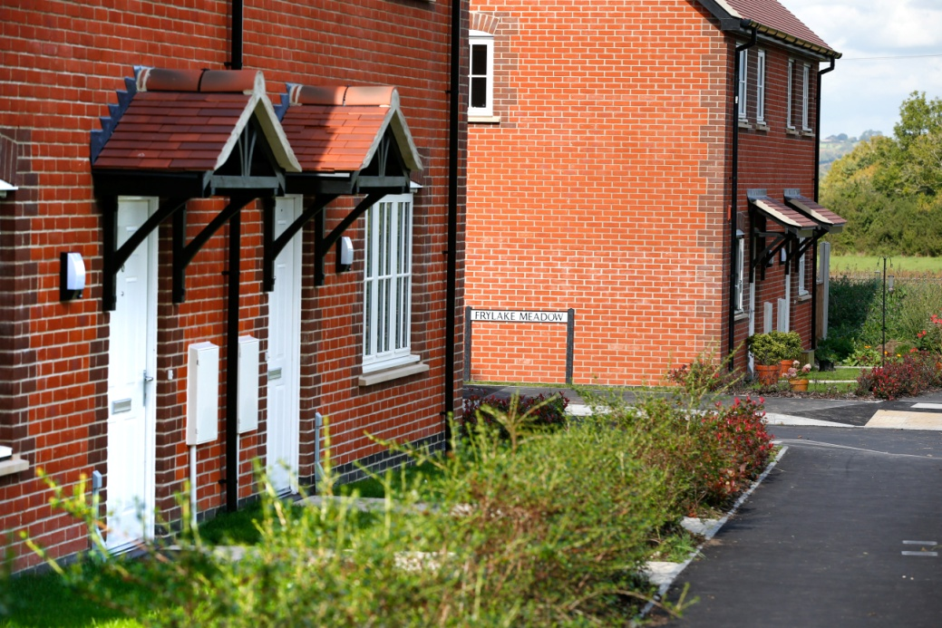
Maxwell Bugler, landowner for affordable rural homes in Yetminster, Dorset

Slide 33
Encouraging and supporting rural landowners
Provide trusted advice and support
  Community engagement
  Design and planning
Allow direct access to Rural Exception Site development
  Long term income
  Local lettings’ policy
  Tax breaks
  Element of control over future use and lettings
Allow access to grant
Where will the new SME developers come from?
  A role for landowners?
Raising design and energy efficiency standards

Slide 34
4. Some examples of community led rural housing

Slide 35
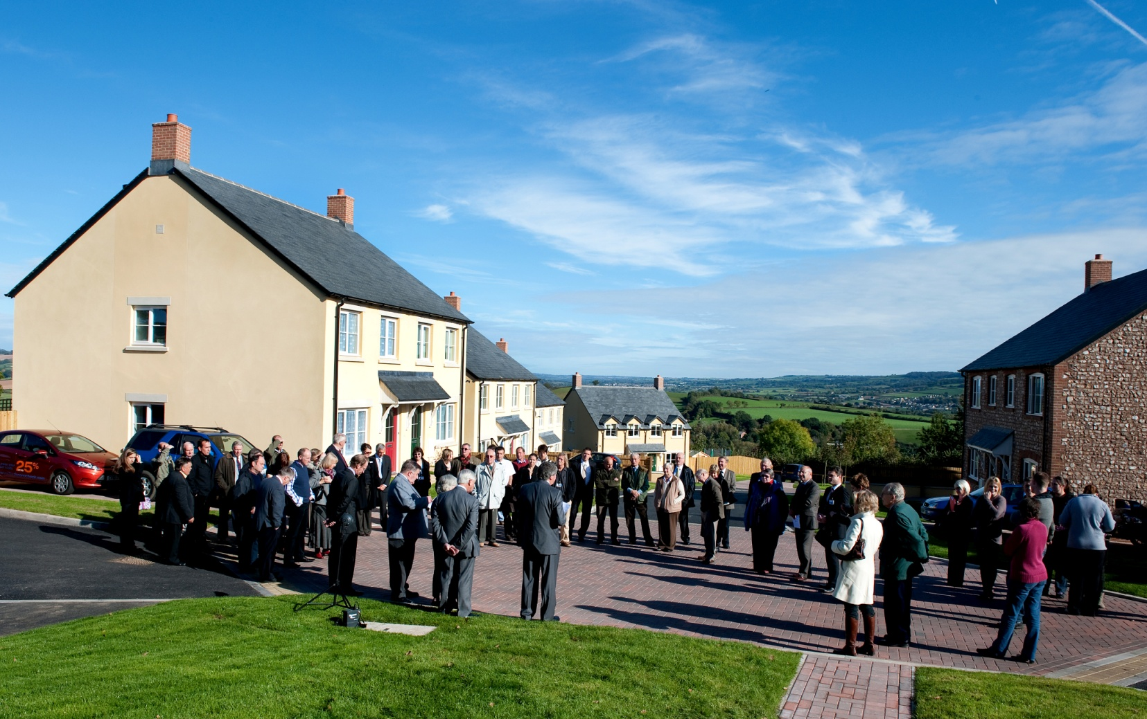
Colyton, Devon

Slide 36
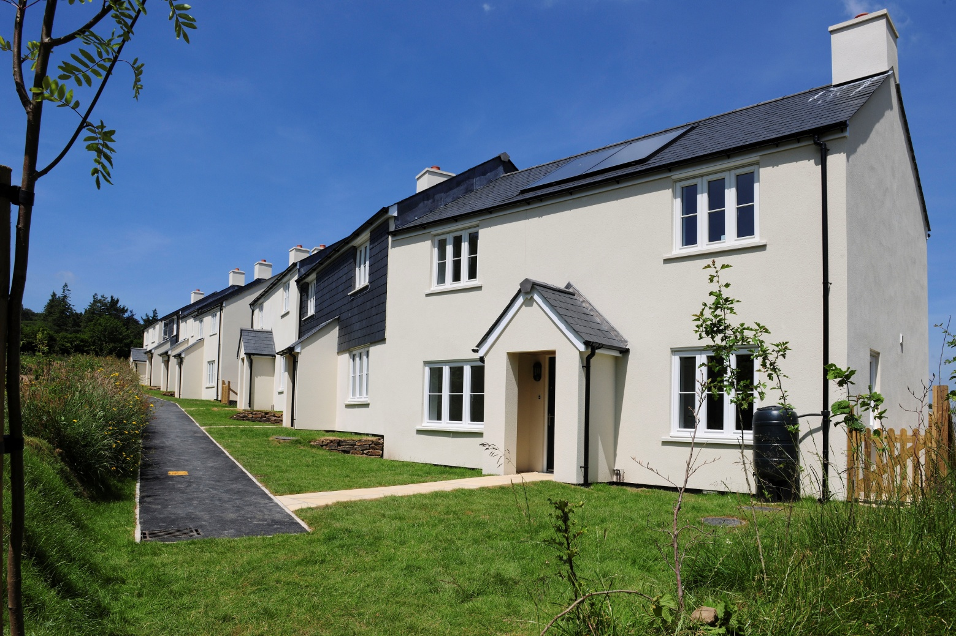
Holne, Devon. Dartmoor National Park

Slide 37
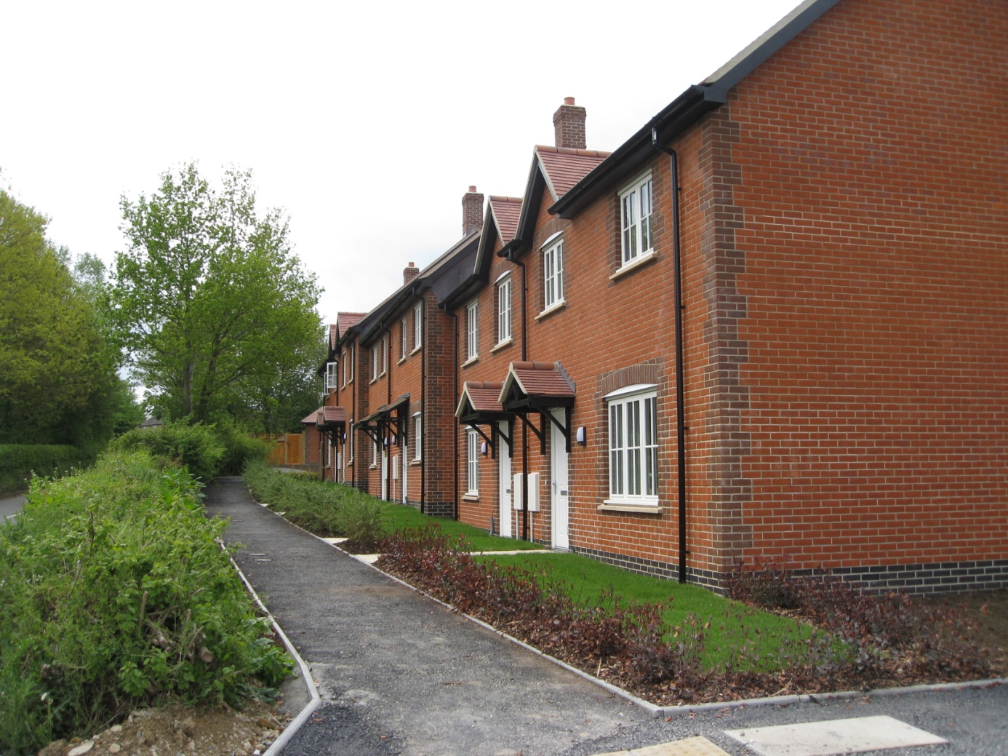
Yetminster, Dorset

Slide 38
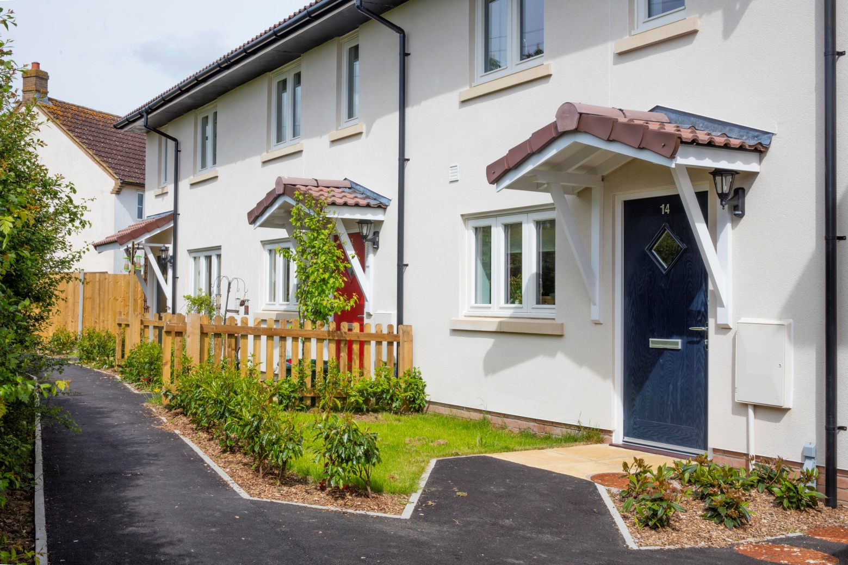
Horton, Somerset

Slide 39
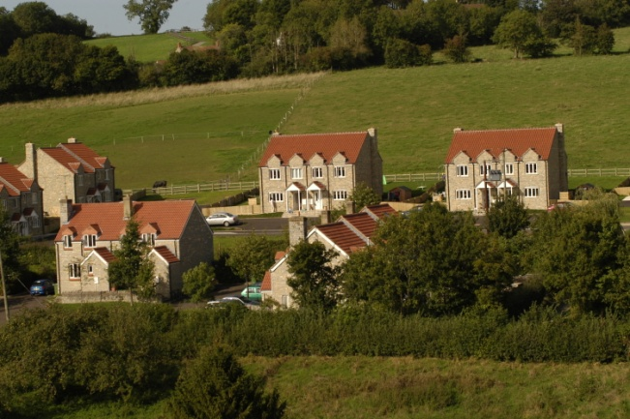
Pilton, Somerset

Slide 40
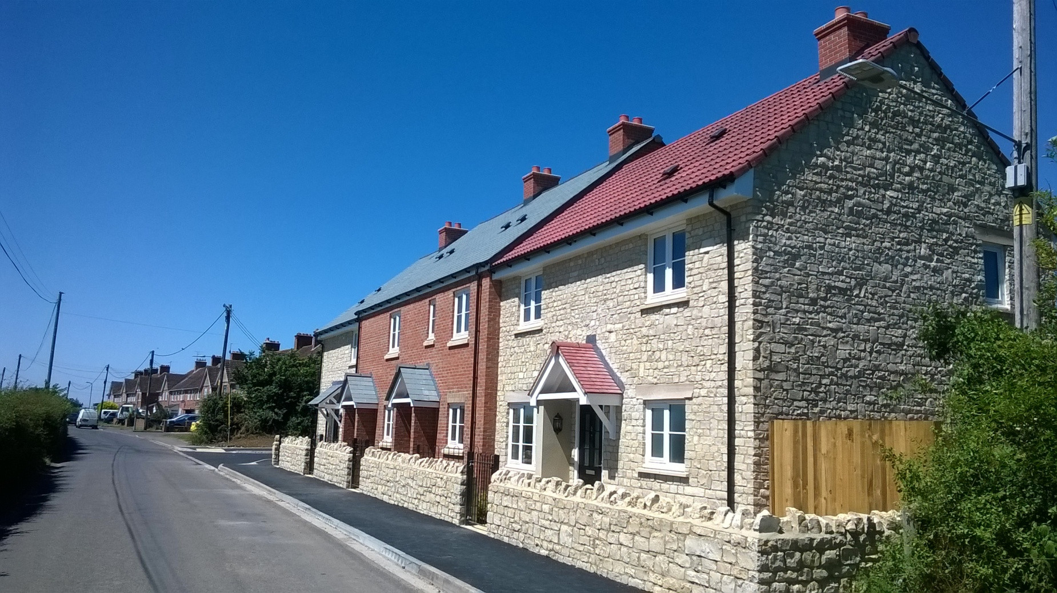
Queen Camel, Somerset

Slide 41
Great Kimble, Bucks

Slide 42
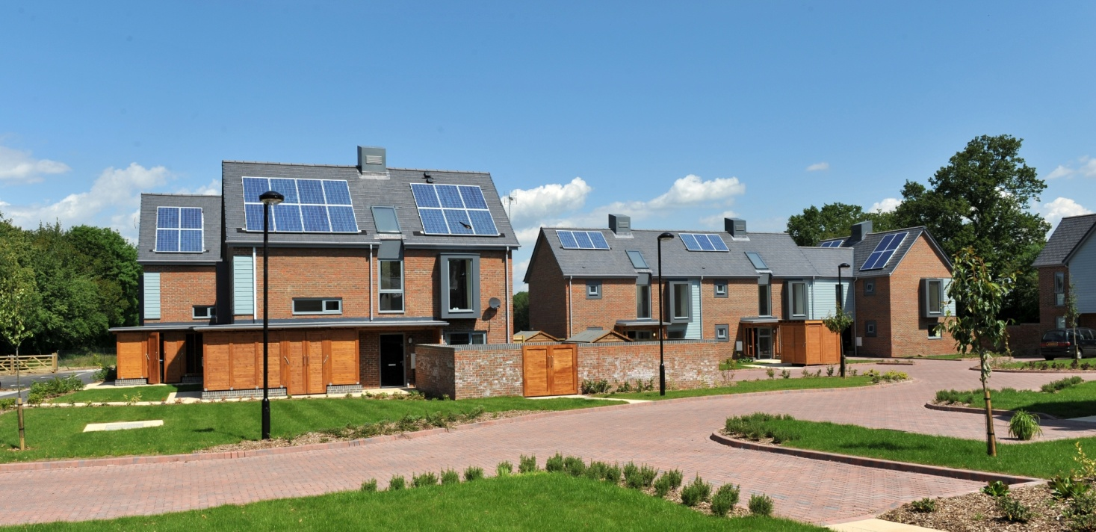
Crawley Down, West Sussex

Slide 43
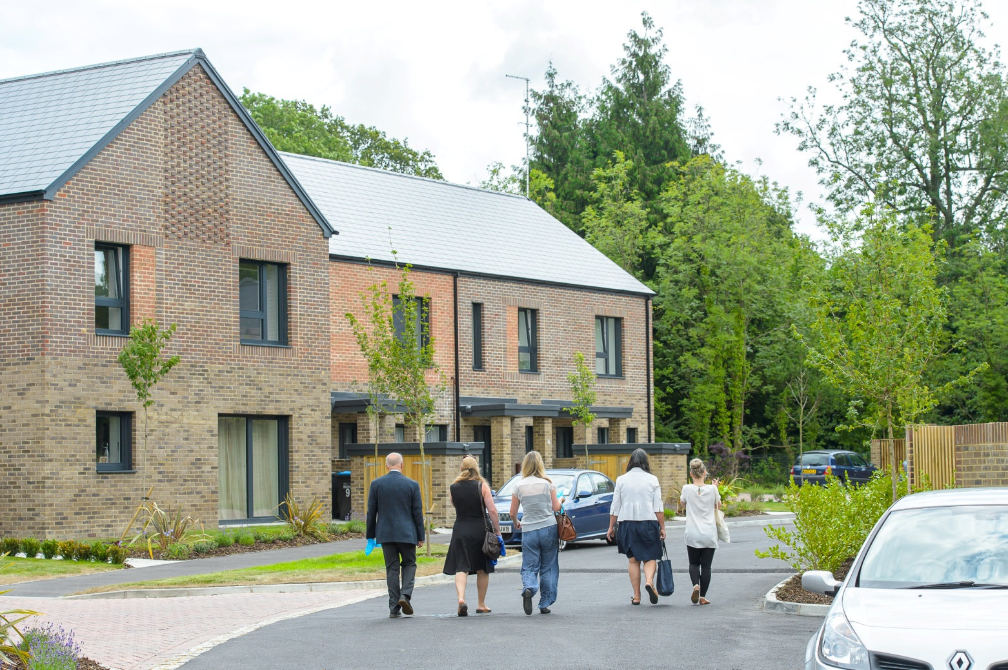
Crawley Down, West Sussex
Passivhaus

Slide 44
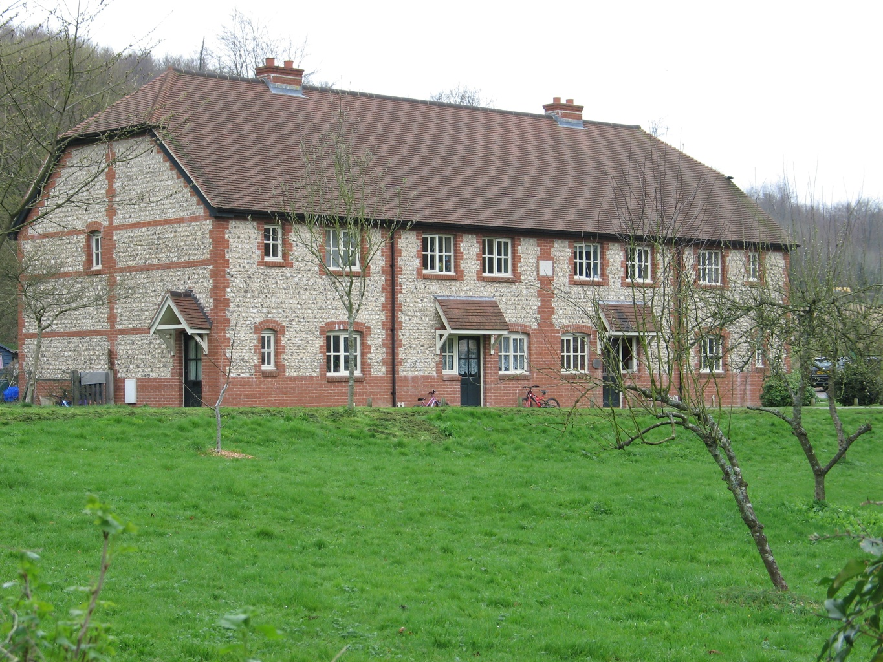
West Dean, West Sussex

Slide 45
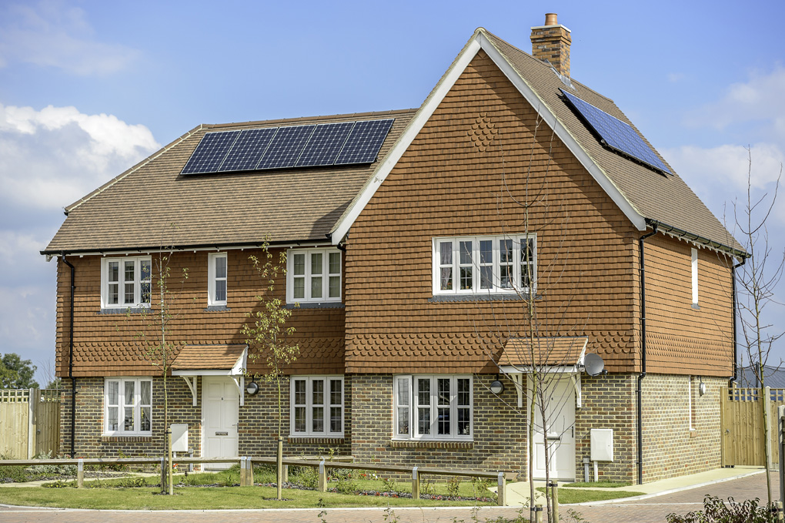
Staplecross, East Sussex

Slide 46
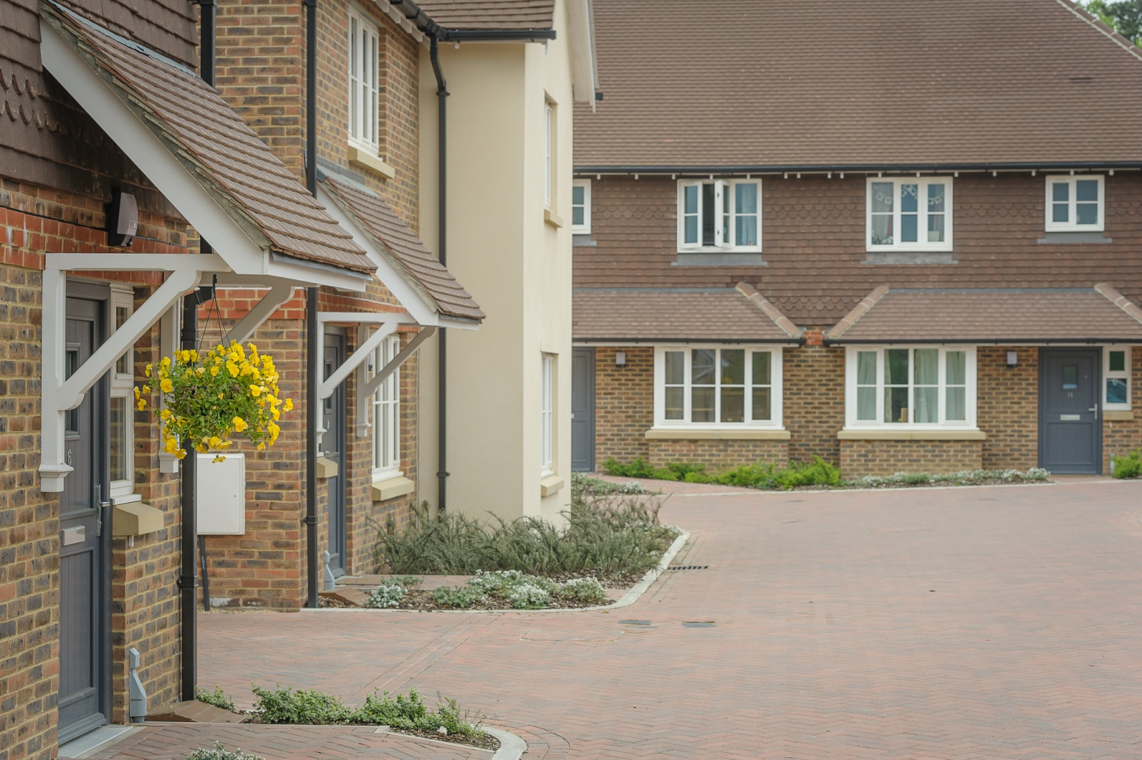
Wivelsfield, East Sussex

Slide 47
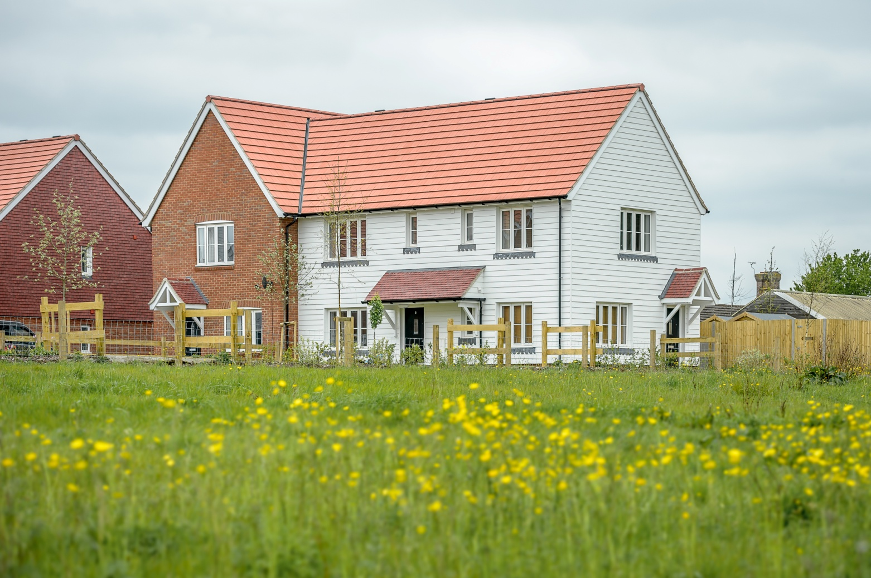
Plumpton Green, East Sussex

Slide 48
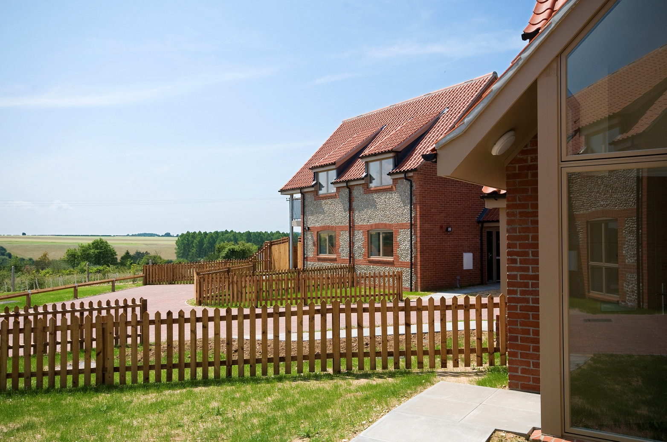
Sedgeford, Suffolk

Slide 49
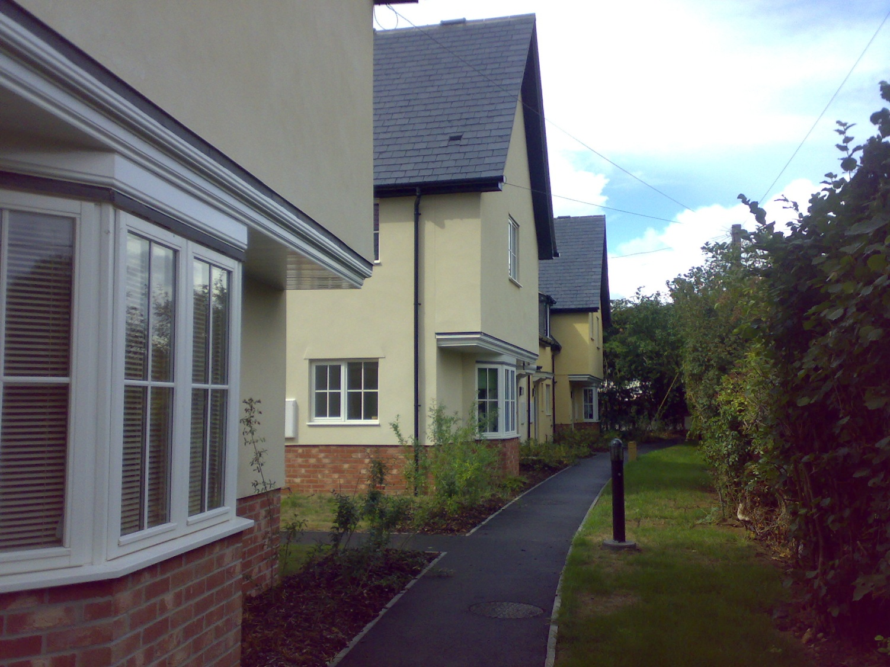
Lavenham, Suffolk

Slide 50
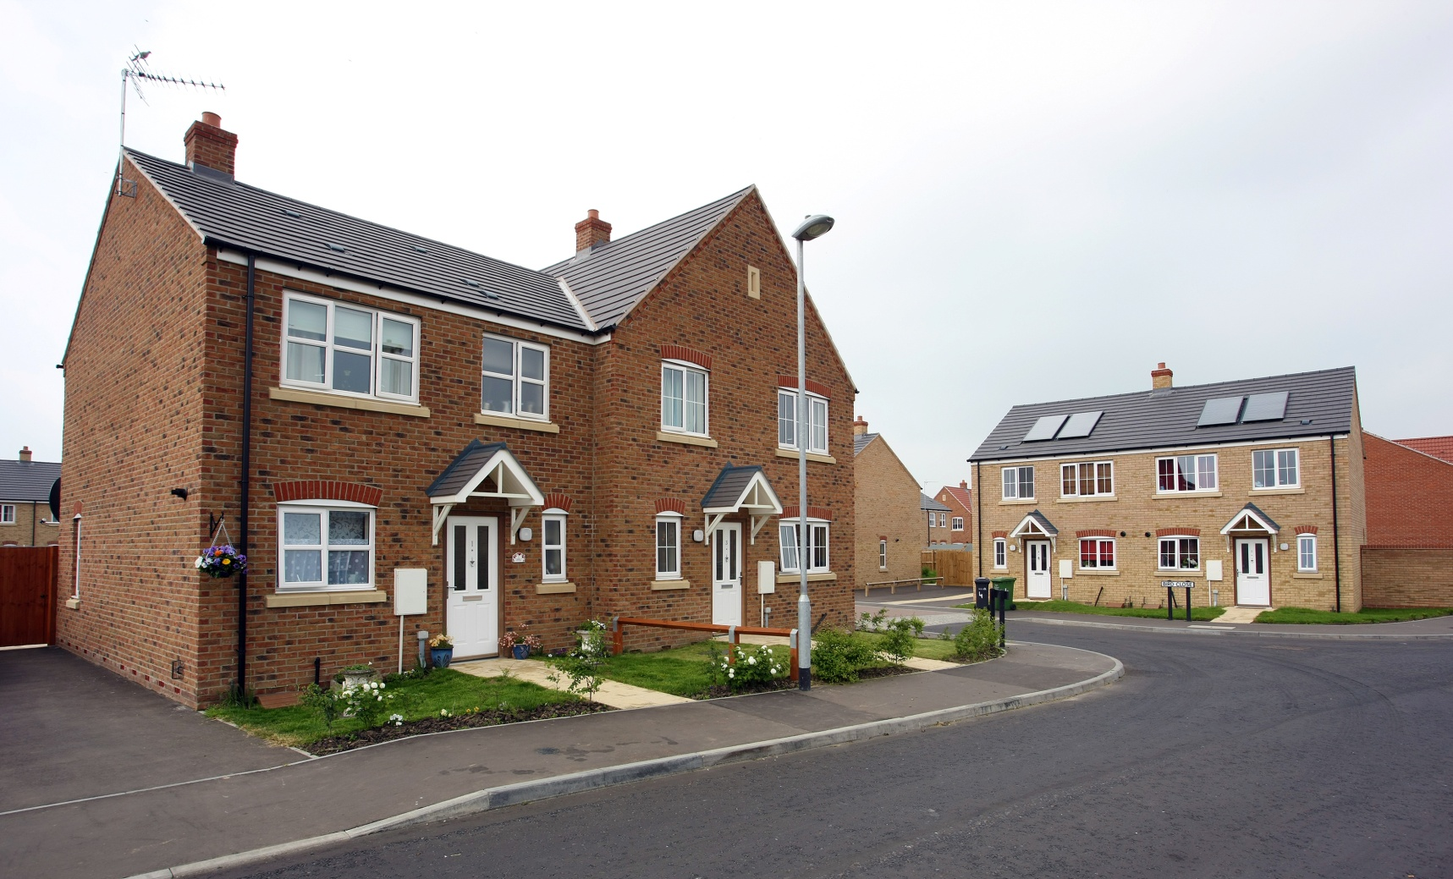
West Lynn, Norfolk

Slide 51
Housing is a long term investment.
The homes we build today must be good enough to last and to cope with increasing impacts of climate change.
Passivhaus.
Burnham Overy Staithe, Norfolk

