Slide 1
Working in partnership to deliver affordable housing
Robin Edwards MRICS FAAV - CLA Director South East
On behalf of Matthew O’Connell -CLA National Housing Adviser

Slide 2
LANDOWNERS CAN PLAY DIFFERENT ROLES IN THE DELIVERY OF AFFORDABLE HOUSING
Landowners can just provide the land
Landowners can develop and manage the properties themselves
Flexibility is the key

Slide 3
AFFORDABLE HOUSES ARE BEING BUILT
Number of affordable properties built on rural exception sites by year

Slide 4
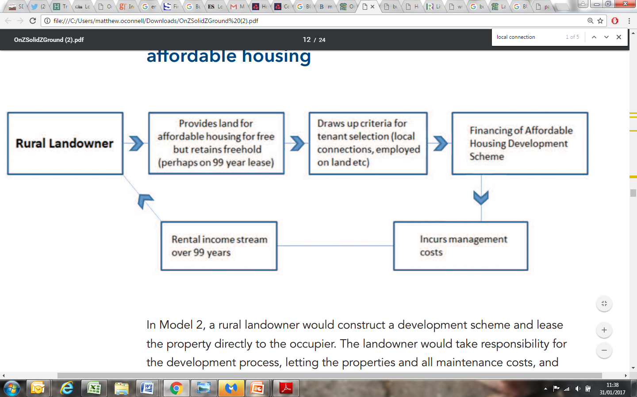
MODEL ONE: RURAL LANDOWNER PROVISION OF AFFORDABLE HOUSING

Slide 5


BOLESWORTH ESTATE, TATTENHALL, CHESHIRE

Slide 6
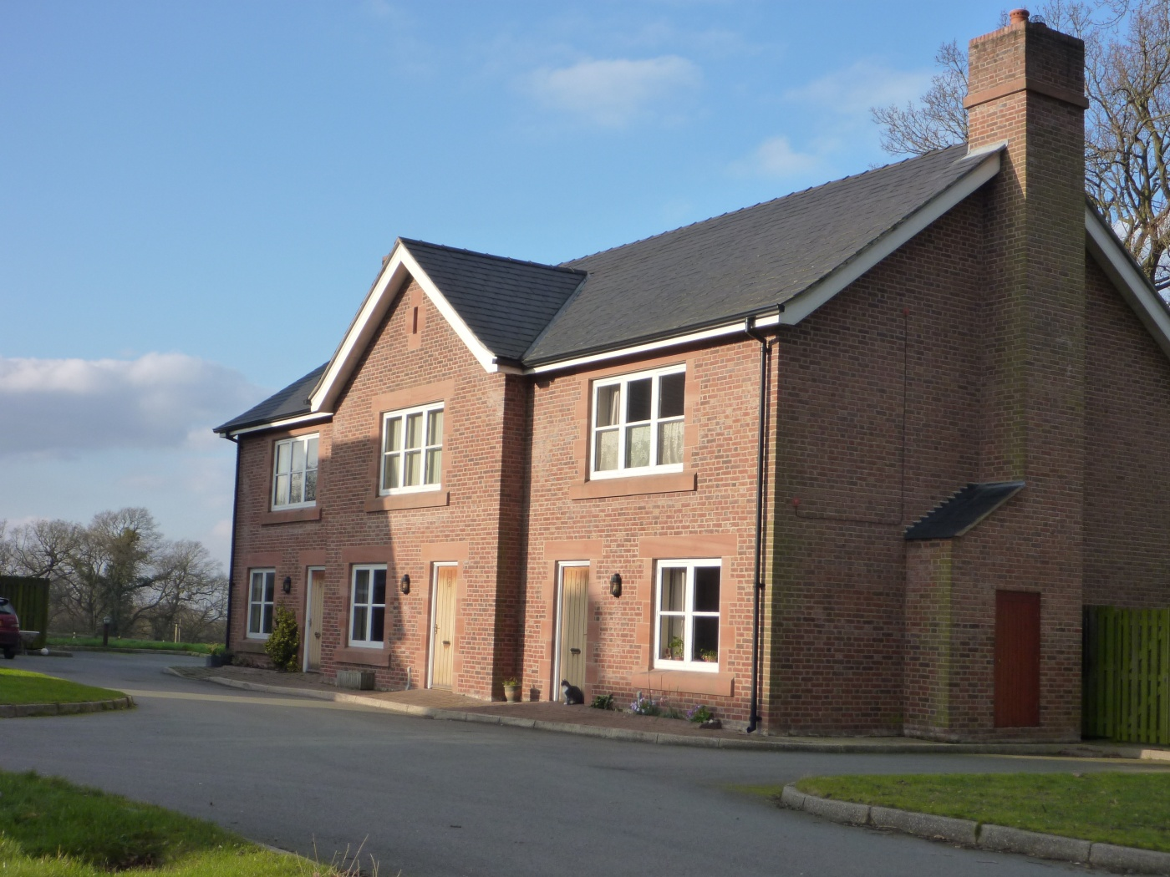
BURWADSLEY COURT, BOLESWORTH ESTATE

Slide 7
BURWADSLEY COURT, BOLESWORTH ESTATE
Seven home scheme on a Rural Exception Site
Four open market homes for rent and three let at an affordable rent
The Estate was the first private landlord to be considered as a Registered Social Landlord (RSL) equivalent
Innovative Section 106 drafting to ensure the properties serve local need

Slide 8
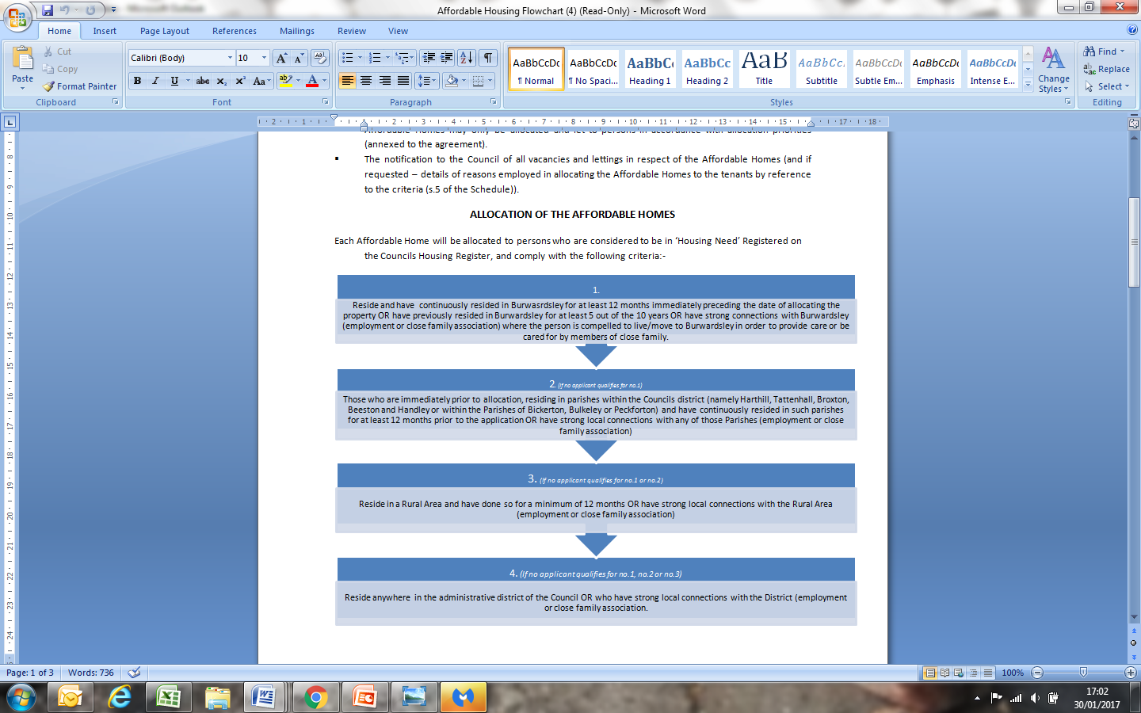
ALLOCATION OF AFFORDABLE HOMES

Slide 9
NINA BARBOUR, OWNER AND MANAGING DIRCECTOR AT BOLESWORTH:
‘I think estates in general have a huge role to play in delivering rural affordable housing. Through their long-term stewardship and by being part of the community they are able to deliver where mass market developers cannot. I think that landowners in particular understand a 'sense of place' and how important it is to ensure that local people have the opportunity to remain in their area.’

Slide 10
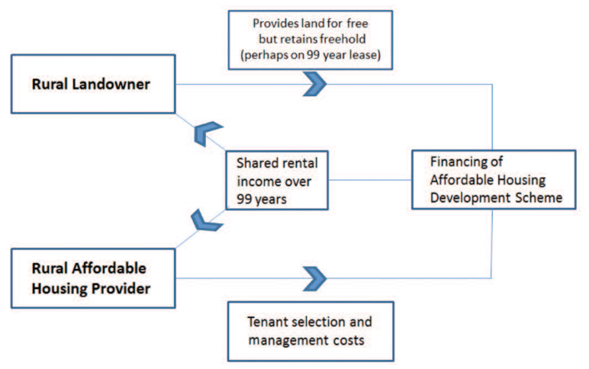
MODEL TWO: INVOLVING A RURAL HOUSING PROVIDER

Slide 11
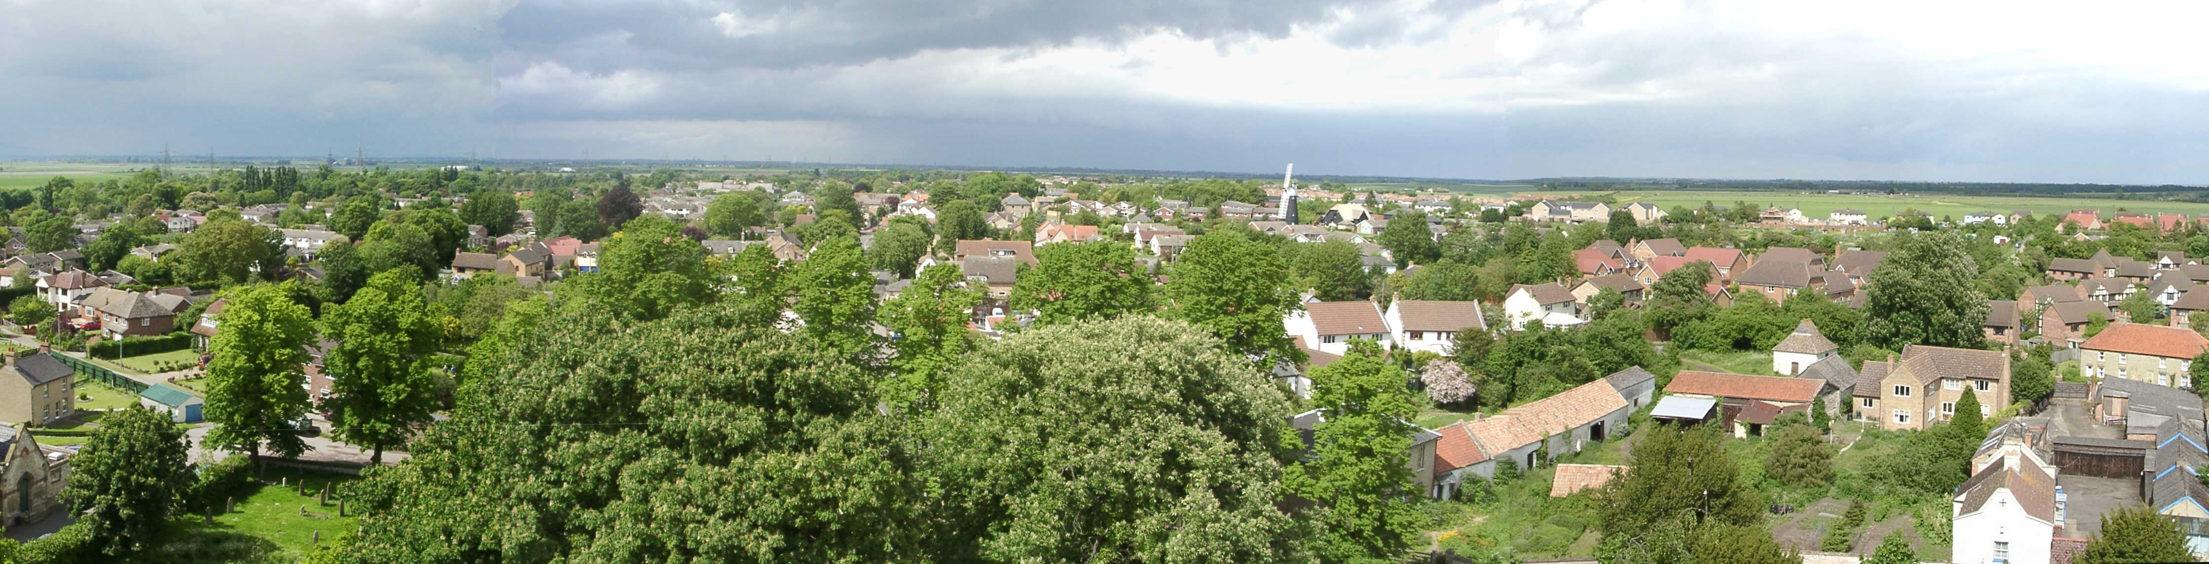
PATRICK FAIRCLIFFE AND HASTOE, BURWELL, CAMBRIDGESHIRE

Slide 12
BURWELL, CAMBRIDGESHIRE
Originally an eleven home scheme on a Rural Exception Site
Landowner not directly involved in the management or selection of tenants
Further housing need and support for new housing from the Parish has led to additional development

Slide 13
ADDITIONAL POINTS TO CONSIDER
Community Support
The Right to Buy

Slide 14
CONCLUSION
Challenge Conventional Thinking
Cross subsidy
Landowners acting as RSL equivalents
Share Knowledge

