Slide 1


Developing mixed affordable / market sale projects
Ian Graham
Presentation ———— February 2017

Slide 2
What is the motivation for sale?
Maximise return
Maximise community benefit
Somewhere in between

Slide 3
A “clean”sale
Highest bidder
No restrictions on future use
Rely on planning re affordable
Overage?

Slide 4
A sale with “strings”
Covenants to control future use
Need to be enforceable in the long term
Impact on value
Impact on fundability

Slide 5
Participation in the project
Use of joint venture
Control tenure / allocation of homes
Share risk and reward
Options: contractual
corporate

Slide 6
Contractual Joint Venture
Land Owner
JV
partner
Affordable homes transfer to Registered Provider
Sale of private units on open market
Construction Team

Slide 7
Corporate Joint Venture
Land Owner
Members/Shareholders Agreement, Equity, sub debt
Land owner
JV partner
Senior Debt funding
New Vehicle
Affordable homes transfer to Registered Provider
Build contractor and professional team
Sale of Private Units on Open Market

Slide 8
Some key drivers when considering joint venture structure
Tax
Funding the development
Transaction complexity/cost
Trust

Slide 9
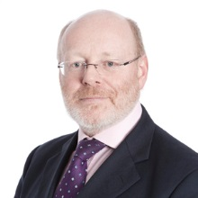
Ian Graham
Partner
d 020 7423 8284
e igraham@trowers.com

